Slide 1
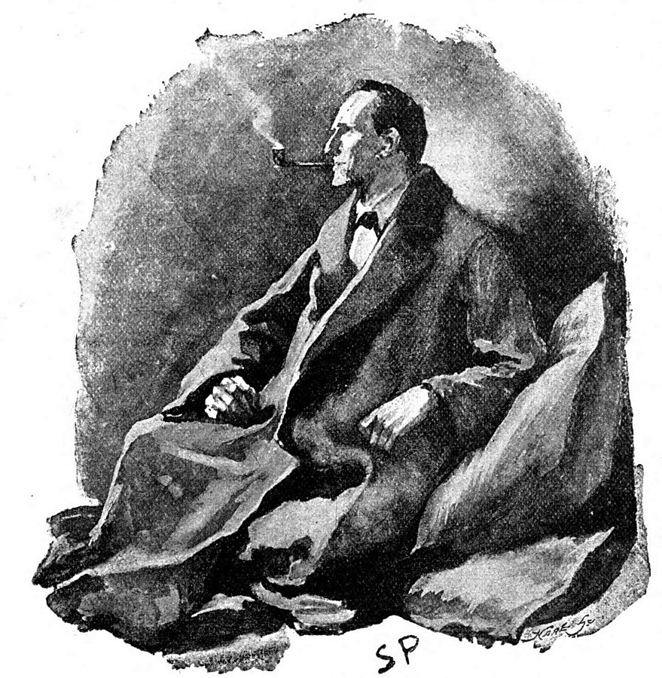
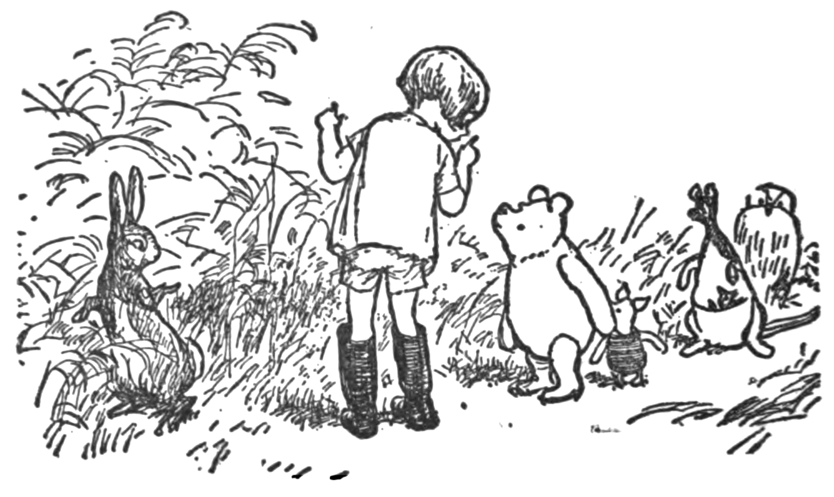

The Public Domain: Setting the Stage
Lise Brin (Université de Saint-Boniface)
June 2024, ABC Copyright Conference
CC0: This work has been marked as dedicated to the public domain.
Notes:
We had our appetite whetted last night and hopefully all have on the brain the various ways in which the public domain has come under fire in recent years
In a few minutes we’re going to hear from Marty Grande-Sherbert about his inspiration for The Public Domain Ball
First I’m going to try to set the stage with a bit of context about the public domain.
And if you read the description for this session don’t be fooled by the upbeat nature of it. There’s been enough going on to limit or hamper the public domain so I hope I’ll be able to get you revved up a bit for the discussion portion of this session.

Slide 2
Defining the Public Domain
The works or intellectual content that is not covered by copyright, that we can use freely without asking permission or paying fees
Like fair dealing, an integral part of a balanced copyright system that recognizes the rights of creators but fosters the dissemination of knowledge and the creation of new works
A gap, or a lack of copyright or the ‘gummy residue left behind when all the good stuff has been covered by property law’ (Boyle, 2008, p. 40, tongue-in-cheek)
The core of the intellectual commons – “the place we quarry the building blocks of our culture.” (Boyle, 2008, p. 64, more optimistic)
Notes:
Central concept to copyright, but not mentioned once in the Copyright Act
In our interactions with users, the stuff that is not covered by copyright, that we can use freely without asking permission or paying fees
Like with fair dealing, the very idea that copyright expires, doesn’t last forever…
Two quotes from James Boyle from his 2008 book The Public Domain: Enclosing the Commons of the Mind.

Slide 3
Defining the Public Domain (cont’d)
Works are in the public domain
  Because the term of copyright has run out
  Or because copyright was never applicable
  Can be because the creator has applied a CC0 licence to it
Currently in Canada most works enter the public domain 70 years after the death of the creator
Notes:
More practically
Currently in Canada most works (but not all) enter the public domain 70 years after the death of the creator, specifically January 1 in the year following the 70 years (new occurrence as of 2022)
or last creator if there are multiple creators
Unless the last creator died in 1971 or earlier, in which case their works are already in the PD
Crown copyright lasts 50 years
UK case law (based on Statute of Anne, 1710) clarified that upon the expiration of term works were in the public domain (Donaldson v. Becket, 1774)

Slide 4
Current Concerns
Variability of terms across different jurisdictions
Term of copyright keeps getting longer
Term of copyright is increasingly being determined via trade agreements
Large, corporate content owners are able to exert considerable influence over term of copyright; renewals of copyright
Determining term of copyright is damn complicated (see UofA flowchart)
Enormous amounts of public domain content are locked up in paid-access collections or are otherwise inaccessible (i.e. the “theoretical public domain”)
Notes:
I guess we’re beyond threats at this point … ? We’re living the aftermath? How do we live with these concerns ? And what else is coming?
I had a look at some recent publications, and just yesterday remembered to look at the Communia website …
1. I was reading in Claudy Op den Kamp’s The Greatest Films Never Seen: The Film Archive and the Copyright Smokescreen about film distributors and the difficulty in packaging works from the public domain
2. Statute of Anne (early 18th cent) - 14-year terms
3. CUSMA ; TRIPS
4. 1976 Sonny Bono Copyright Term Extension Act (US) which “tacks on an additional 20 years [of copyright protection] for works published before January 1, 1978.”
In 2015, copyright term for sound recordings was extended to 70 years because of lobbying by Universal Music and Sony Music.
6. I put these together but they are really two distinct issues. There are benefits to having public domain content organized as part of thematic collections (libraries pay for many of these, the public appreciates those genealogy sites where they can search through historical documents) and there is still potential for use or for public institutions to create public digital collections if they can access the same original documents. But the second case is more difficult: works that are only in private collections, or in the case of early cinematic works, for example, the studios do not anticipate profits and don’t see the value of digitizing these works, so they are unavailable to anyone. The PD works that do get redistributed tend to be the huge hits, which means again that regional cultural works are often lost.

Slide 5
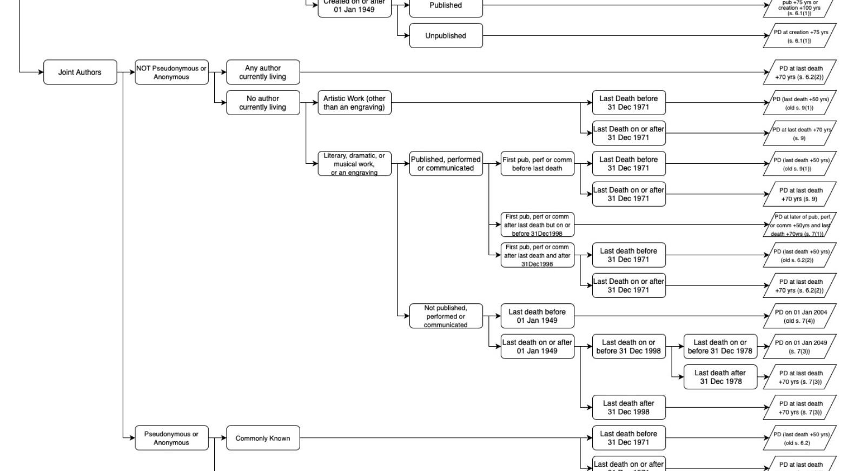
Current Concerns (1)
Term of copyright is lengthening
Term of copyright is being determined via trade agreements
Large, corporate content owners are exerting considerable power
Determining term of copyright is damn hard (see UofA flowchart)
The enormous amount of public domain content that is locked up in paid-access collections or re-copyrighted when scanned (thanks Lauren Byl)
Notes:
This is part of one section of the University of Alberta’s Copyright Term and Public Domain flowchart.
Don’t get me wrong, I love this resource and am grateful to the folks who created it, but I also must admit I frequently use it to make people at my institution feel better about their limited comfort with copyright (or copyright anxiety – thanks Amanda Wakaruk).

Slide 6
Current Concerns (cont’d)
Archives and others are intent on re-copyrighting PD works when scanning or digitizing them (thanks Lauren Byl)
Some countries’ cultural heritage laws that try to control uses of reproductions of works in their collections
Incongruity between idea of expiration of copyright (both economic and moral rights) and respect for Indigenous concepts of ownership
Uncertainty around copyright applicability to AI-generated content
Notes:
7. Similarly to what we just saw on the previous slide, not only is much of the PD content locked up, but we are seeing many cases where archives or others are claiming that the content that they’ve digitized is once again eligible for copyright protection … And we find ourselves with insufficient case law in Canada to support what seems like the obvious statement that merely photographing or scanning a work without adding additional creative input should not be grounds for attributing copyright to a work in the public domain…
8. If this wasn’t bad enough … Italian Ministry of Culture tried to sue Ravensburger; other European countries. (Communia calls this the “hollowing out of the public domain”
9. On another note, as with fair dealing, it is clear that we are grappling with the incongruity between the very idea of a limited term for copyright and Indigenous concepts of ownership around traditional or protected knowledge
10. And finally, I don’t think it’s possible to have a presentation at this year’s conference that doesn’t mention artificial intelligence. Some have suggested that AI-generated content is in the public domain, as Canadian (and other) copyright laws require that copyrighted content be created by humans. So, the question is, how much human intervention or involvement (via prompts, for example) would be necessary for content to be covered by copyright? And on the flipside, will AIs trained on copyrighted content (without licence agreements) be determined to be unlawful? Will that mean that more AIs will be trained on PD content?

Slide 7
Protecting the Public Domain
Libraries have taken on the role of speaking up on behalf of content users
  Difficult to make this argument in academic settings – seamless access to licenced content protects users from seeing what is locked up and what isn’t
Difficult to quantify the public good (as opposed to lost revenues) ; dependent on anecdotal evidence
There is still lots of content out there to digitize and make available …
Notes:
So, we have these threats that have now become concerns. What do we do about them?

Slide 8
Images
Illustration by Ernest Howard Shepard from Winnie-the-Pooh (1926), by A A Milne. From Wikimedia
Art depicting Sherlock Holmes in "The Man with the Twisted Lip" (1891). From Wikimedia

Slide 9
References
Boyle, J. (2008). The Public Domain: Enclosing the Commons of the Mind. Yale University Press.
Gaon, A. H. (2021). The Future of Copyright in the Age of Artificial Intelligence. Edward Elgar Publishing Limited.
Hunsaker, A. J., & Schultz, T. A. (2021). “Is Rhapsody in Blue in the public domain?”: Copyright knowledge of U.S. music librarians. Music Reference Services Quarterly, 24(1–2), 38–58. https://doi.org/10.1080/10588167.2020.1729602
Op den Kamp, C. (2018). The Greatest Films Never Seen: The Film Archive and the Copyright Smokescreen. Amsterdam University Press.
Samuelson, P. (2023). Generative AI meets copyright. Science, 381(158-161). https://www-science-org.uml.idm.oclc.org/doi/10.1126/science.adi0656
Wood, N. (2023). The people’s access to information: How definitions of ownership influence the public domain. The Serials Librarian, 84(1–4), 26–31. https://doi-org.uml.idm.oclc.org/10.1080/0361526X.2023.2172515

Slide 10
For discussion…

Slide 11
Any thoughts on how to use the Public Domain Ball as an education or advocacy tool?
Notes:
Can it be useful to think about the public domain from the perspective of its inhabitants?

Slide 12
Are there any other looming issues or concerns around the public domain?

Slide 13
How’s your gut feeling about the public domain these days?
Notes:
I asked some of you what you were feeling about the public domain a few weeks ago, and the response I got was rather defeated, dejected. So how are you feeling?
Can it get worse?

Slide 14
Where do we go from here?
Notes:
What are our biggest challenges going forward?
What activities (if any) are you planning in relation to the public domain?

