Slide 1
Securing Library IT
A View From The Ground
Marc Comeau
Director, Library IT

Slide 2
The Dalhousie Libraries
5 physical libraries
Serving over 18 000 students
Primary mission is to support learning and research
We do that through our services and resources

Slide 3
Library Information Technology Services
Provide IT services to all libraries
From desktop to server infrastructure
Some behind the scenes, some front facing
Distinct from central IT group (ITS)
Strong collaborations

Slide 4
Our Mission
Our mission is three-fold:
To support teaching and learning through innovative services, physical and virtual spaces and the dissemination of knowledge in all forms.
To actively partner in the research endeavour through collaboration, dissemination and management of information resources and the preservation of Dalhousie’s scholarly output.
To provide inclusive and inviting spaces to enable our diverse communities to thrive intellectually.
Notes:
90% of our security problems exist because of our mission of “dissemination and management of information resources“ – Make slide transitions so that it goes from the Library mission to bold this chunk and pull it out.

Slide 5
Our Mission
“dissemination and management of information resources”
Notes:
90% of our security problems exist because of our mission of “dissemination and management of information resources“ – Make slide transitions so that it goes from the Library mission to bold this chunk and pull it out.

Slide 6
Our Challenge
“Information Wants To Be Free. Information also wants to be expensive. …That tension will not go away.” – Stewart Brand
Brand, S. (1987). The Media Lab : Inventing the future at MIT. New York: Viking.

Slide 7
Our Challenge
Conflicting values between libraries and vendors
We want to provide access for all
They must limit access to create scarcity
Despite differing goals, we work together

Slide 8
Our Challenge
Goal is access wherever, whenever by users covered under license
Access starts either in our Learning Commons or personal devices via our proxy server
Easy with our open access resources
Vendor provided resources are more complicated

Slide 9
Learning Commons Challenges
Open workstations for public
Secure multi-user desktops for students
Leverage Ghost and Deep Freeze
A lot of work goes into providing a secure environment
Mistakes are rare but…

Slide 10
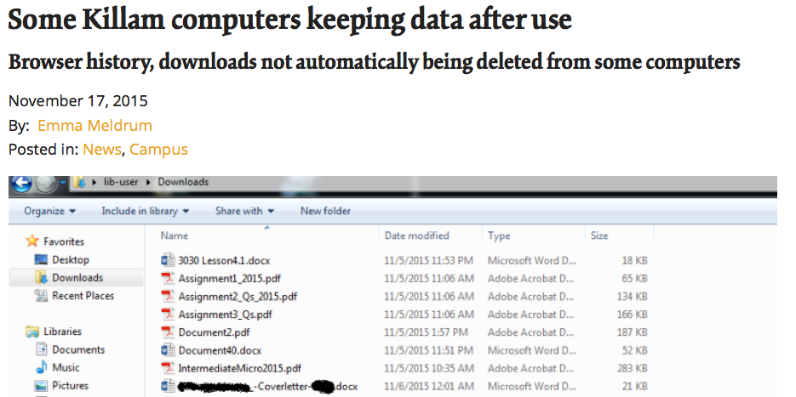
Digital Security

Slide 11
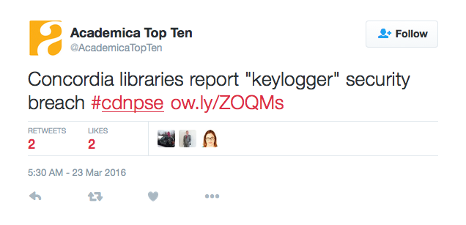
Physical Security

Slide 12
Server Side Security
Housed in Killam server room
Covers the physical and some digital
Proxy server is different
A launching point to our resources from off-campus

Slide 13
The Old Threats
Distributed Denial of Service
Brute force attempts
Spam code injection
Single end-user breach
Notes:
Viagra ad injection for *66.* where it should have been 66.* Only seen in Computer Science, but only on some of them.

Slide 14
Vendor Response
Different responses from different vendors
From passive to aggressive
We get a brief window between first notice and action taken
Can result in patrons losing access to resources
Communications can be a challenge

Slide 15
Library Response
We take information that vendors send us and analyze logs
Often have to go back to ask for more information
Normally can respond quickly when provided with details
Sometimes push back since usage is normal to our eye

Slide 16
Emergence Of Sci-Hub
Essentially The Pirate Bay for academic research
Leverages automation and scale
Uses accounts from schools all over
“donated” credentials vs phishing

Slide 17
Evolution Of Threat
Change in footprint
No longer a mass harvest
More scattered

Slide 18
Playing Catch-Up
At first, we struggled to identify patterns
Challenging communications with vendors
Experience improved both
But vendors have incomplete information at their end

Slide 19
Working With Vendors
With one vendor using some technical strategies
Provides us with better information
We use that to then trace the breach
Less content blocked by vendors
Shorter time where an account is breached

Slide 20
Further Evolution
Breaches moved to leverage VPN
Bypasses the proxy server
Direct to vendor
Bypasses libraries logs

Slide 21
Problem!
We don’t have logs
VPN logs were not frequently used
Little automation, labour intensive
We had a good partner

Slide 22
Leveraging Partners
Central IT had just completed a tool to help them draw from log files safely and quickly
Small modifications to allow us as a trusted partner to run queries
Worked just as efficiently as if the data was in our own log files

Slide 23
Impact
Our patrons can lose access to content
The genie is out of the bottle
If Sci-Hub goes down, there will likely be another
No expectation that the threat will abate
Work to contain the problem

Slide 24
Containment
Breached account must have password reset
Locks user out of all services
Libraries have become the front line for phishing

Slide 25
Looking Forward
Automated, predictive or other aggressive methods create false positives
That creates service problems
Expect that threats will continue to evolve, leveraging new exploits

Slide 26
Back To The Tension
Libraries also want information to be free
Using a very different approach
Open Access
Slower, more difficult strategy, but operates within copyright law

Slide 27
Looking Forward
Information tension will continue
That tension means we will continue to be a target
Phishing is the root of the problem
Education helps but is an incomplete solution

Slide 28
Questions?

