Slide 1
Accessing the inaccessible: digital forensics at the Dalhousie University Archives
Creighton Barrett
Dalhousie University Archives
Council of Nova Scotia Archives Conference May 11, 2017

Slide 2
Overview
Introduction to digital forensics in archival repositories
Development of Dalhousie’s digital forensics lab
Forensic images
Digital forensics tools and workflows
Free digital forensics tools
Ask questions any time!

Slide 3
What is digital forensics?
Forensic science – recovery and investigation of data found in digital storage devices
Primarily used in criminal investigations, corporate investigations
Archives are adopting digital forensics techniques to support acquisition, accessioning, preservation, and access
Acquisition
Identification
Evaluation
Admission
Source: Infosec Institute, Digital Forensic Models (January 25, 2016): http://resources.infosecinstitute.com/digital-forensics-models/

Slide 4
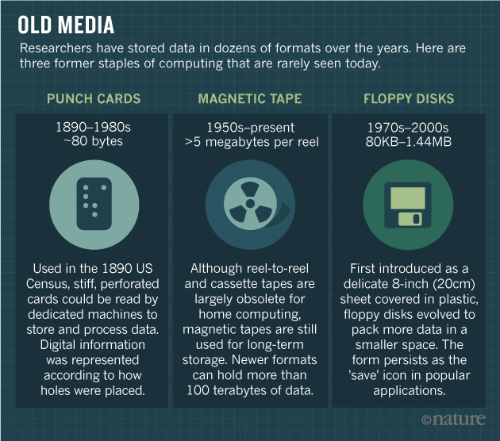
Why have a digital forensics lab?
Source: Baker, M. (2017, May 2). Disks back from the dead. Nature, 545 (7652), 117–118. https://doi.org/10.1038/545117a

Slide 5
Why have a digital forensics lab?
Archivists are now working with a wide variety of:
  Digital storage devices
  Computer file systems, operating systems, and software
  File formats
Digital storage devices are unstable and data is at risk
Supports archival mission to preserve authenticity and integrity of records

Slide 6
How are archives doing digital forensics work?
Use write-blockers to create forensic images
Adopt forensic software (BitCurator or FTK or EnCase)
Incorporate digital forensics tools and techniques into core archival functions
New policy decisions (e.g., preserve forensic image or extract files?)
Archival functions become blurred (e.g., files can be arranged before they are accessioned)

Slide 7
Timeline at Dalhousie
February 2016 – Acquire forensic workstation
May – November 2016 – Digital archives collection assessment project: http://hdl.handle.net/10222/72663
January 2017 – Install BitCurator and Forensic Toolkit (FTK) software
February 2017 – Advanced computer forensics training
May 2017 – Launch digital forensics lab
April 2017 – Dal’s first time at BitCurator Users Forum

Slide 8
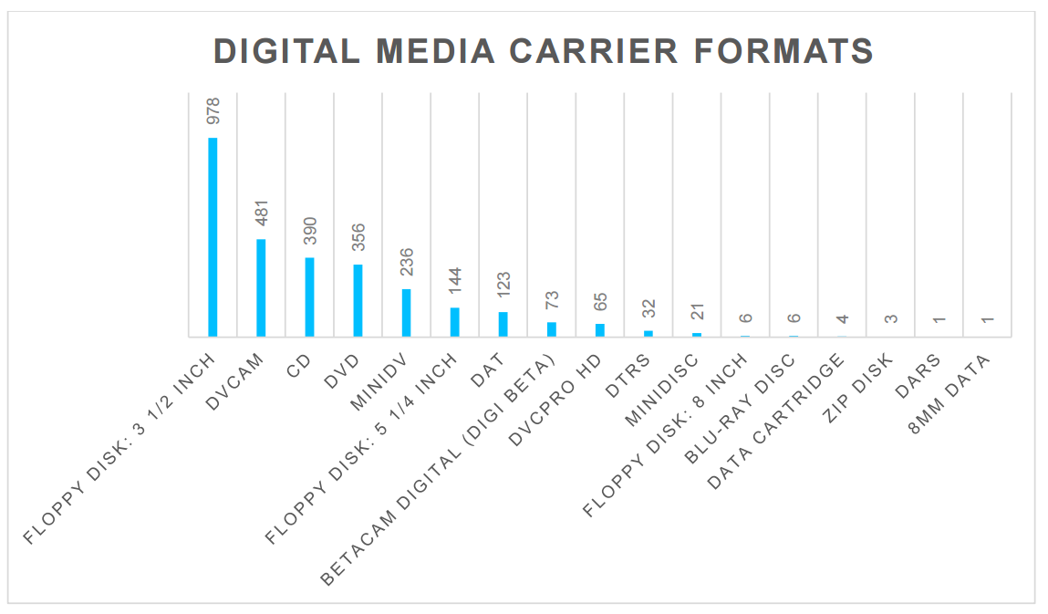

Slide 9
Components of Digital Forensics Lab
Forensic tower
  Dual Intel Xeon processors
  64 GB RAM
  Tableau T35689iu write-blocker
  AFT EX-S3 forensic card reader
FTK software
BitCurator software

Slide 10
Forensic images

Slide 11
What is a forensic image?
Complete (i.e., bit-level) copy of a hard drive or other digital storage media
Includes unallocated space and slack space
Includes operating system and file system
Includes computer registry files, browser history, and other contextual information about how the computer was used
Includes all files on the hard drive

Slide 12
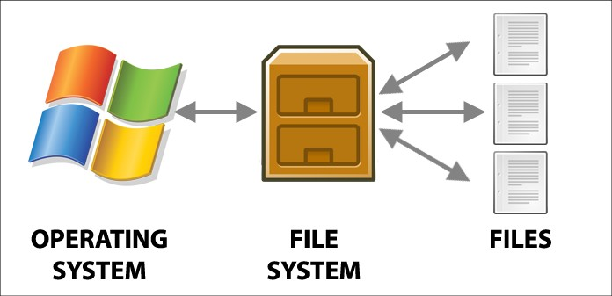
Preserve information about the operating system and file system
Source: Power Data Recovery: The Volume does not contain a recognized file system – how to fix : https://www.powerdatarecovery.com/hard-drive-recovery/volume-not-contain-recognized-file-system.html

Slide 13
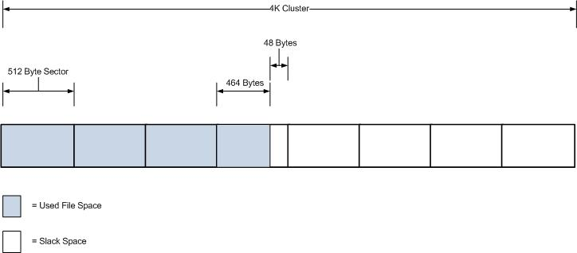
Preserve data in slack space / unallocated space
Notes:
Overwrite zero with one = more like 0.95
Overwrite one with one = more like 1.05
Normal equipment will read both values as a one
Digital forensics equipment makes it possible to determine what data exists in “slack space” and “unallocated space.”

Slide 14
Some differences between forensic and logical images
Forensic image | Logical image
Recovers operating system and file system | Does not recover operating system and file system
Potential for password recovery, decryption, etc. | Almost no potential for password recovery, decryption, etc.
Recover Internet search queries and form data | Cannot recover Internet search queries and form data
Size of entire hard drive, regardless of how many files are stored | Size of files on hard drive

Slide 15
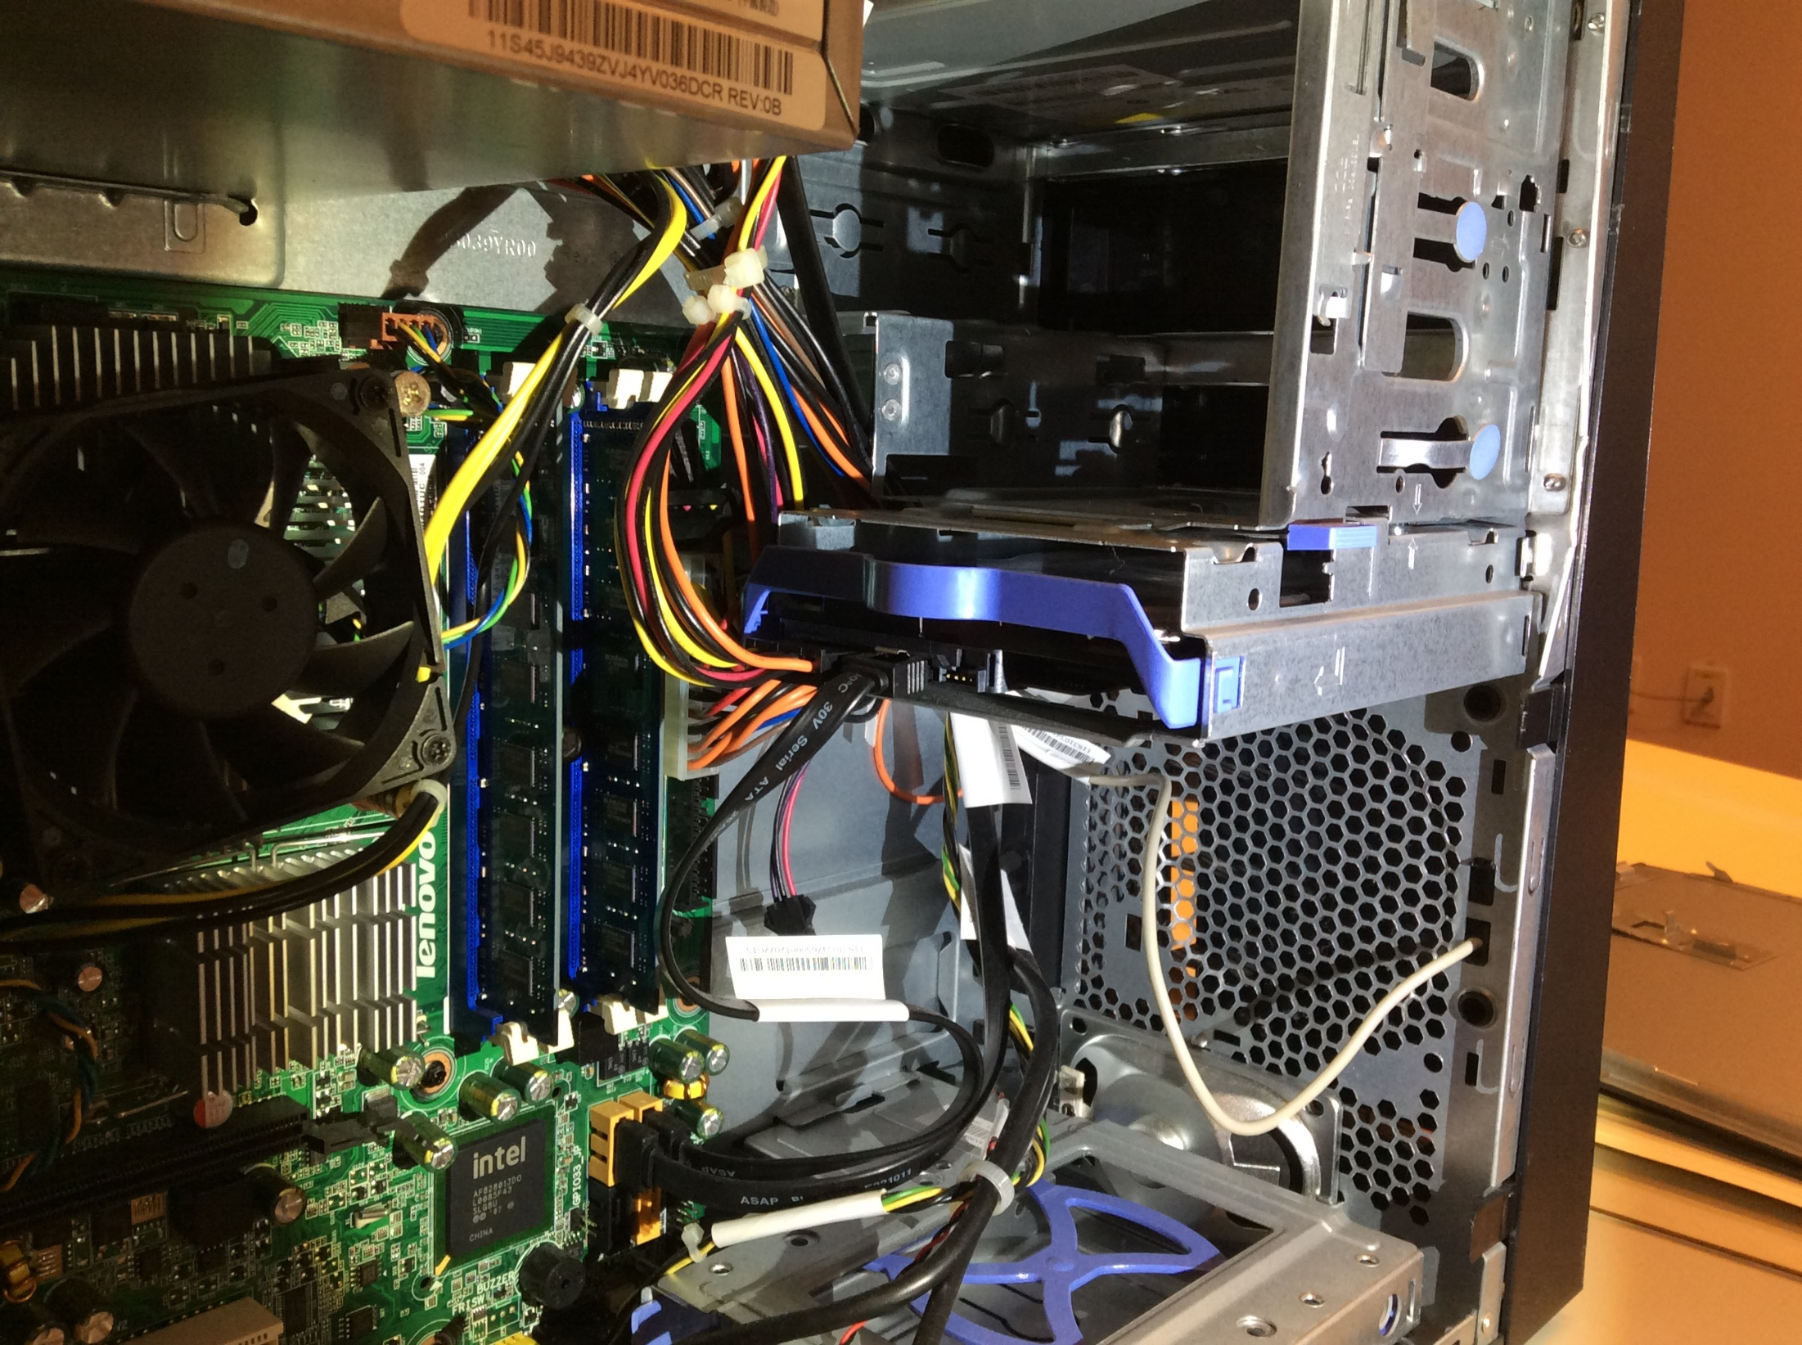

Slide 16
Digital forensics tools

Slide 17
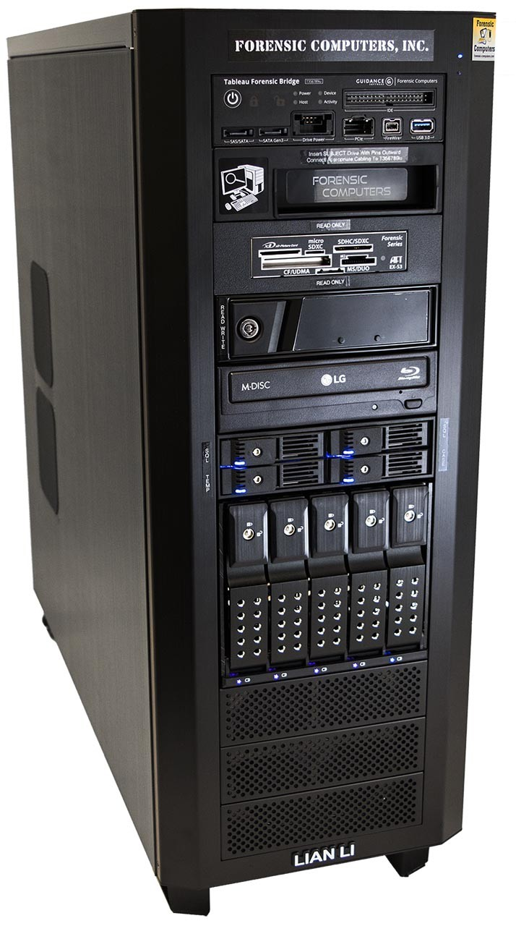

Slide 18
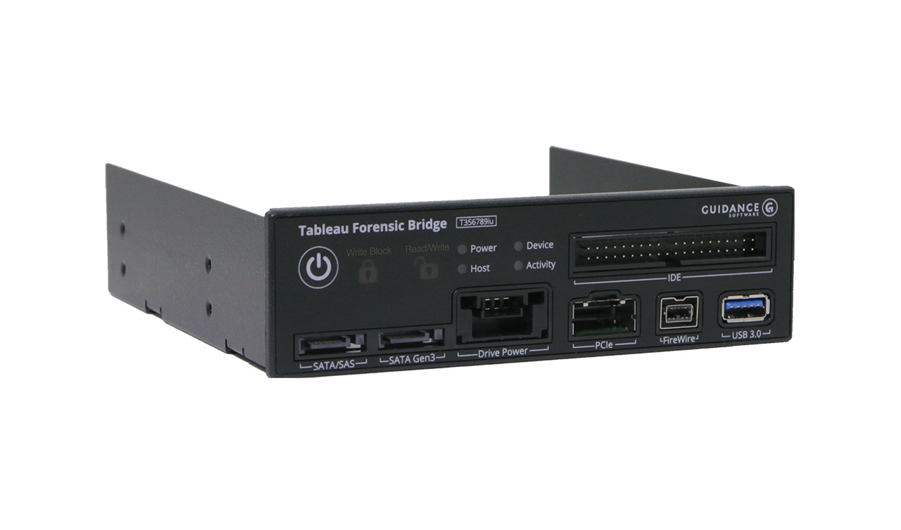

Slide 19
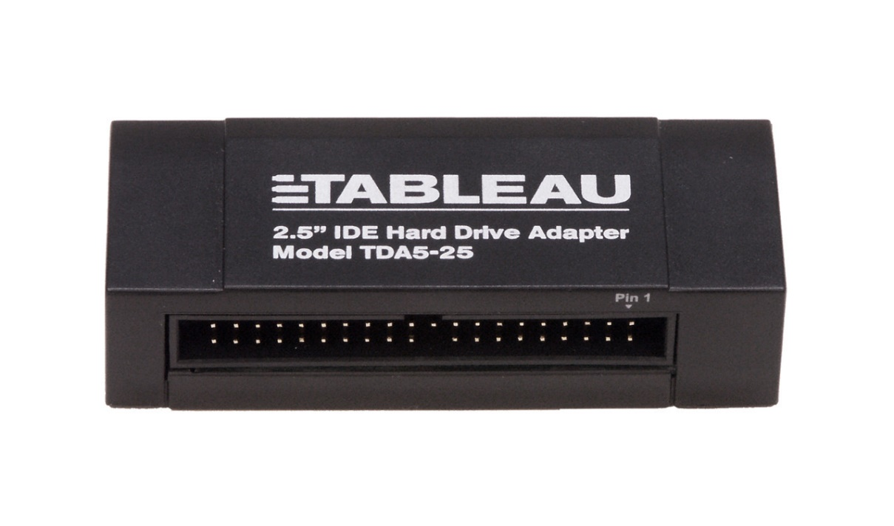
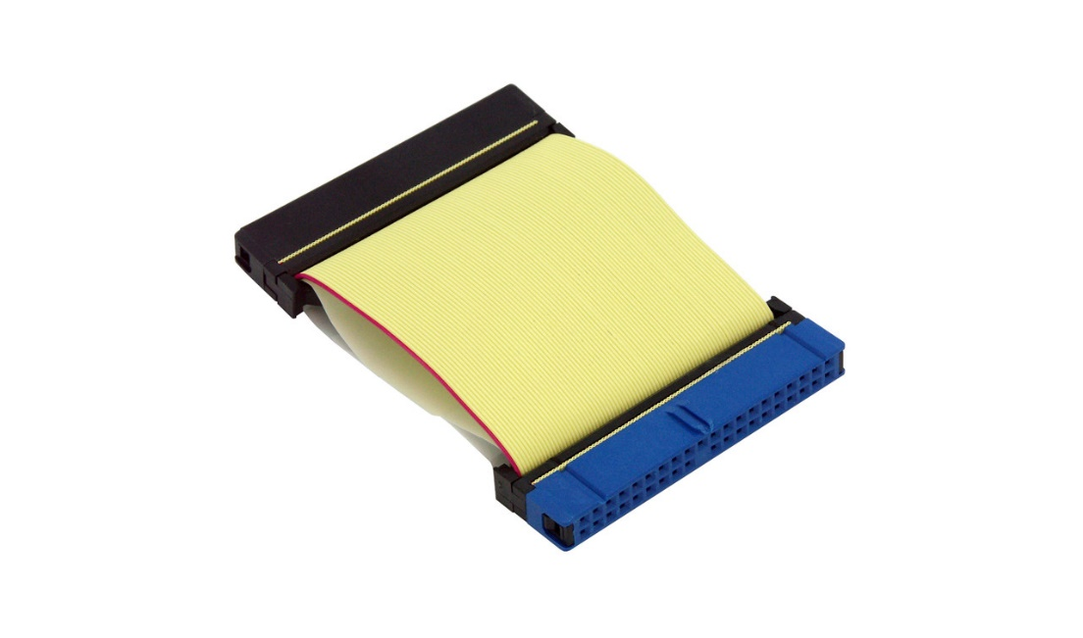

Slide 20
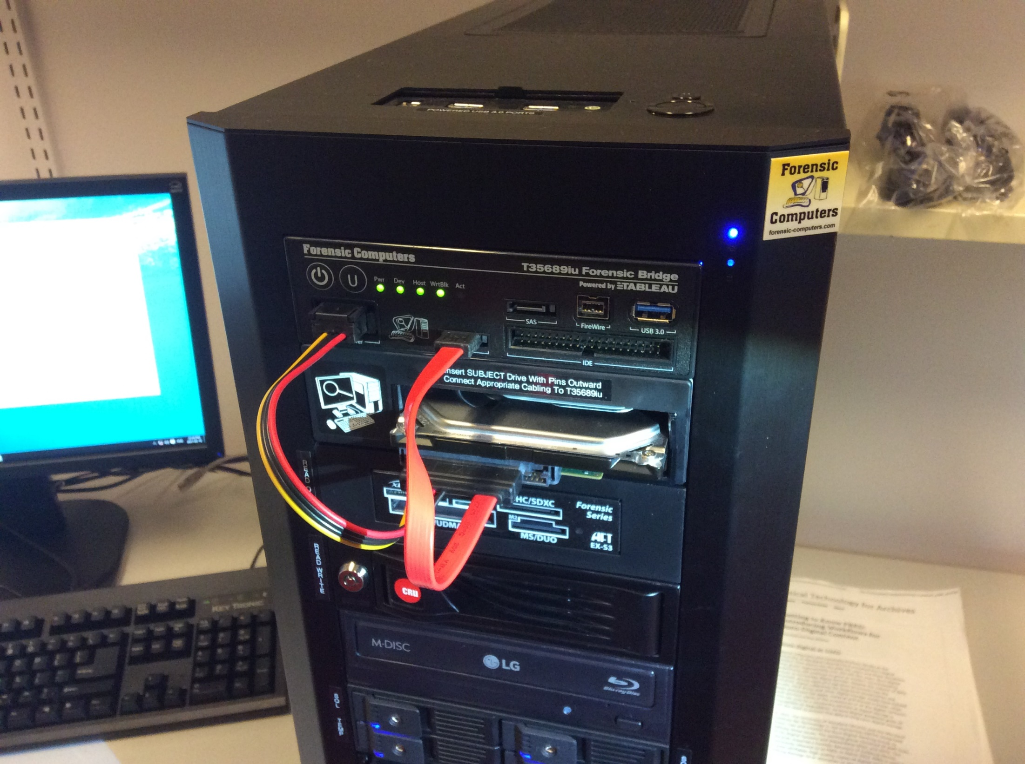

Slide 21
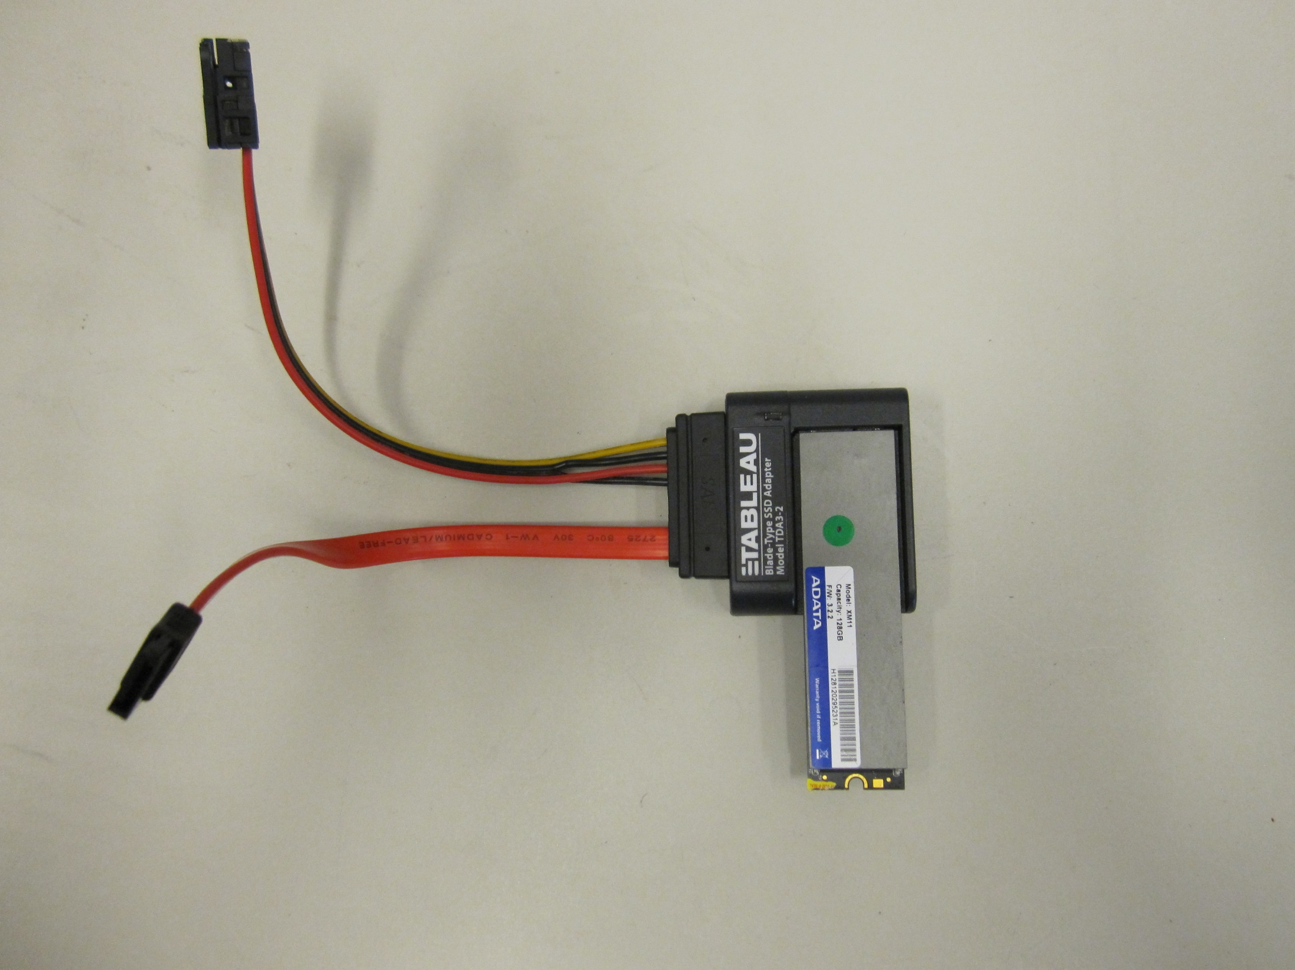

Slide 22
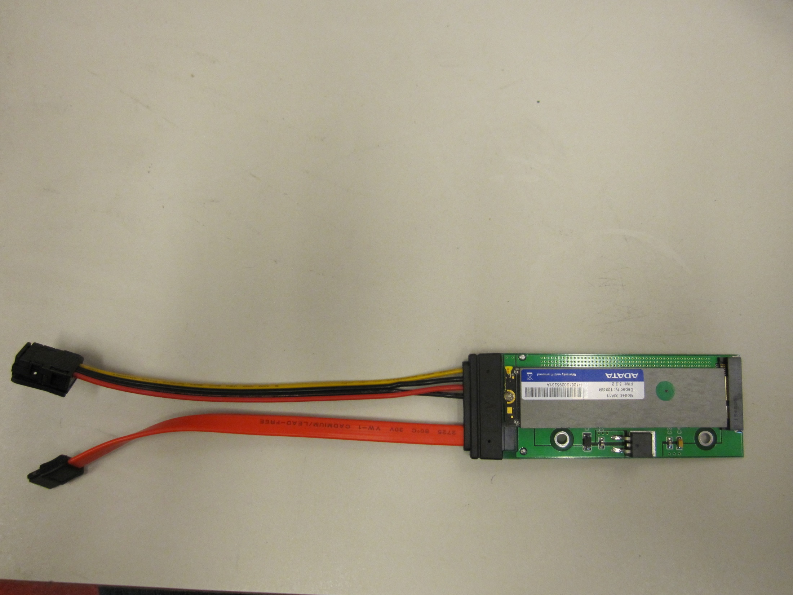

Slide 23
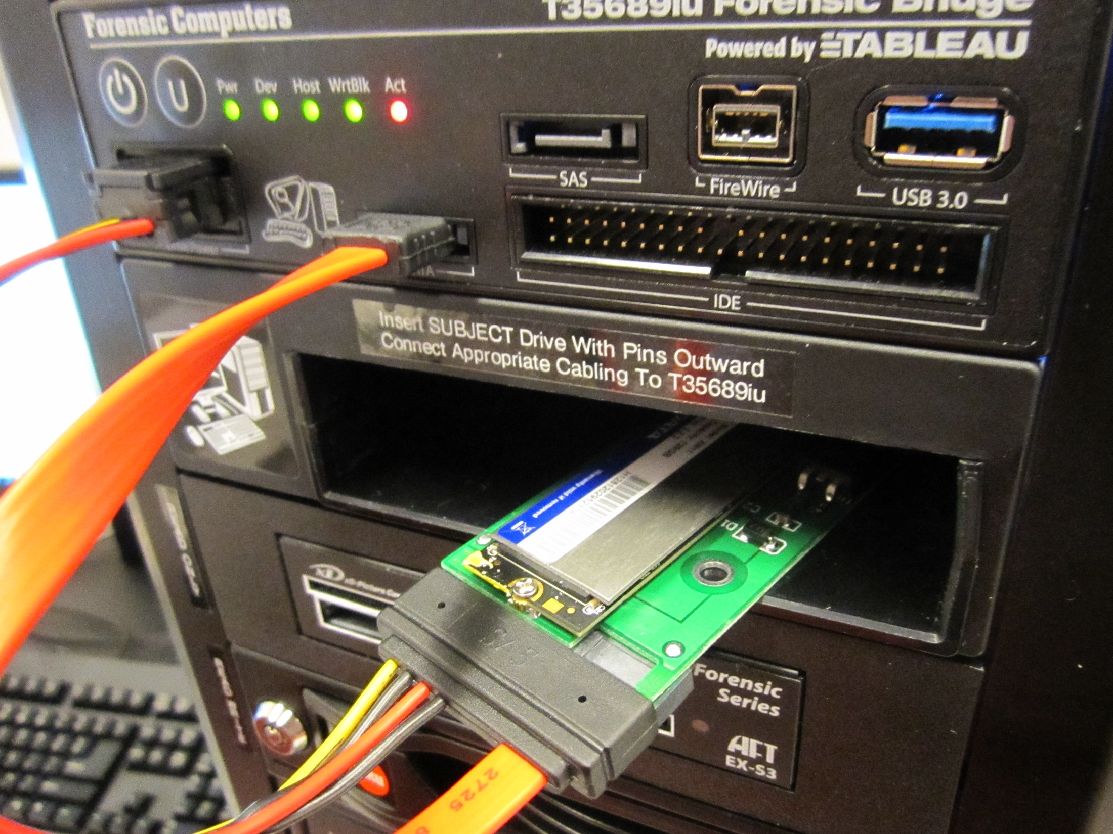

Slide 24

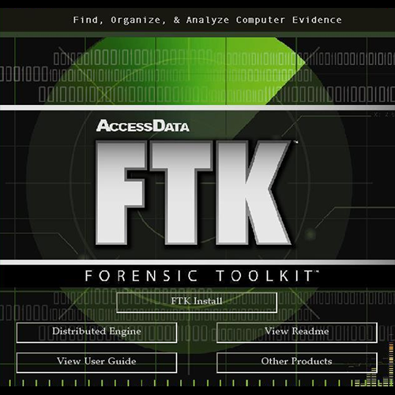



Slide 25
Digital forensics workflows

Slide 26
Abstract digital forensics model
Identification
Preparation
Approach Strategy
Preservation
Collection
Examination
Analysis
Presentation
Returning Evidence
Source: Infosec Institute, Digital Forensic Models (January 25, 2016): http://resources.infosecinstitute.com/digital-forensics-models/

Slide 27
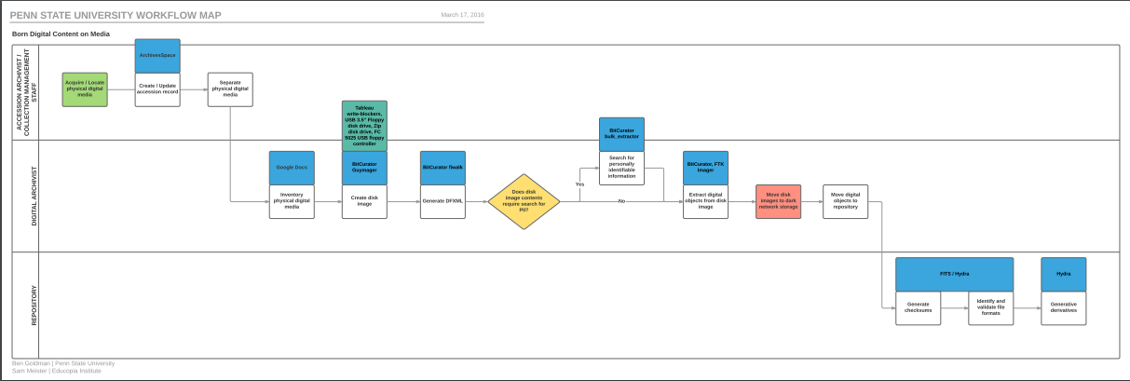
Penn State University workflow

Slide 28
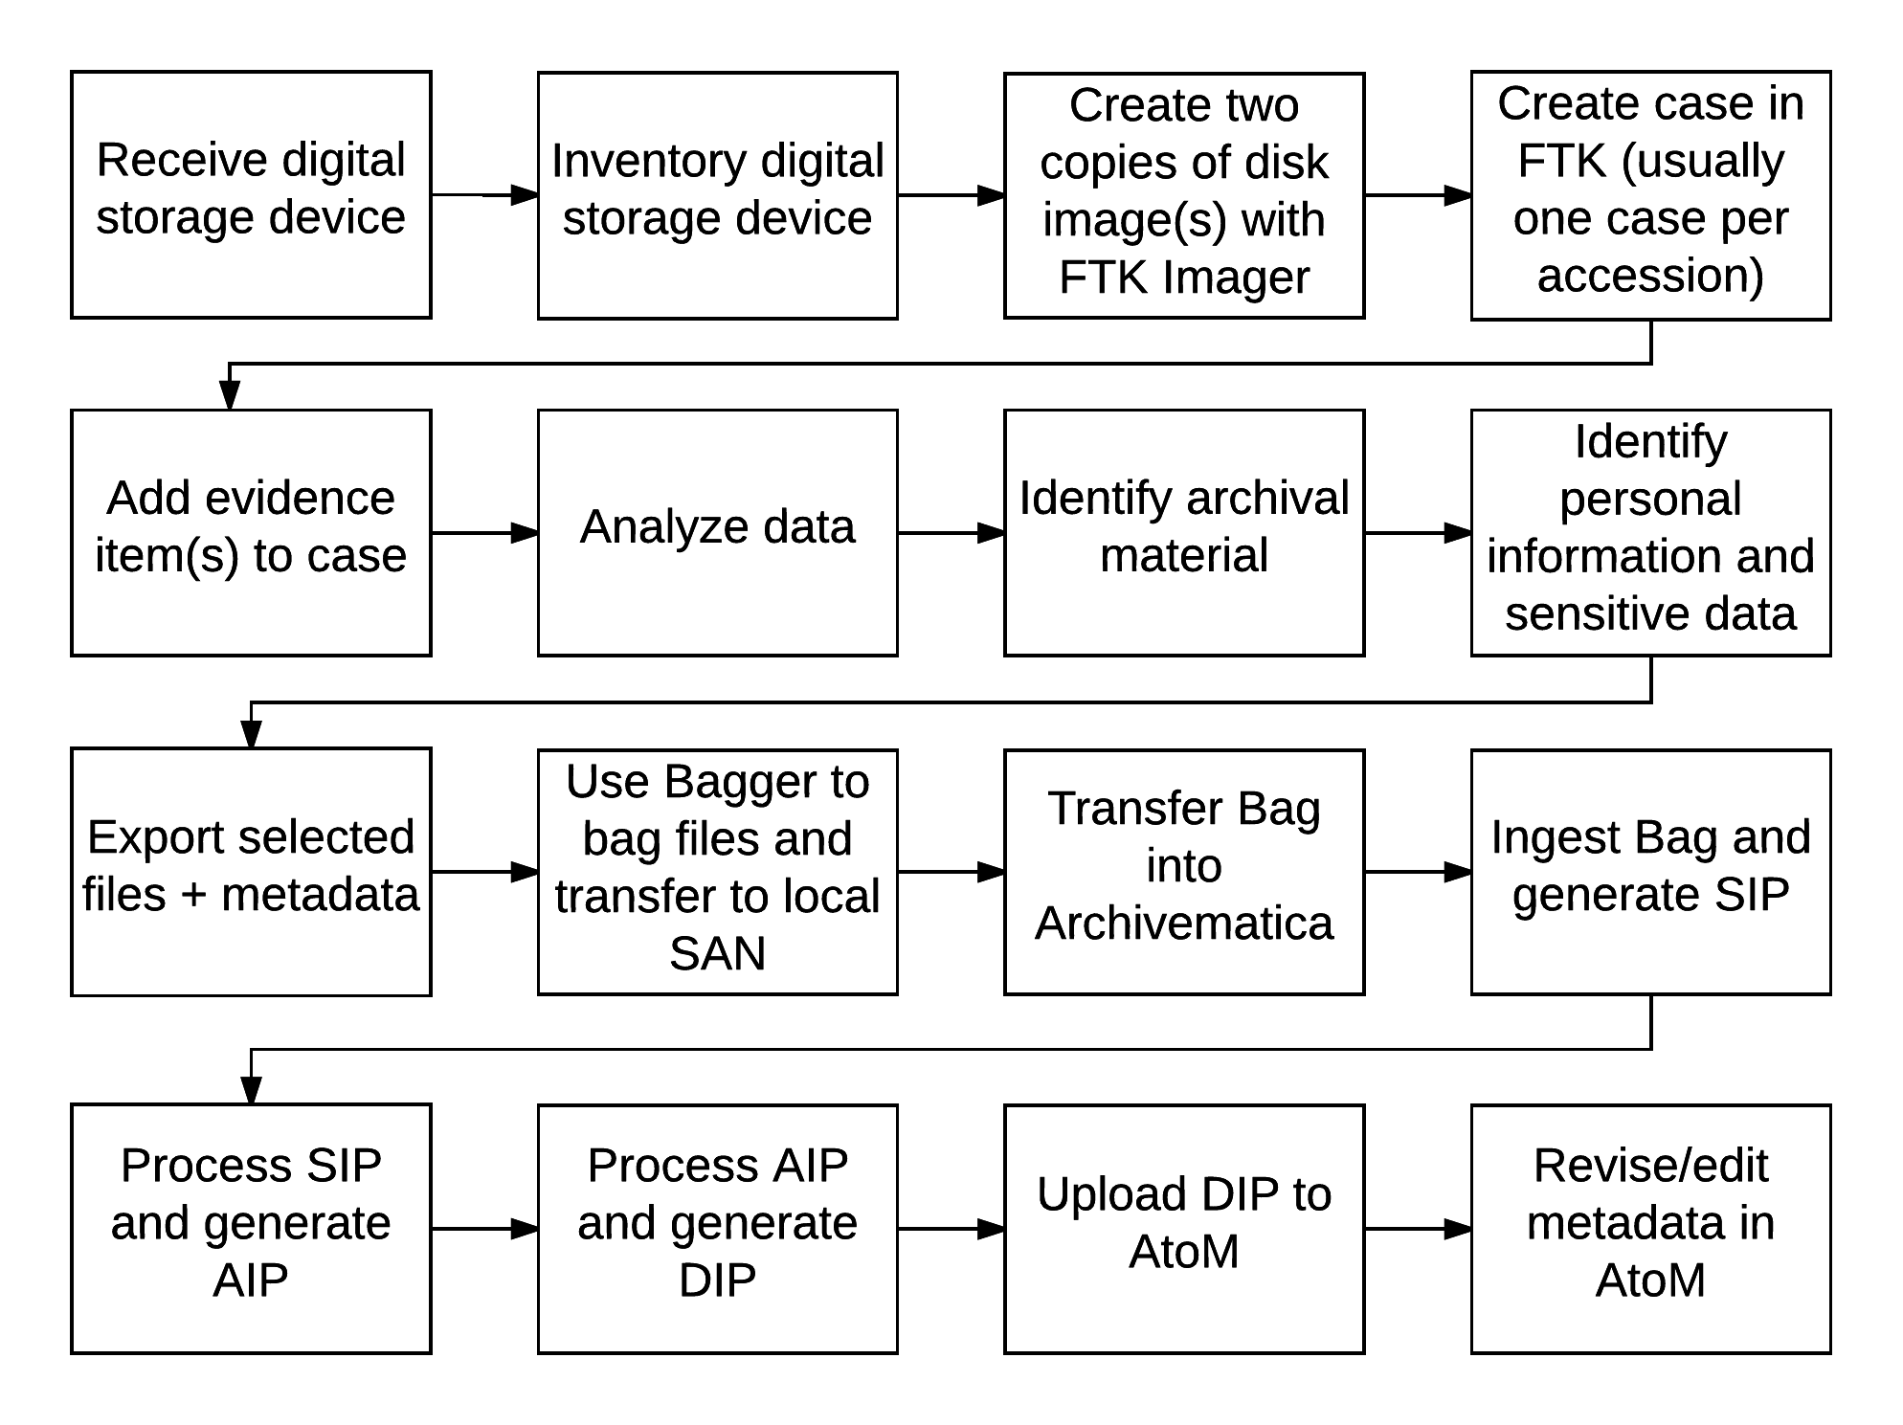
Dalhousie University workflow (draft)
Notes:
Very premature
Does not factor staffing, roles and responsibilities, etc.
Relates to other workflows in development (e.g., acquisitions, accessioning)

Slide 29
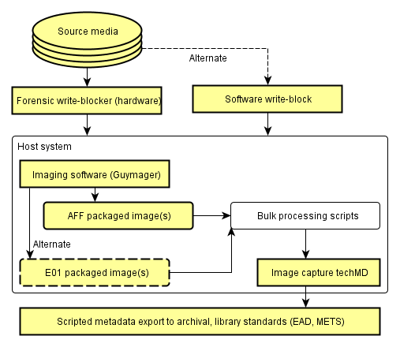
Forensic imaging workflow (BitCurator)

Slide 30
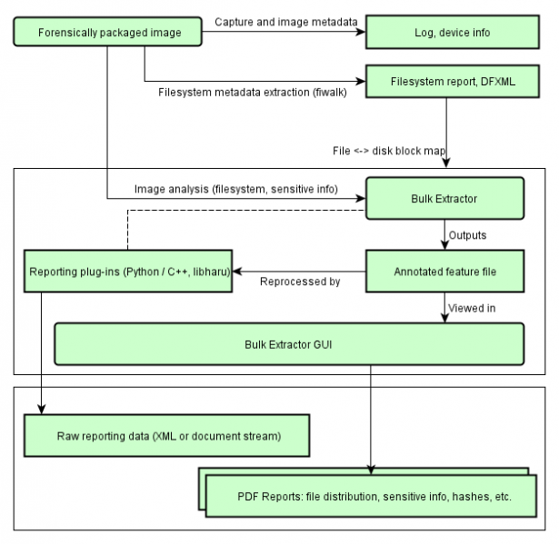
Identify privacy concerns

Slide 31
Bill Freedman fonds filtered in FTK
Filter | Description | # of files | Size
Unfiltered | All files in case | 26,651,084 | 3,568 GB
Primary status | Duplicate File indicator IS “Primary” | 731,417 | 83.48 GB
Secondary status | Duplicate File indicator IS “Secondary” | 16,569,218 | 271.5 GB
KFF Ignore | Match all files where KFF status IS “Ignore” | 2,548,119 | 44.29 GB
No KFF Ignore | Match all files where KFF status IS NOT “Ignore” + KFF status IS “Not checked” | 24,102,965 | 3524 GB
Primary status + No KFF Ignore | Match all files where duplicate file indicator IS “Primary” + KFF status IS NOT “Ignore” | 626,351 | 71.95 GB
Actual files + Primary status + No KFF Ignore | Match all disk-bound files where duplicate file indicator IS “Primary” + KFF status IS NOT “Ignore” | 103,412 | 61.81 GB

Slide 32
Free digital forensics tools and resources – FTK Imager, BitCurator, and SleuthKit

Slide 33
FTK Imager (free download)
Create forensic images of source media
Intended for use with hardware write blocker
Preview, triage, and image
Export, hash, convert
Notes:
Preview data
Triage
Create forensic images
Export
Hash
Convert

Slide 34
FTK Imager (free download)
Imaging tool – create forensic images of mounted
Preview tool – preview evidence to determine if further analysis is needed
Export tool – quickly select and export files prior to performing full analysis of the disk image
FTK Imager can open mounted drive, contents of a folder, or a forensic image
FTK Imager cannot create image of a networked drive

Slide 35
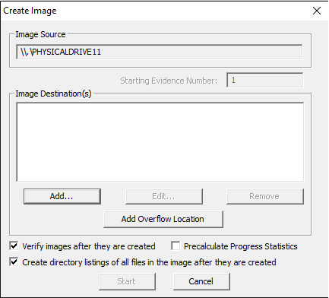
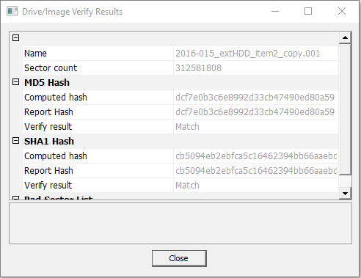
FTK Imager – Create Image

Slide 36

SleuthKit + Autopsy
Images source: https://www.sleuthkit.org/

Slide 37
SleuthKit + Autopsy
SleuthKit is a collection of command line tools to investigate disk images
Tools support the analysis of volume and file system data
Autopsy is graphical user interface to SleuthKit and other digital forensics tools

Slide 38
Free resources
Forensics wiki: http://forensicswiki.org/wiki/Main_Page
List of digital forensics tools: https://en.wikipedia.org/wiki/List_of_digital_forensics_tools
BitCurator wiki: https://wiki.bitcurator.net/index.php?title=Main_Page

