Slide 1
Digitizing and exhibiting the archives of artist-run centres in Halifax, Nova Scotia
Digital Humanities Brownbag Lunch
McCain Room 2130
20 November 2015, 12:00 p.m.
Creighton Barrett, Dalhousie University Archives

Slide 2
Overview
Artist-run centres (ARCs) in Halifax
Upcoming exhibition at the Dalhousie Art Gallery
Digitization of archival material + metadata
Exhibition of archival material

Slide 3

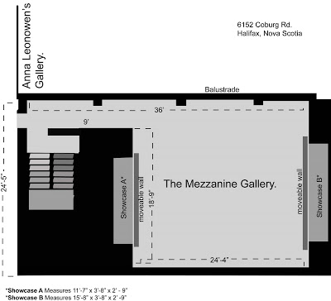

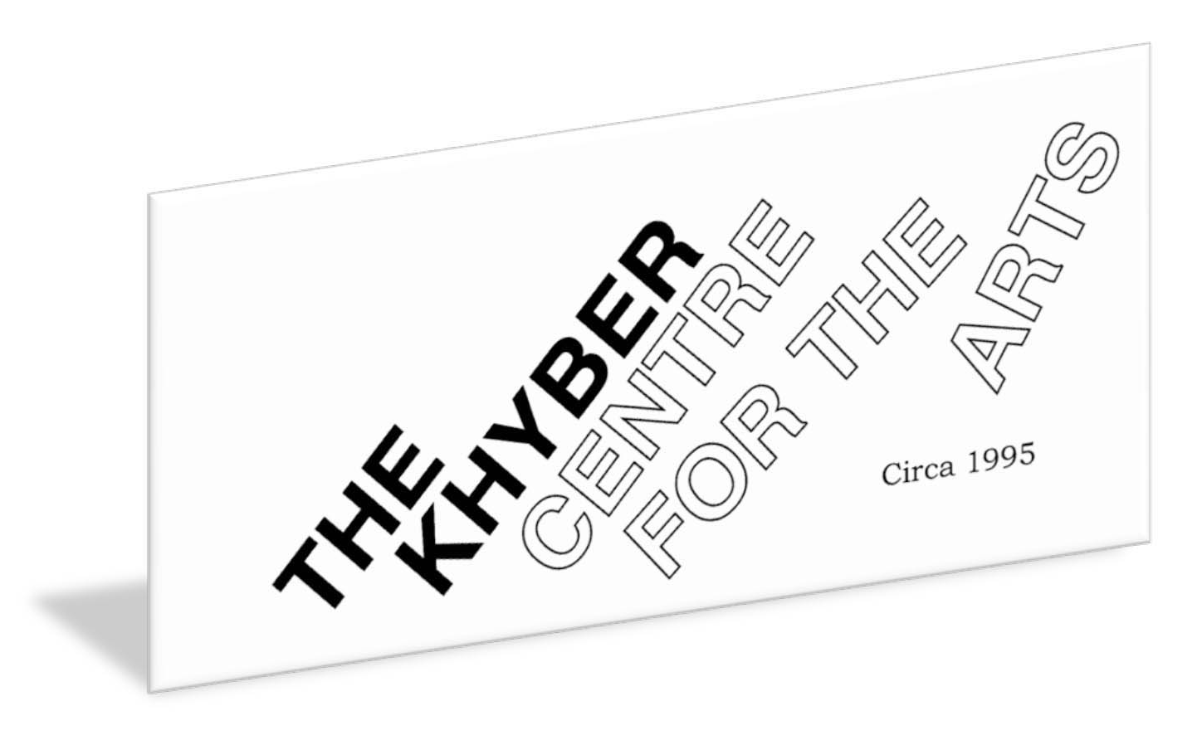
ARCs in Halifax

Slide 4
ARC collections in the Dalhousie University Archives
Eyelevel Gallery fonds
Centre for Art Tapes fonds
Centre for Art Tapes Tape Collection

Slide 5

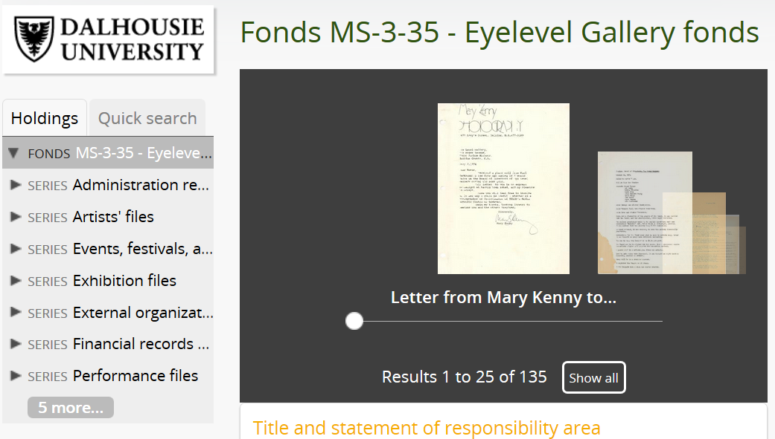

Notes:
Eyelevel Gallery currently has three “archives:”
Eyelevel Gallery fonds at Dal Archives
“Inventions Library & Archives in the ELG space
Online “Archive” of Exhibitions created for 35th anniversary

Slide 6
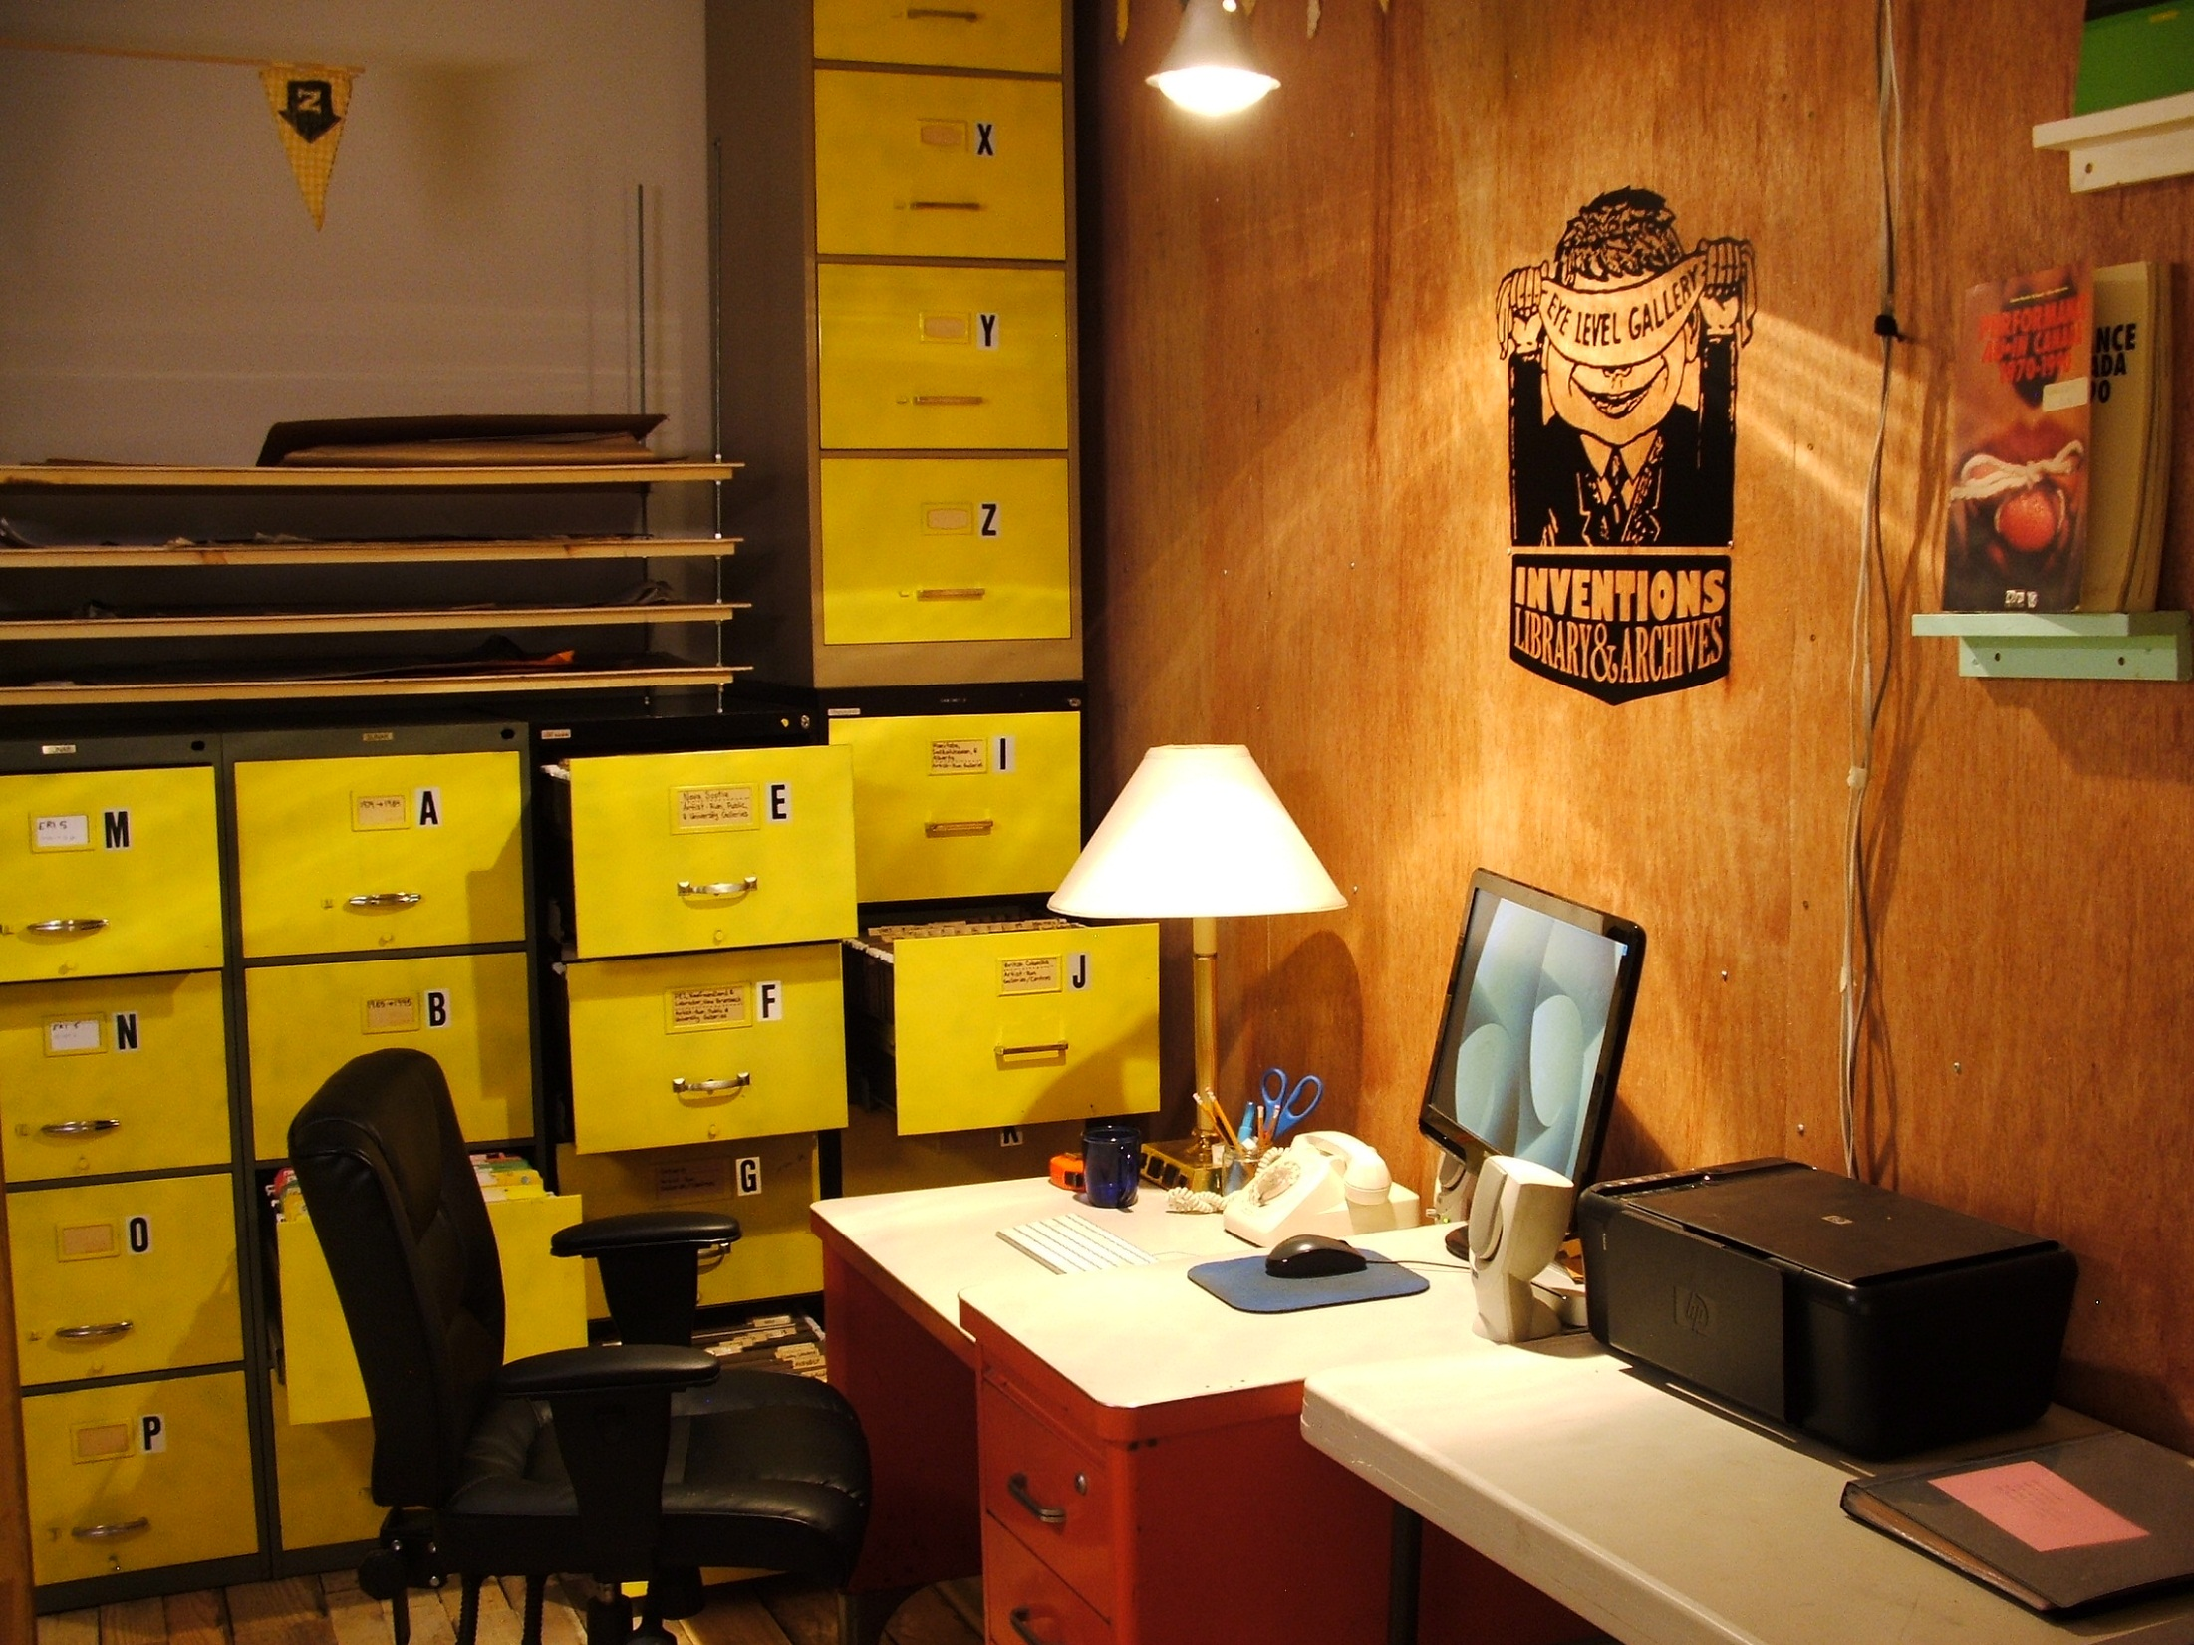

Slide 7
“Why are we saving All these artist publications + Other Galleries stuffs?”
15 January to 17 April 2016
Dalhousie Art Gallery

Slide 8
“Why are we saving All these artist publications + Other Galleries stuffs?”
AMAZING!
Woah, look what we have here…
Research: ARCs began as “parallel galleries” or “alternative spaces” but they are now parallel to mainstream institutions…
An article becomes an exhibition…
ARCHIVES!
OR NOT!

Slide 9
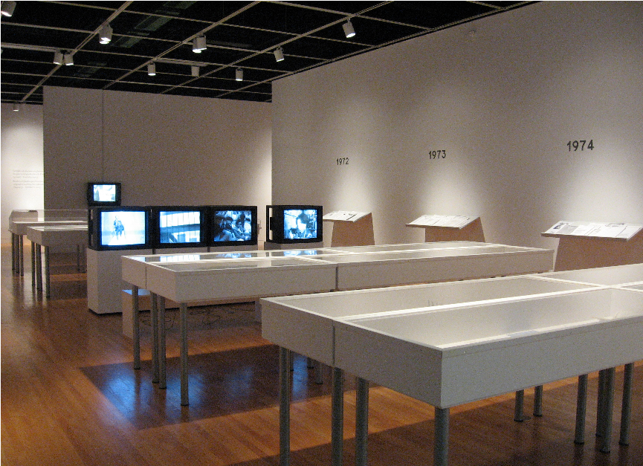
View of Room A
Documentary Protocols II, curated by Vincent Bonin
Photograph by Paul Litherland

Slide 10
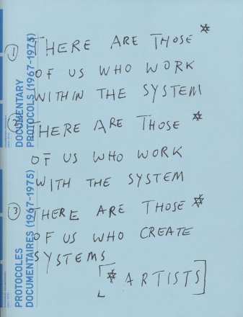
Documentary Protocols / Vincent Bonin
Emergence of ARCs in Canada, 1967-1975
Did not include Atlantic Canadian ARCs
AMAZING!
OR NOT!

Slide 11
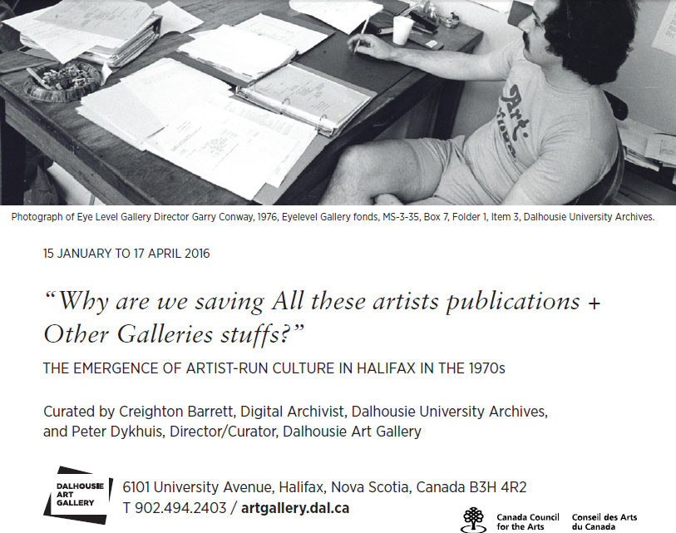

Slide 12
Digitization of archival material
Dalhousie Libraries’ technical standards
File-level description vs. item-level display in gallery
Online display
Artists’ rights

Slide 13
MS-3-35, Box 46, Folder 15
MS-3-35
  46
    46.15
TIFF directory structure based on reference code
TIFF filename based on reference code “prefix” + sequential number
MS-3-35_46_15_001.tiff
MS-3-35_46_15_002.tiff

Slide 14
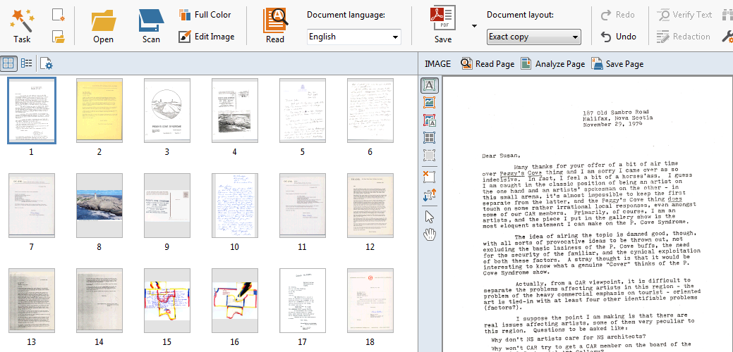
Optical Character Recognition of Peggy's Cove Syndrome: group exhibit, November 30 - December 18, 1974, MS-3-35, Box 40, Folder 4

Slide 15
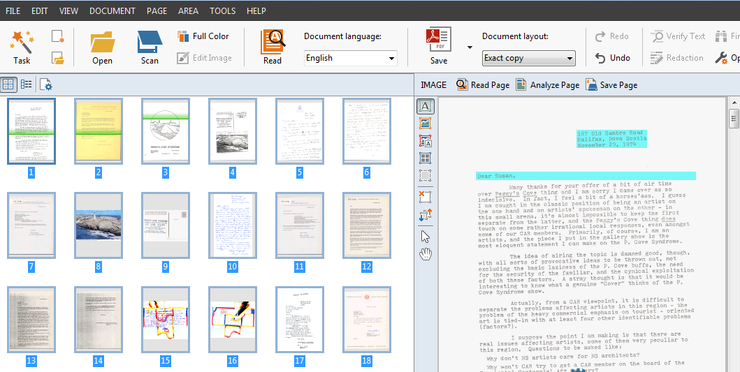
Optical Character Recognition of Peggy's Cove Syndrome: group exhibit, November 30 - December 18, 1974, MS-3-35, Box 40, Folder 4

Slide 16
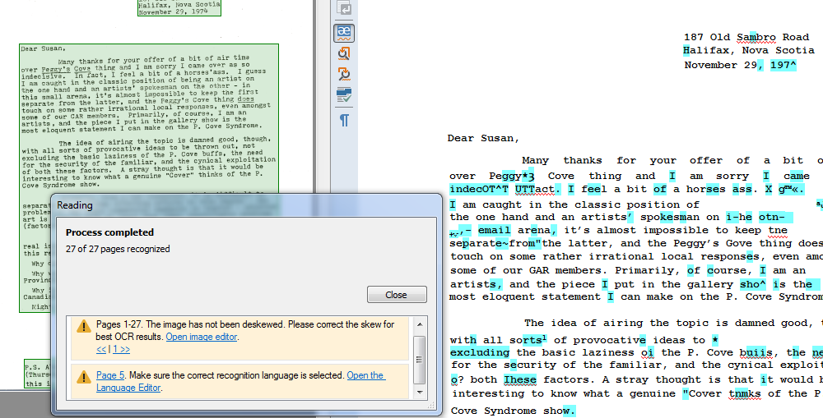
Optical Character Recognition of Peggy's Cove Syndrome: group exhibit, November 30 - December 18, 1974, MS-3-35, Box 40, Folder 4

Slide 17
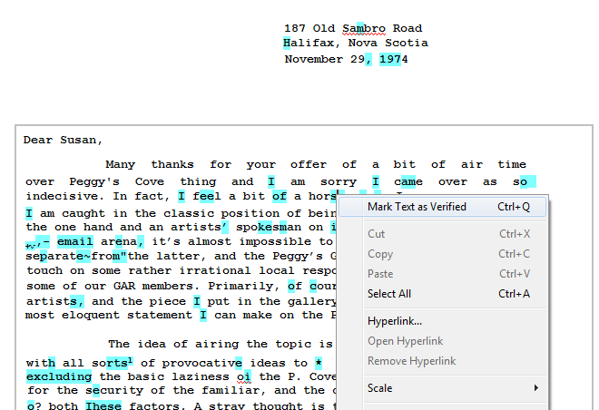
Optical Character Recognition of Peggy's Cove Syndrome: group exhibit, November 30 - December 18, 1974, MS-3-35, Box 40, Folder 4

Slide 18
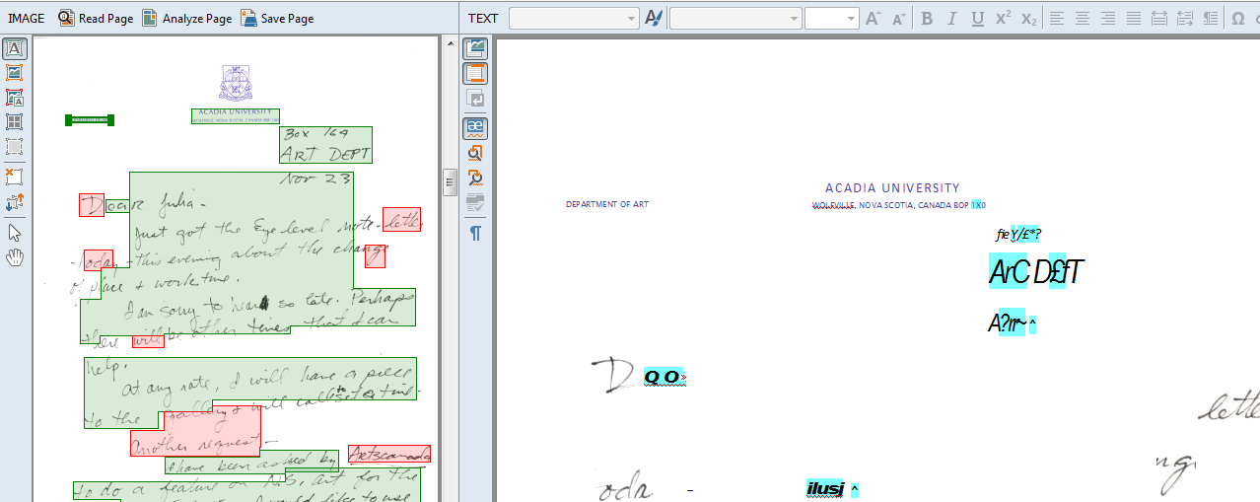
Optical Character Recognition of Peggy's Cove Syndrome: group exhibit, November 30 - December 18, 1974, MS-3-35, Box 40, Folder 4

Slide 19
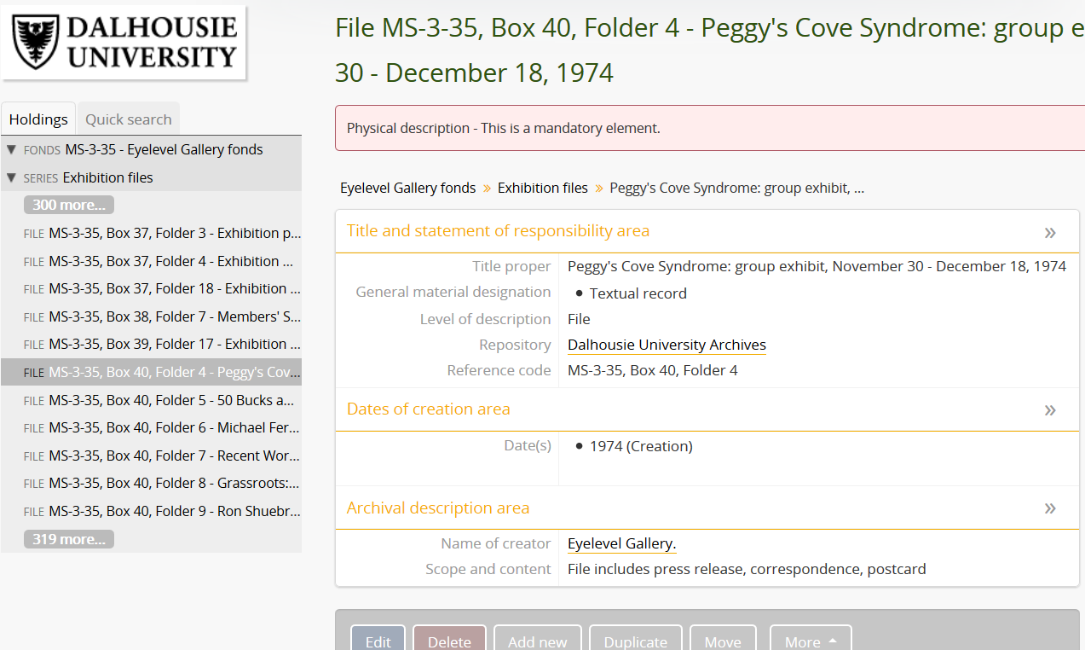
Optical Character Recognition of Peggy's Cove Syndrome: group exhibit, November 30 - December 18, 1974, MS-3-35, Box 40, Folder 4

Slide 20
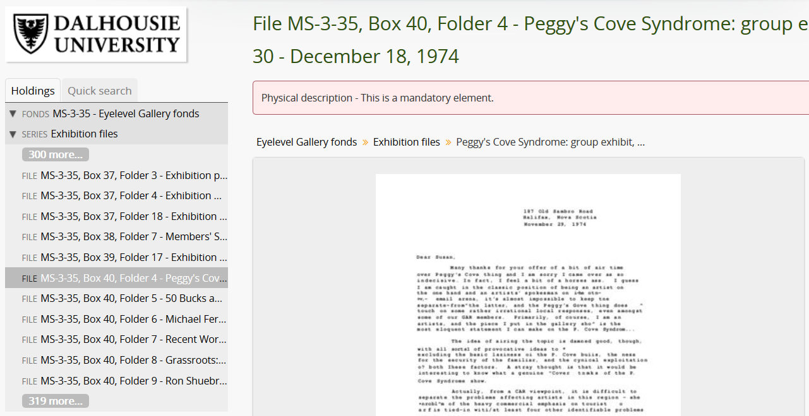

Slide 21
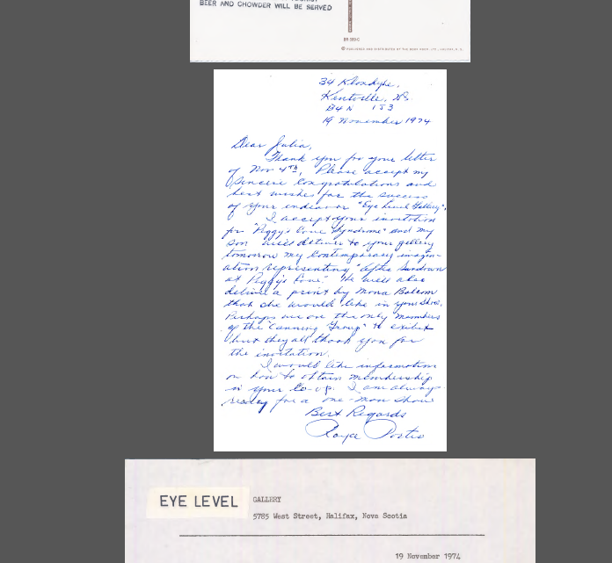

Slide 22
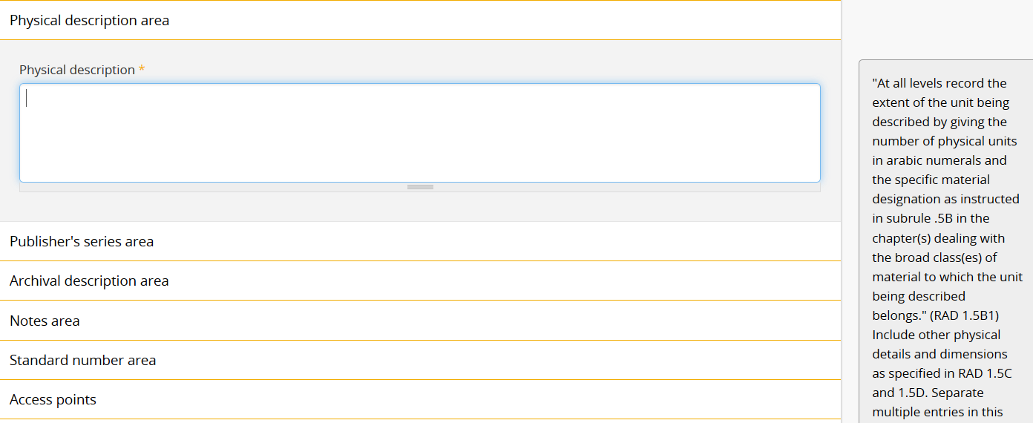

Slide 23
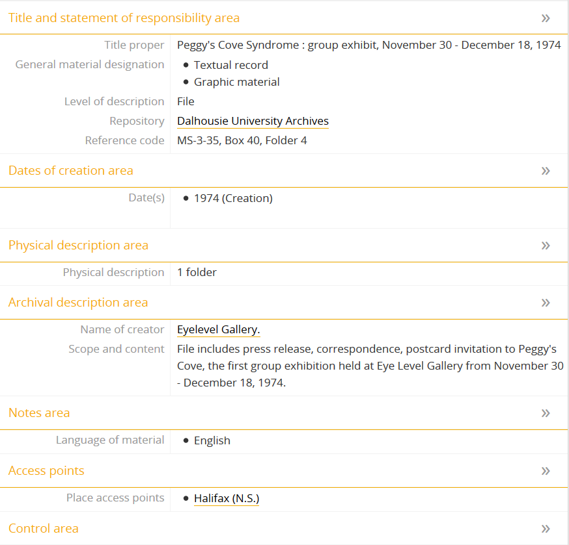

Slide 24
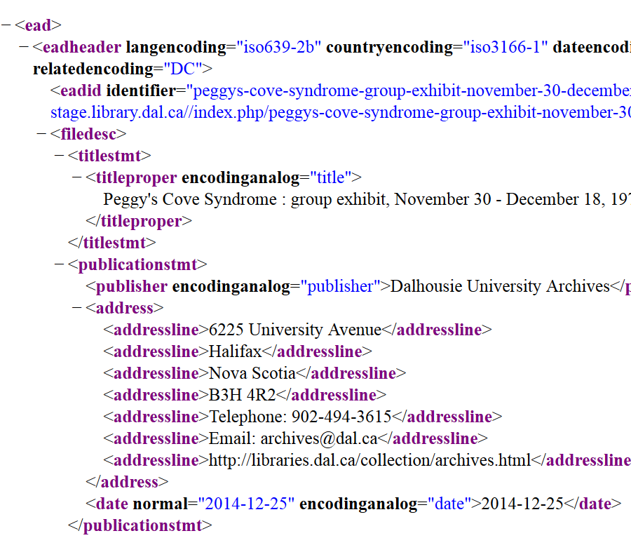

Slide 25
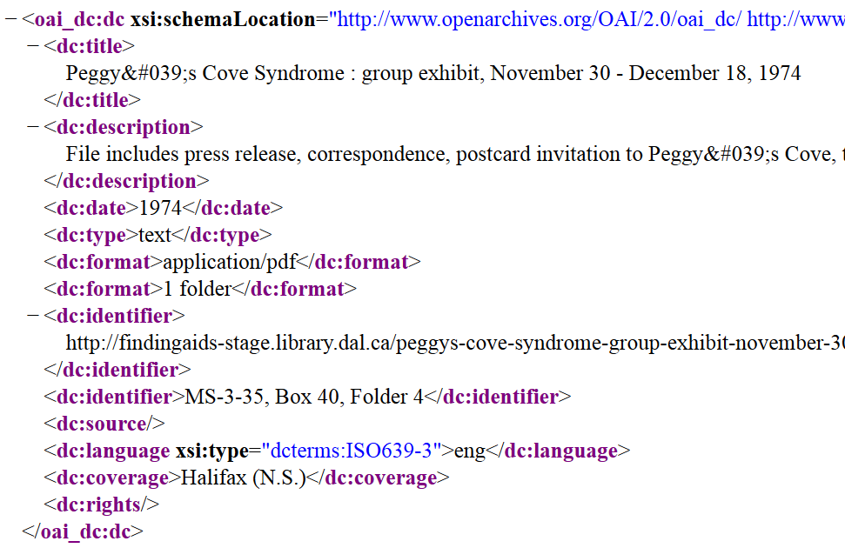

Slide 26
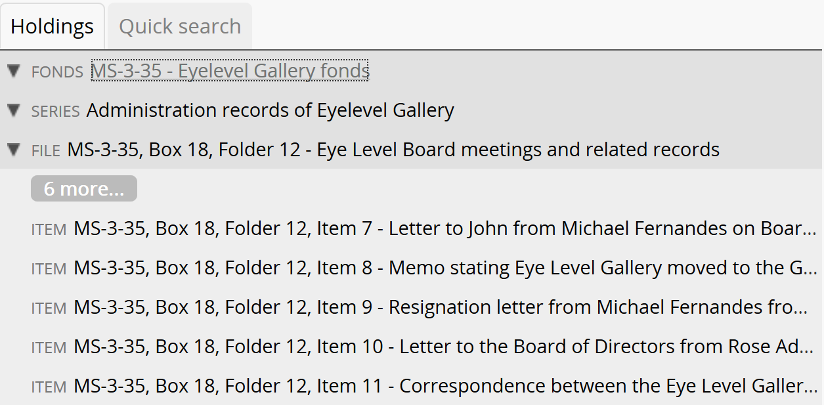

Slide 27
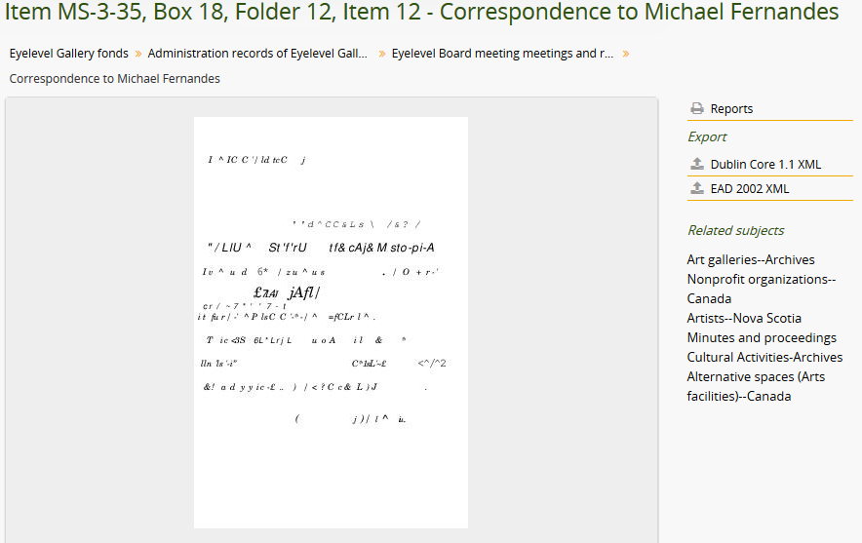
Item-Level Description of letter from Catriona Talbot to Michael Fernandes, MS-3-35, Box 18, Folder 12, Item 12

Slide 28
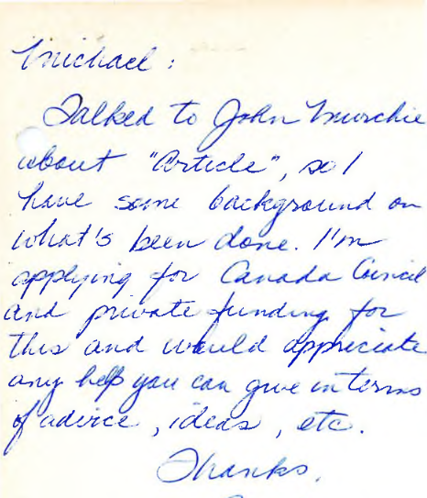
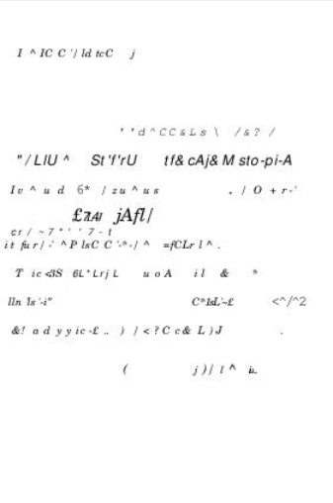
Letter from Catriona Talbot to Michael Fernandes, MS-3-35, Box 18, Folder 12, Item 12

Slide 29
Artists’ rights
Fee schedules for exhibitions
Is the Archives an Art Gallery?
Is the Archives Catalogue an Exhibition?
Copyright tools for the Libraries

Slide 30
Owner’s Economic Rights - “High risk” material
Artistic works created with intent to disseminate through exhibitions, screenings, presentations, publications, and other methods of controlled access
Correspondence with prominent literary, artistic, scholarly or public figures

Slide 31
Author’s Moral Rights - “High risk” material
The material is a highly creative work produced in digital form in an uncommon format that does not easily normalize into a standard digital access format
The material is a highly creative work produced in an analog format that does not easily transfer to a digital preservation format and/or a standard digital access format

Slide 32
Exhibition of archival material
Spatial issues
Analog content
Digital content

Slide 33
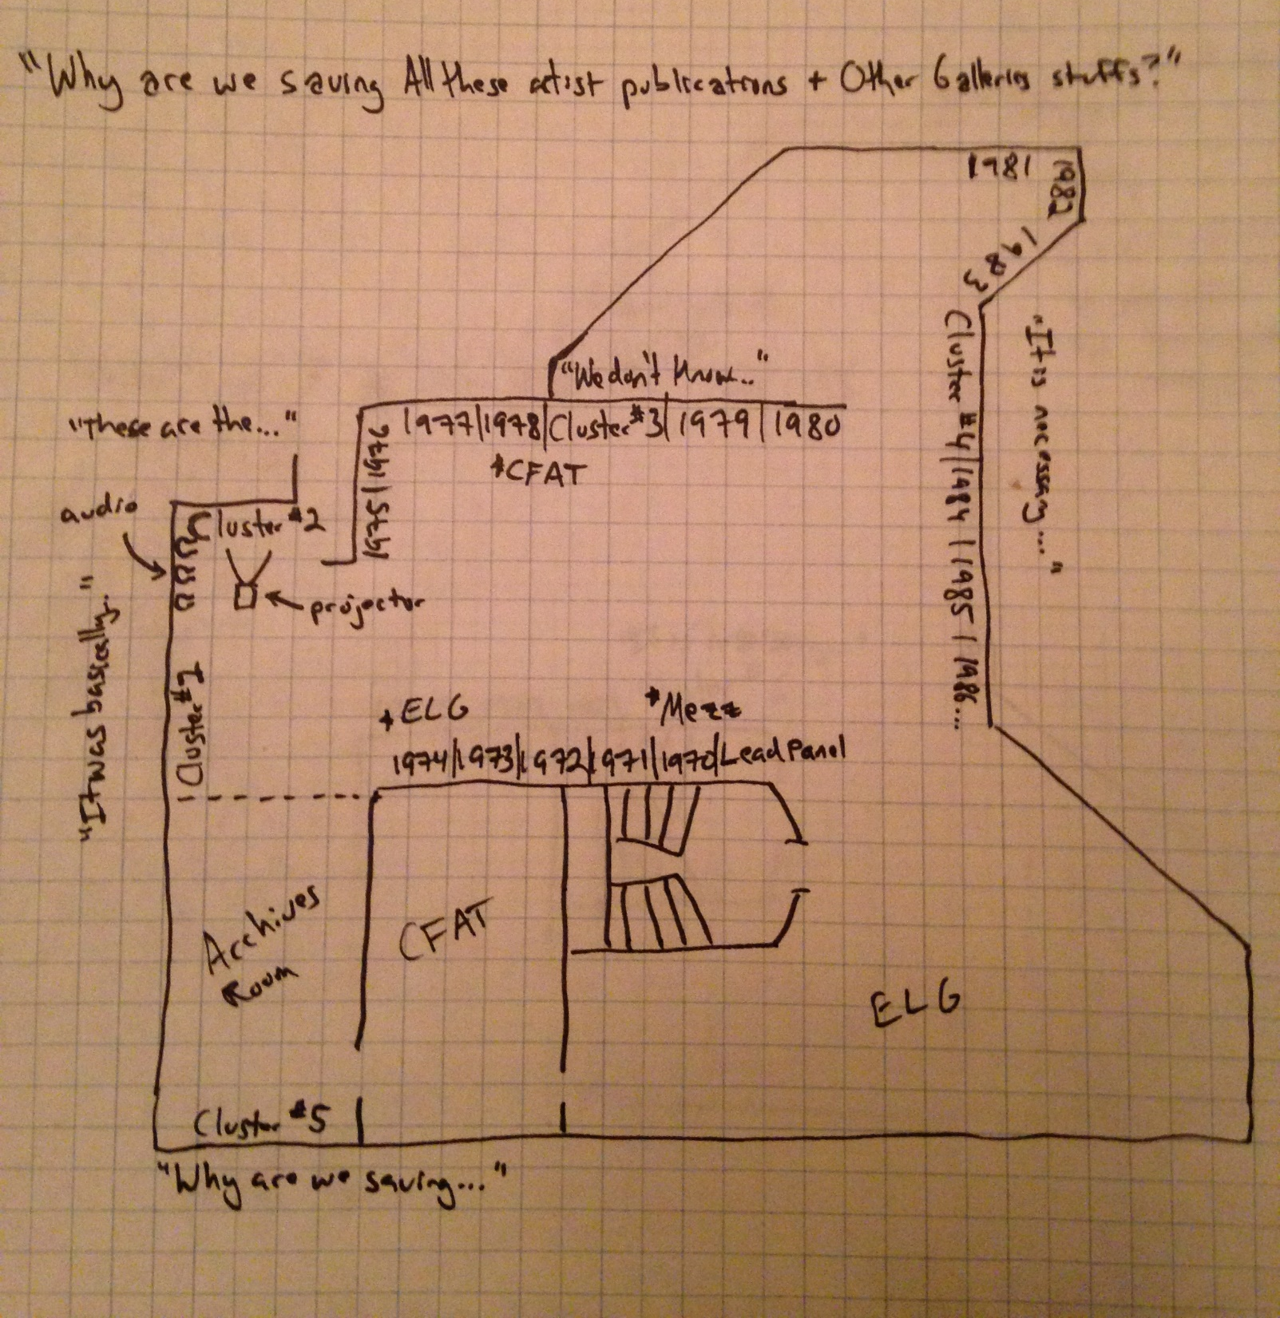
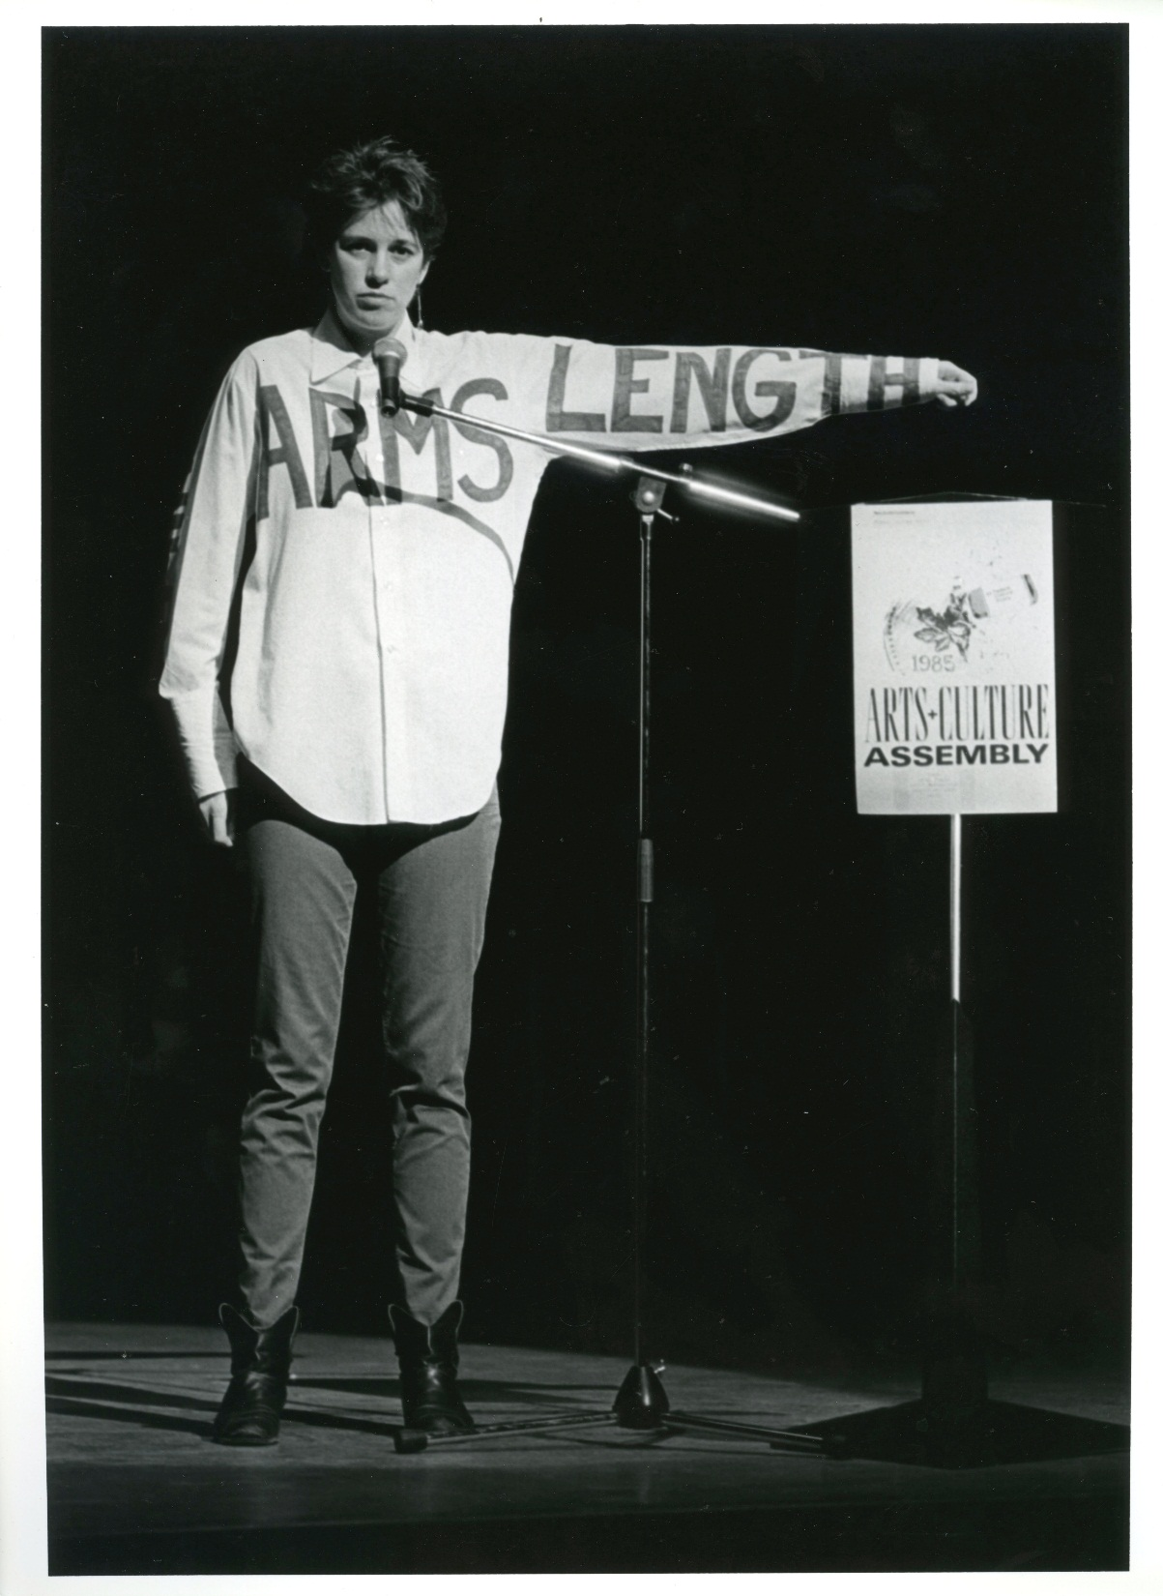
Exhibit diagram
Floorplan, v.3
Creighton Barrett

Slide 34
Challenges
Estimating space requirements
Analog content in a gallery space
Projection of high-resolution digitized archival documents, photographs, etc.
Presenting “alternative galleries” in a “traditional gallery”

Slide 35
Image credits
Eyelevel Gallery logo: http://www.eyelevelgallery.ca/
Centre for Art Tapes logo: CFAT website: http://cfat.ca/
AFCOOP logo: AFCOOP website: http://afcoop.ca/
Khyber Centre for the Arts logo: Khyber website: http://www.khyber.ca/
Mezzanine Gallery floorplan: The Mezzanine Gallery blog post: http://nscadhistoryworkshop.blogspot.ca/2008/10/mezzanine-gallery.html
Image of Inventions Library and Archives: http://www.eyelevelgallery.ca/exhibition/launch-inventions-library-archives-exhibition
Launch poster for Inventions Library and Archives: http://www.eyelevelgallery.ca/exhibition/launch-inventions-library-archives-exhibition
Excerpt of Eyelevel Gallery meeting roll call, ca. 1979, Eyelevel Gallery fonds, MS-3-35, Box 18, Folder 12, Item 2, Dalhousie University Archives
View of Room A, photograph by Paul Litherland: http://ellengallery.concordia.ca/wp-content/uploads/2015/09/ExhibitingResearchTheriaultEN.pdf
Photograph of Eye Level Gallery Director Garry Conway, 1976, Eyelevel Gallery fonds, MS-3-35, Box 7, Folder 1, Item 3, Dalhousie University Archives
Floorplan diagram, Creighton Barrett
Photograph of Cathy Quinn’s performance at the Arts and Culture Assembly, Centre for Art Tapes fonds, MS-3-46, Box 7, Folder 34, Item 10, Dalhousie University Archives

