Slide 1
INFO 6850 Archives II
Week Eight
http://hdl.handle.net/10222/64571
PROGRAMMING AND PUBLIC SERVICE
Is programming a “core” archival function?

Slide 2
AGENDA
Announcements
Discuss first assignment
Review the ISAAR(CPF) standard
Discuss readings
Exhibition exercise

Slide 3
ROLE OF PROVENANCE IN ARCHIVAL DESCRIPTION
Trend towards separate descriptions of creators
“Authority records” created with new International Standard for Archival Authority Records (ISAAR-CPF)
What does this mean for RAD’s rules for administrative histories and biographical sketches?

Slide 4

ISAAR(CPF)
First edition published in 1996
Second edition published in 2004
Provides guidance for preparing authority records
How can authority records be used in archival description systems?
Notes:
Scope and Purpose 1.2
Authority records may be used to:
to describe a corporate body, person, or family as units within an archival descriptive system; and/or
to control the creation and use of access points in archival descriptions;
to document relationships between different records creators and between those entities and the records created by them and/or other resources about or by them.

Slide 5
RECORDS AND CONTEXT CONTROL
RAD ARCHIVAL DESCRIPTION
PROVENANCE
FONDS
Corporate body
Series
Person
File
Family
Item
Notes:
Last week, we discussed how Australian Peter Scott used the terms “records control” and “context control” to describe the “series-system.”
RAD “merges” records and context control into one description but the series-system separates them.
Context control is achieved through the Archival Description Area
Administrative History/Biographical Sketch
Custodial History
Records control is achieved through the rest of the archival description

Slide 6
CONTEXT CONTROL
Organization
Family
Agency
Person
RECORDS CONTROL
RAD ARCHIVAL DESCRIPTION
Series
File
Item
ISAAR-CPF AUTHORITY RECORD
Notes:
The ISAAR-CPF standard more or less codifies the “separate” context control and records control that the Australian “series-system” encourages.
Context is “encoded” in an authority record that is linked to archival descriptions.
The ISAAR(CPF) standard provides for a richer and more useful description of the creators of records than the RAD administrative history/biographical sketch note.

Slide 7
ELEMENTS OF AN AUTHORITY RECORD
Identity area
Description area
Relationships area
Control area
Notes:
ELEMENTS OF AN AUTHORITY RECORD
5.1 IDENTITY AREA
5.1.1 Type of entity
5.1.2 Authorized form(s) of name
5.1.3 Parallel forms of name
5.1.4 Standardized forms of name according to other rules
5.1.5 Other forms of name
5.1.6 Identifiers for corporate bodies
5.2 DESCRIPTION AREA
5.2.1 Dates of existence
5.2.2 History
5.2.3 Places
5.2.4 Legal status
5.2.5 Functions, occupations and activities
5.2.6 Mandates/Sources of authority
5.2.7 Internal structures/Genealogy
5.2.8 General context
5.3 RELATIONSHIPS AREA
5.3.1 Names/Identifiers of related corporate bodies, persons or families
5.3.2 Category of relationship
5.3.3 Description of relationship
5.3.4 Dates of the relationship
5.4 CONTROL AREA
5.4.1 Authority record identifier
5.4.2 Institution identifiers
5.4.3 Rules and/or conventions
5.4.4 Status
5.4.5 Level of detail
5.4.6 Dates of creation, revision or deletion
5.4.7 Languages and scripts
5.4.8 Sources
5.4.9 Maintenance notes

Slide 8
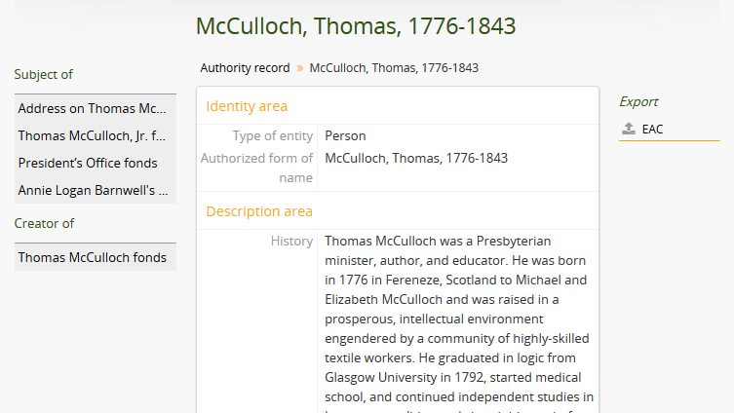
AUTHORITY RECORD
Notes:
Authority records can be linked to archival descriptions through a “Creator” access point or a “Subject” access point.
Here, you can see that Thomas McCulloch is the creator of his own fonds but he is also the subject of other fonds and collections.
Most applications now support the ability to import and export standardized data. Here, you can see that the Access to Memory application lets you export ISAAR(CPF) authority records as Encoded Archival Context (EAC) XML.

Slide 9
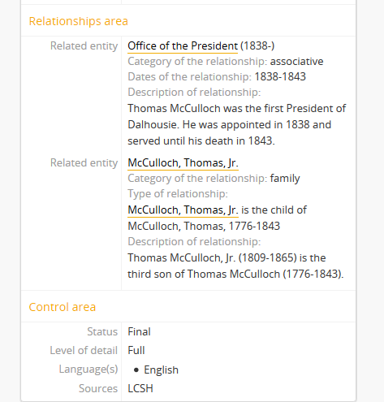
AUTHORITY RECORD
Notes:
Authority records can be linked to other authority records and the nature of the relationship can be described. Here, you can see that Thomas McCulloch is related to the “Office of the President” authority record because McCulloch was the first President of Dalhousie. He is also related to the authority record for Thomas McCulloch, Jr., who is McCulloch’s third son.
The control area is a place record information about the authority record. Here, you can see that the “authorized form of name” came from the Library of Congress Subject Headings.

Slide 10
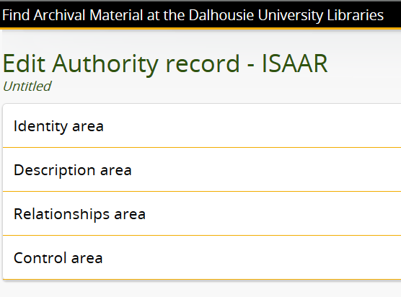
AUTHORITY RECORD

Slide 11
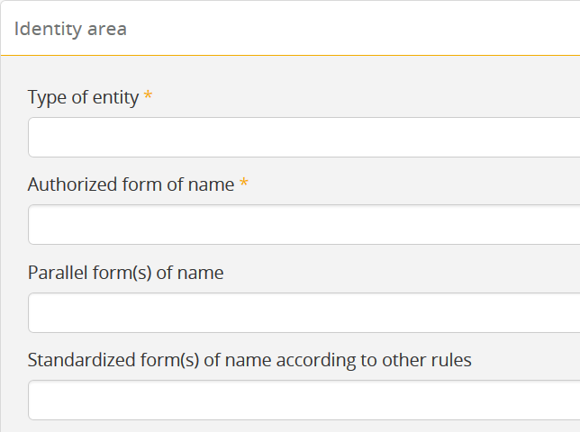
AUTHORITY RECORD

Slide 12
AUTHORITY RECORD

Slide 13
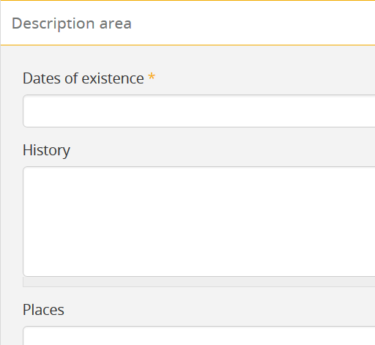
AUTHORITY RECORD

Slide 14
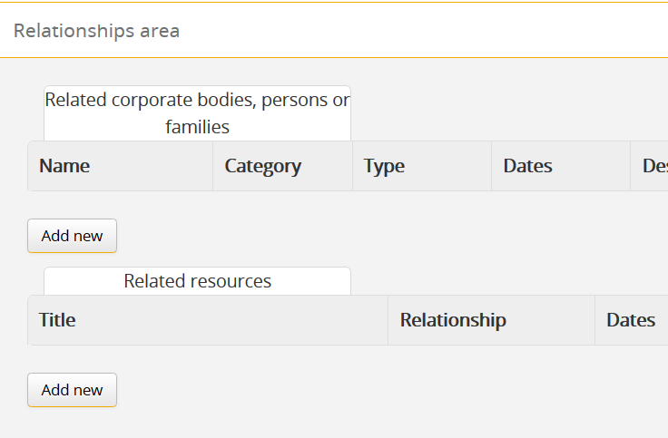
AUTHORITY RECORD

Slide 15
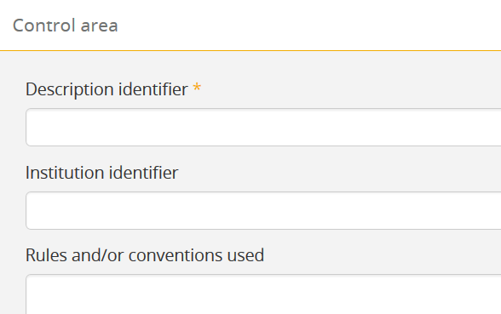
AUTHORITY RECORD

Slide 16
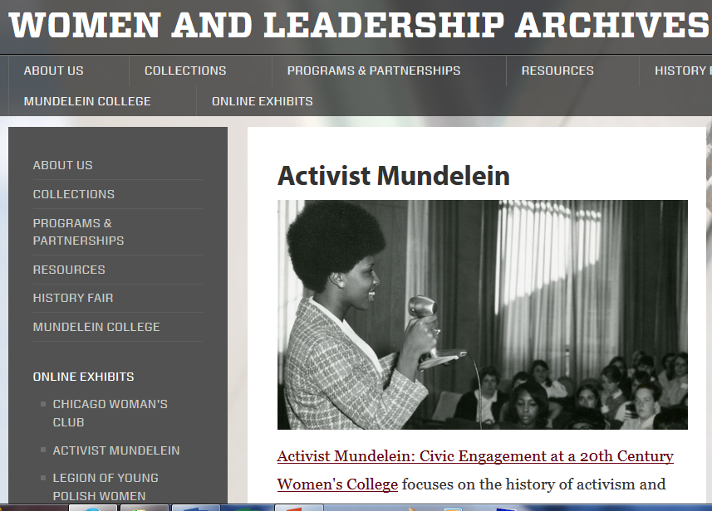
Notes:
Activist Mundelein online exhibit launched in fall 2013
Focus on social activism at Mundelein College from WWII to 1970
Legal restraints limited the exhibit to oral histories recorded in the 1990s
http://www.lib.luc.edu/specialcollections/exhibits/show/activist-mundelein--student-en

Slide 17
Freeman and Riter, p. 1
ACTIVIST MUNDELEIN EXHIBIT
“Significant aspects of judgment are required when creating an exhibit to make clear to online visitors the reasons for selection of certain records over others. Consultation with communities of interest helps to include diverse perspectives that in turn, inform actions and decisions regarding the exhibit.”

Slide 18
Freeman and Riter, p. 2
ACTIVIST MUNDELEIN EXHIBIT
“Negative reaction to the exhibit from several Mundelein alumnae resulted in closer examination of documents used and subsequent revision of parts of the exhibit.”
.

Slide 19
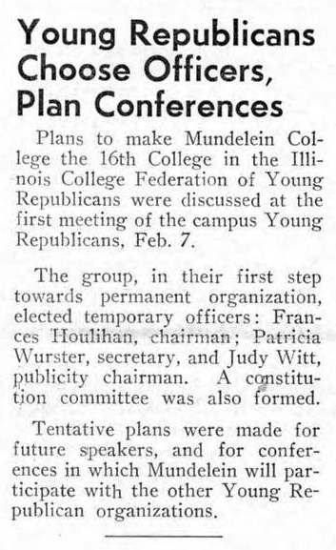
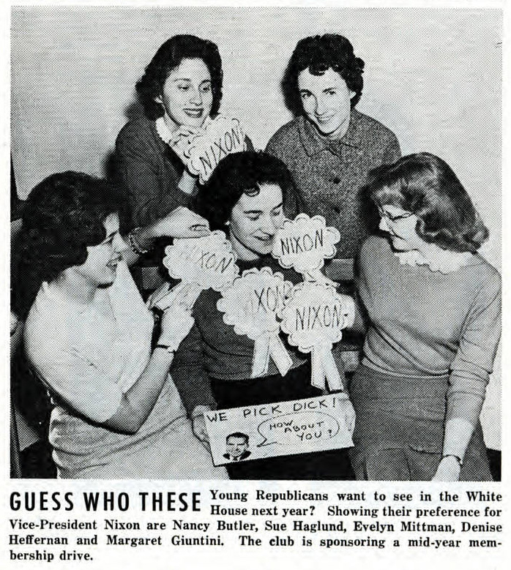
ACTIVIST MUNDELEIN EXHIBIT
Notes:
The exhibit highlighted activities of the Young Republicans on campus but did not include content about the Young Democrats on campus.
Freeman and Riter, p. 5: “The assumption was that viewers of the online exhibit would intuitively realize Mundelein was a liberal college and would thus be supportive to Young Democrats. Young Republicans, on the other hand, perhaps would have been unusual on campus.”

Slide 20
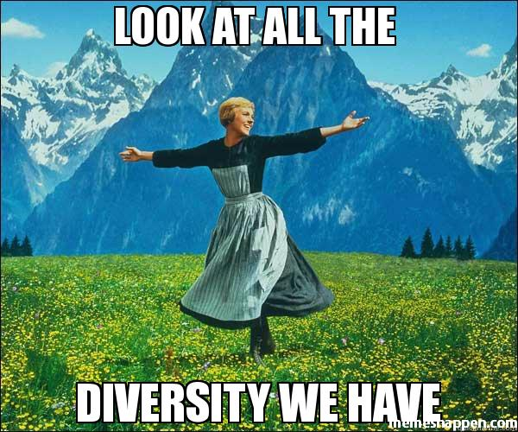
ACTIVIST MUNDELEIN EXHIBIT
.
Notes:
The exhibit was updated to include information on the Young Democrats.
Freeman and Riter, p. 6: “In the end, the online exhibit highlights both groups, showing all voices on Mundelein’s campus.”
Work to update the exhibit was completed by a volunteer.

Slide 21
ACTIVIST MUNDELEIN EXHIBIT
How do professional codes of ethics relate to programming and outreach activities?
Should the exhibit team have insisted on additional funding to “fix” the problem raised by alumnae?
.

Slide 22
ACTIVIST MUNDELEIN EXHIBIT
Are there other voices that the exhibit team should have considered?
How can archivists avoid assumptions when curating exhibits? Is there a risk in providing too much information about all of the “diverse perspectives” on a given topic?
.

Slide 23
SAA CODE OF ETHICS: JUDGEMENT
“ …Archivists should carefully document their collections-related decisions and activities to make their role in the selection, retention, or creation of the historical record transparent to their institutions, donors, and users. Archivists are encouraged to consult with colleagues, relevant professionals, and communities of interest to ensure that diverse perspectives inform their actions and decisions.”

Slide 24

Harris and Weller
SPECIAL COLLECTIONS OUTREACH
Outreach enhances the research, teaching, and service missions of academic institutions.
Notes:
Outreach: “proactive endeavors by special collections staff to increase awareness and use of their collections and the professional mission of special collections librarians and archivists, both within and outside the academy.”

Slide 25
SPECIAL COLLECTIONS OUTREACH
What are the “conflicting” roles of special collections departments?
What are some common outreach activities in the academic setting?
What are some less common outreach activities in the academic setting?
Notes:
Conflicting roles: Special collections departments are responsible for preserving collections *and* making them accessible to users.
Common activities: In-class instruction sessions and working with professors to highlight collections, creating finding aids, digitizing collections, LibGuides, social media etc.
Less common activities: Student orientation programs, having prominent exhibit spaces, using campus news media, hosting receptions, hosting talks and seminars, working with development officers, collaborating with other library departments.

Slide 26
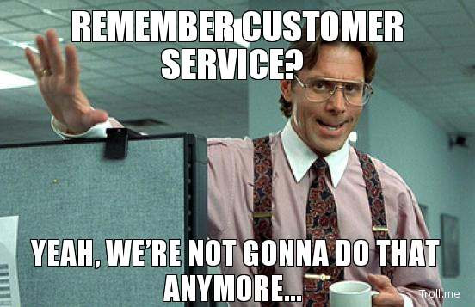
SPECIAL COLLECTIONS OUTREACH
Notes:
Harris and Weller: “Pleasant interactions with users are the most important tool special collections librarians have for making lasting connections and building collaborations.”

Slide 27
McCrea, Neilsen, and Foster
NWA MENTORING PROGRAM
Northwest Archives set up mentorship program in 2007
Program coordinator proved to be valuable
Pilot found that a structured, formal orientation would help
Relationships difficult to sustain
Notes:
In A Step-by-Step Guide to Designing an Effective Mentoring Program, Cohen stated that these questions must be answered before beginning a mentoring
program:
What are the primary goals of the program?
Who should be targeted as participants?
What are the objectives of the participants?
What criteria and procedures will be used to conduct the match?
What instruments and techniques will be used for assessment?

Slide 28
NWA MENTORING PROGRAM
Make sure you have the right “match”
Take the time to establish a “human relationship”
Face-to-face meetings are the best, but “e-mentoring” can succeed with the right tools (e.g., video chat)
Enable short-term “micro-mentoring” relationships

Slide 29
McKay
D.C. HARVEY’S LABORATORY FOR HISTORY
Notes:
McKay, page 155: “Seen from this perspective, Harvey’s career can be generally interpreted as one devoted to liberal public pedagogy – of imagining and instituting a liberal enlightenment for Nova Scotians. More specifically, it could be seen as one involving five steps:
the enunciation and defence of a new methodology of history, entailing the objective exploration of the past through the exhaustive critical study of its documents
The revelation through these methods of humanity’s social-evolutionary progress toward enlightenment, defined as the liberation of mind from superstition, intolerance, and the freedom-denying burdens of material life
The reconceptualization of Canadian history itself, now seen as centred on the emergence of a new sense of nationalism, one that allowed for the full flourishing of the local identities upon which it depended
The rethinking of the writing of local history, whose proper focus should be not on the accumulation of detail, but rather on illuminating the ways in which ordinary people had painstakingly evolved an enlightened democratic culture

Slide 30
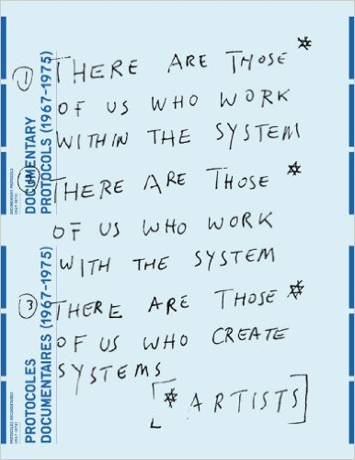
DOCUMENTARY PROTOCOLS

Slide 31
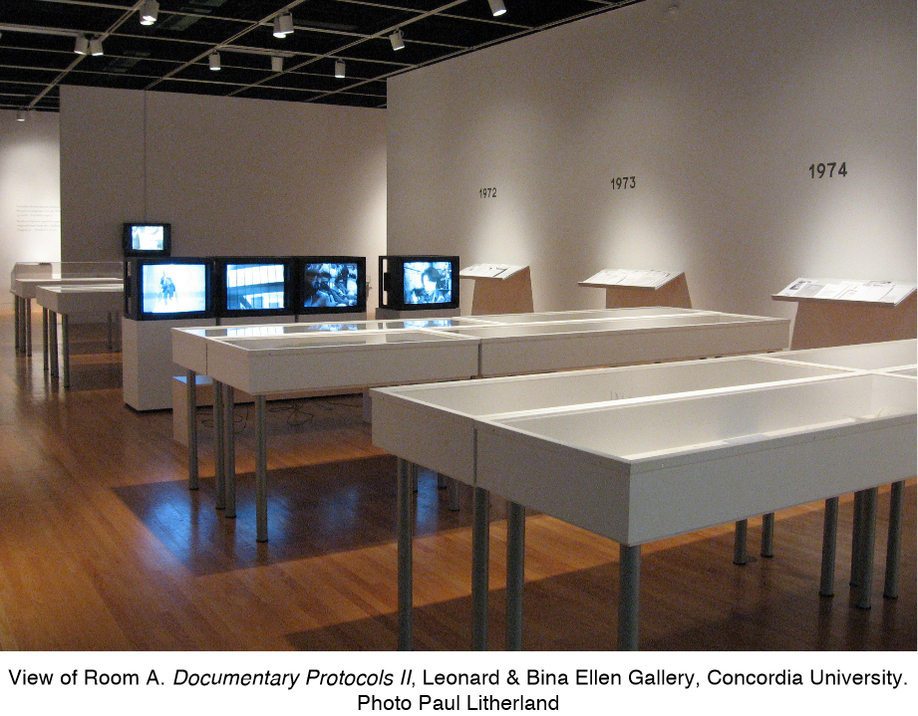
DOCUMENTARY PROTOCOLS
Notes:
Vincent Bonin’s Documentary Protocols essay, p. 22: “Bringing together documents stemming from various related fonds undermines a given archive's institutional ‘house arrest.’ Such an act creates a mediating structure which reassembles traces of varying provenance that are nonetheless linked to contiguous processes.”

Slide 32
READINGS
Freeman, Nancy and Robert B. Riter. “An Online Exhibit: A Tale of Triumph and Tribulation.” Case Studies in Archival Ethics, Case #1. Society of American Archives, May 2014. http://www2.archivists.org/sites/all/files/AnOnlineExhibit-SAA-CaseStudy_0.pdf.
Harris, Valerie A., and Ann C. Weller. "Use of Special Collections as an Opportunity for Outreach in the Academic Library." Journal Of Library Administration 52, no. 3/4 (April 2012): 294-303. DOI:10.1080/01930826.2012.684508.

Slide 33
READINGS
McCrea, Donna E., Nielsen, Elizabeth A. and Anne Foster. “The Northwest Archivists Mentoring Program: A Case Study.” The American Archivist 77, no. 2 (Fall/Winter 2014): 350-376. http://www.metapress.com.ezproxy.library.dal.ca/content/2458080u50422715/fulltext.pdf.
McKay, Ian. “Imagining a Liberal Enlightenment: D.C. Harvey and a “Laboratory for History” for Nova Scotia.” Journal of the Royal Nova Scotia Historical Society 16 (2013): 154–IX. http://ezproxy.library.dal.ca/login?url=http://search.proquest.com.ezproxy.library.dal.ca/docview/1444641683?accountid=10406.

Slide 34
IMAGES
Slides 17: Screenshot of the “Activiist Mundelein” Online Exhibit Landing Page: http://www.luc.edu/wla/onlineexhibits/activistmundelein/
Slide 18: “Young Republicans Choose Officers, Plan Conferences” clipping, Activist Mundelein online exhibit: http://www.lib.luc.edu/specialcollections/exhibits/show/activist-mundelein--student-en/item/1001
Slide 18: “Guess Who These” clipping, Activist Mundelein online exhibit: http://www.lib.luc.edu/specialcollections/exhibits/show/activist-mundelein--student-en/item/1014
Slide 20: “Look at all the Diversity We Have” image: http://memeshappen.com/meme/sound-of-music/look-at-all-the-diversity-we-have-7994

Slide 35
IMAGES
Slide 24: The More You Know clip: http://giphy.com/gifs/the-more-you-know-Y2nbrJyAR6RiM
Slide 26: “Remember Customer Service?” image: http://notalwaysright.com/not-gonna-do-that-any-more/33059
Slide 29: D.C. Harvey in his office, photograph found on o. 157 of Ian McKay’s article
Slide 30: Cover of Documentary Protocols by Vincent Bonin. http://e-artexte.ca/21720/
Slide 31: Photograph of Documentary Protocols II exhibition. Excerted from Exhibiting Research by Michele Thériault. http://ellengallery.concordia.ca/wp-content/uploads/2015/09/ExhibitingResearchTheriaultEN.pdf

