Slide 1
INFO 6850 Archives II
Week Nine
http://hdl.handle.net/10222/64568
GRANT WRITING

Slide 2
AGENDA
Announcements
Discuss finding aid assignment
Discuss readings
Grant writing exercise

Slide 3

Harrop et al
COMPETETIVE FUNDING
.

Slide 4

COMPETETIVE FUNDING
.

Slide 5
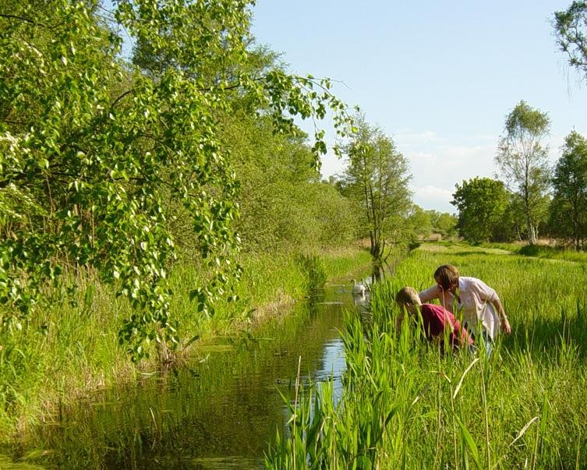

Slide 6
COMPETETIVE FUNDING
Investigation of the effects of “bidding culture” on local authority archives, libraries, and museums
  Literature review
  Survey of archives, libraries, and museums
  In-depth interviews

Slide 7
COMPETETIVE FUNDING
Archives are less involved than libraries and museums
Archives readily admit strong reliance on external funding
“Archives may be the least well-resourced of the three domains and may therefore face particular challenges in competing…”
Harrop et al, p. 38.

Slide 8
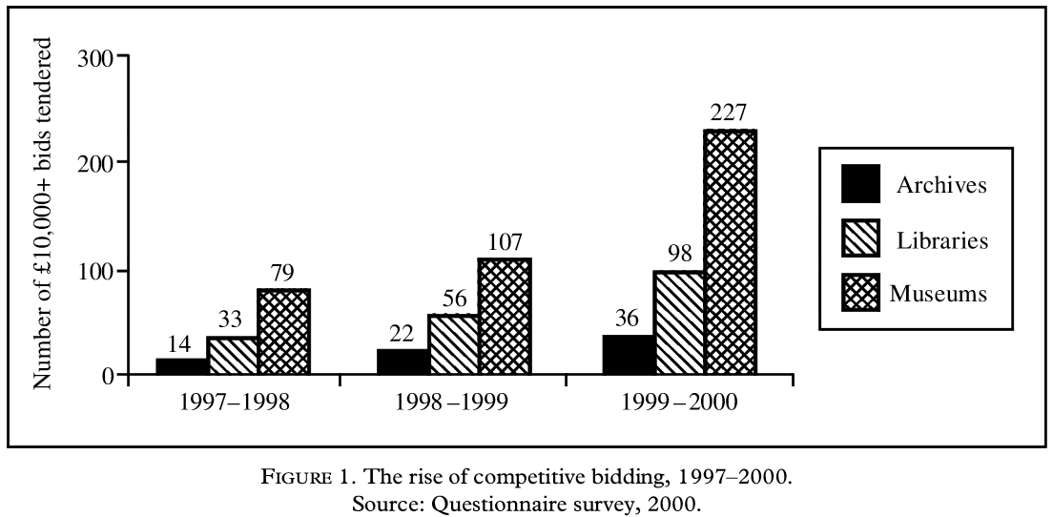
COMPETETIVE FUNDING
.

Slide 9
COMPETETIVE FUNDING
Catch-22: “Are resources to be redirected from essential frontline and already under-funded core activities in order to free up staff time to develop new proposals?”
Three areas to direct particular attention:
  The profession
  Policy and strategy
  Partnerships
Harrop et al, p. 39.

Slide 10

YOUNG CANADA WORKS

Slide 11
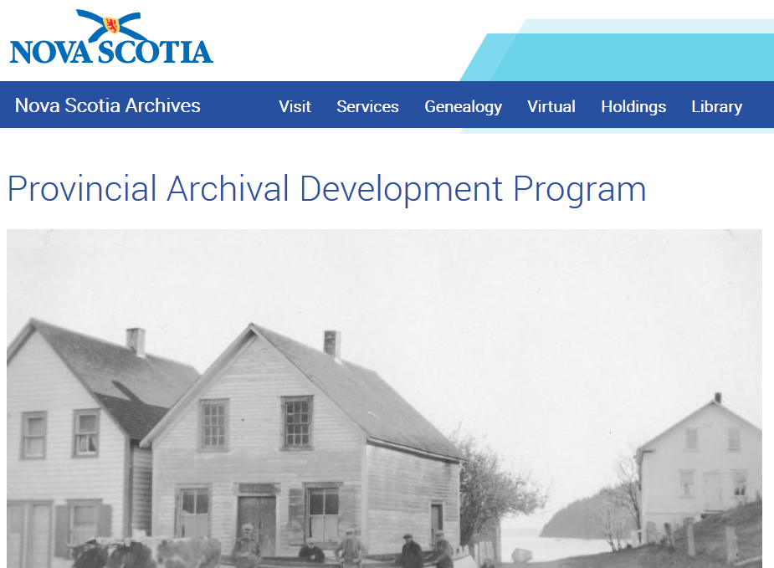
PROVINCIAL ARCHIVAL DEVELOPMENT PROGRAM

Slide 12
PADP ADJUDICATION CRITERIA
GENERAL ELIGIBILITY CRITERIA
PRIMARY OBJECTIVE OF PROJECT
RELEVANCE OF PROJECT

Slide 13
GRANT WRITING EXERCISE
George Myerhof
  One of Canada’s most distinguished geotechnical engineers
  Author of over 200 papers
  Best known for work on bearing capacity of foundations
  Son of Nobel Laureate
  21 metres of textual records
  Accessions 2002-022, 2010-022, 2012-022

Slide 14
READINGS
Harrop, Ken et al. “Bidding for Records: Local Authority Archives and Competitive Funding.” Journal of the Society of Archivists 23, no. 1 (2002): 35–50. http://dx.doi.org/10.1080/00379810220120546. http://www.tandfonline.com.ezproxy.library.dal.ca/doi/pdf/10.1080/00379810220120546.
Kraicer, Jacob. The Art of Grantsmanship (1997). http://www.hfsp.org/funding/art-grantsmanship.
Levine, S. Joseph. Guide for Writing a Funding Proposal (2014). http://learnerassociates.net/proposal/.

Slide 15
READINGS
Przeworski, Adam and Frank Salomon. On the Art of Writing Proposals. Social Science Research Council (1995 rev., 1988). http://www.ssrc.org/publications/view/7A9CB4F4-815F-DE11-BD80-001CC477EC70/.
Canadian Heritage. About Young Canada Works (2014). http://www.pch.gc.ca/eng/1358260464627/1358260720464.
Nova Scotia Communities, Culture, and Heritage. Provincial Archival Development Program (2015). http://novascotia.ca/archives/padp/

Slide 16
IMAGES
Slide 3: Heritage Lottery Fund logo. http://www.gsm.cam.ac.uk/heritage-lottery-funding-education/.
Slide 4: Screenshot of Leicester LGBT Oral History Project Website: http://www.lgbt-stories.org/
Slide 5: Image of two people exploring the Great Fen’s rivers and grasslands. http://www.hlf.org.uk/our-projects/restoring-our-fenland-heritage-purchase-and-restoration-holmewood-estate

Slide 17
IMAGES
Slide 8: Competitive bidding figure: Harrop, Ken et al. “Bidding for Records: Local Authority Archives and Competitive Funding.” Journal of the Society of Archivists 23, no. 1 (2002): 35–50 (p. 38).
Slide 10: Young Canada Works logo. https://www.youngcanadaworks.ca/index-eng.cfm.
Slide 11: Screenshot of Provincial Archival Development Program website. http://archives.novascotia.ca/padp.

