Slide 1
INFO 6850 Archives II
Week One
http://hdl.handle.net/10222/63746
INTRODUCTION
Pick up worksheet as you enter class and write down answer to “Why do you want to work in an archives?” question…

Slide 2
“The primary duty of archivists is to maintain the integrity of the records in their care and custody. In the accomplishment of this duty they must have regard to the legitimate, but sometimes conflicting, rights and interests of employers, owners, data subjects and users, past, present and future.”
- International Council on Archives Code of Ethics, 1996
Notes:
http://www.ica.org/5555/reference-documents/ica-code-of-ethics.html

Slide 3
AGENDA
Introductions
Overview of course
Review “core functions”
Introduce types of documents created by archivists

Slide 4
INTRODUCTIONS
Your preferred name in class
Tell us about something you have with you
Give your answer to “Why do you want to work in an archives?” question
Hand in your worksheet (so I can save it for later!)

Slide 5
OVERVIEW OF COURSE
Brand new “special topics” course
Will (hopefully) be offered as regular course next year
Trying out new content / teaching methods
Feedback is strongly encouraged! (instructor rating + curriculum committee)

Slide 6
COURSE DESCRIPTION
This course will consider advanced topics in archives, with an emphasis on Canadian practice. It will provide an overview of the management of archives by closely examining topics including donor relations, archival and monetary appraisal, multi-level archival description, project management, and public service.

Slide 7
COURSE GOAL
The goal of this course is to introduce students to advanced topics in archival theory and practice, including collections management, donor relations, multi-level description, grant writing and budgeting, and the information technology used in archival settings.

Slide 8
REVIEW SYLLABUS
Learning outcomes
Assignments
Course schedule
Readings
Any questions?

Slide 9
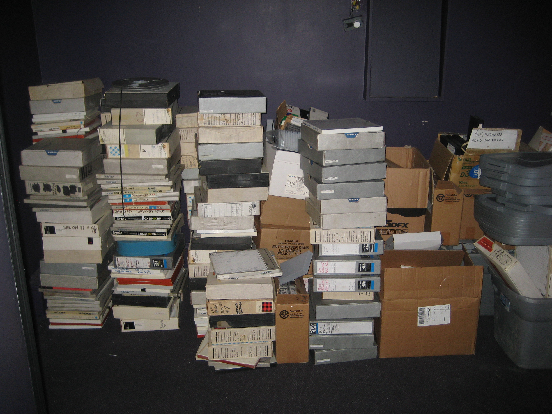
ACQUISITIONS
Sound recordings found in the attic of Solar Audio Recording Studio, Cunard Street, Halifax, Nova Scotia, May 2, 2012

Slide 10
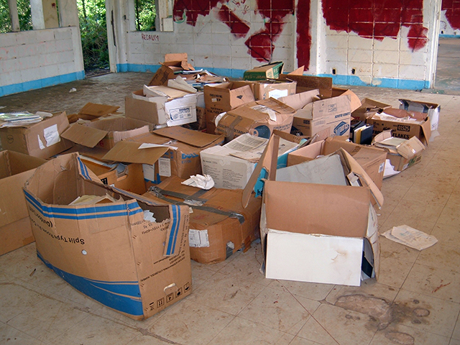
ACCESSIONING
Records in the school building behind the Archives Office in Airai, Palau, June 24-July 4, 2013

Slide 11
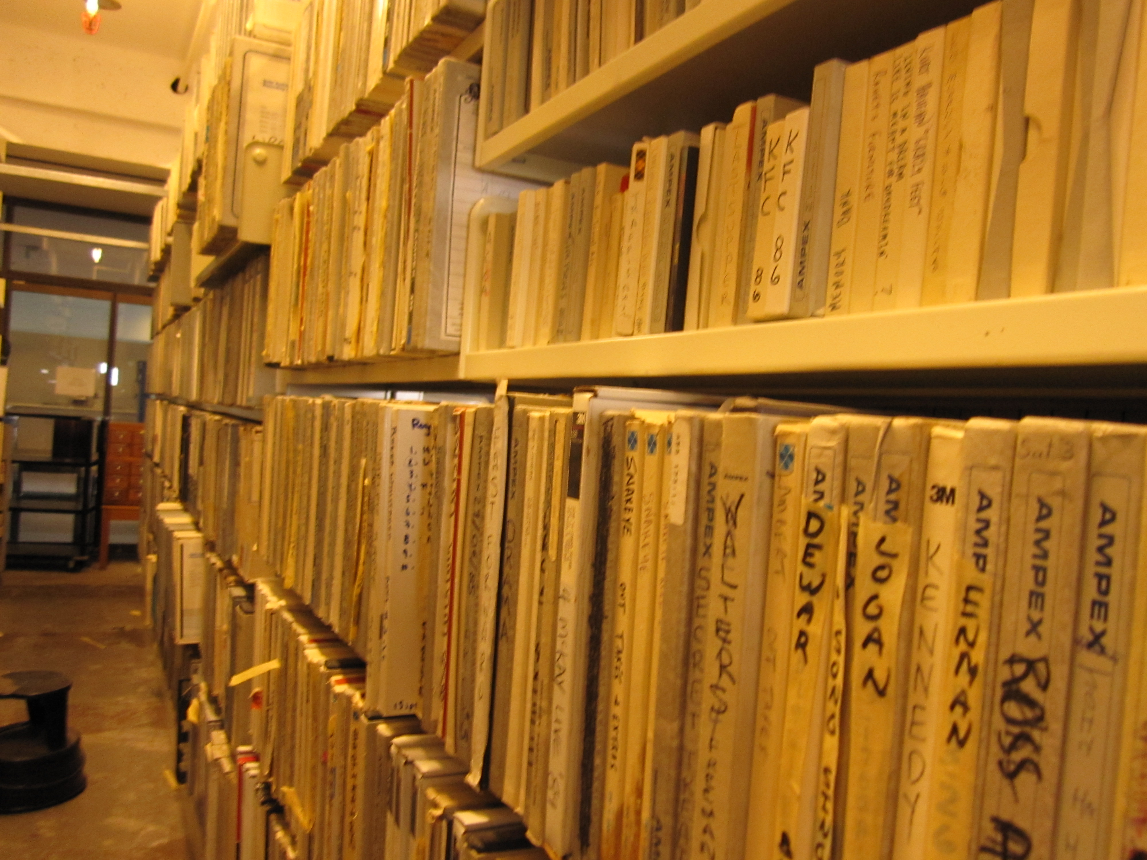
ARRANGEMENT
Sorting the Solar Audio Recording Studio Collection at the Dalhousie University Archives, May 14, 2012

Slide 12
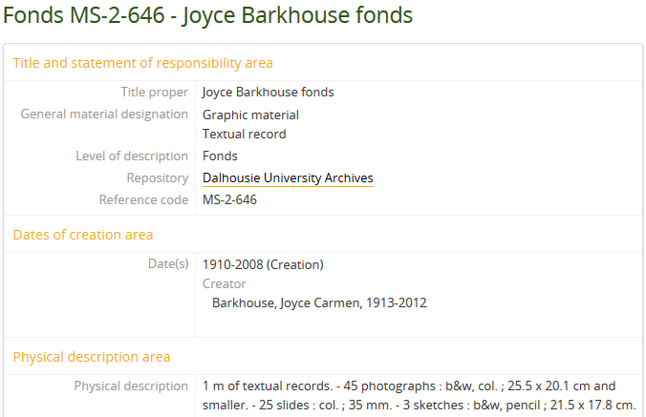
ARCHIVAL DESCRIPTION
Finding aid created using the Canadian Rules for Archival Description

Slide 13
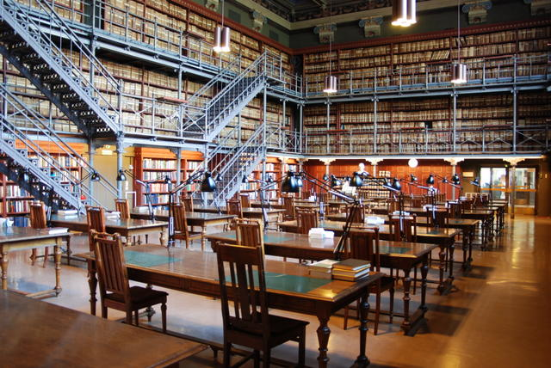
ACCESS
Old reading room of the National Archives of Finland
Notes:
Source: https://commons.wikimedia.org/wiki/File:Old_reading_room_of_the_National_Archives_of_Finland.png

Slide 14
NEW TOPICS
Monetary appraisal
Grant writing
Grant project management
Rights management

Slide 15
WHAT ARE SOME OF THE DOCUMENTS PRODUCED DURING ARCHIVAL PRACTICE?
WHAT ARE SOME OF THE STYLES OF WRITING USED BY ARCHIVISTS?

Slide 16
DOCUMENTS
Donation agreements
Accession records
Archival appraisal reports
Monetary appraisal reports
Cultural property applications

Slide 17
DOCUMENTS
Archival descriptions
Conservation reports, collection assessment reports, etc.
Deaccession record, transfer agreement, etc.
Correspondence

Slide 18
DOCUMENTS
Training manuals
Policy and procedure documents
Annual reports
Job descriptions

Slide 19
IMAGE SOURCES
Records in the school building behind the Archives Office in Airai, Palau, June 24-July 4, 2013. Palau Survey Analysis of Records Project. International Council on Archives, Pacific Regional Branch. http://www.parbica.org/news/xmas-reading/palau-report.aspx.

Slide 20
IMAGE SOURCES
Old reading room of the National Archives of Finland. National Archives of Finland, July 20, 2012. https://commons.wikimedia.org/wiki/File:Old_reading_room_of_the_National_Archives_of_Finland.png.

