Slide 1
ASSC 1200 / HIST 1900
Raiders of the Lost Archives
USING THE DALHOUSIE UNIVERSITY ARCHIVES
Creighton Barrett
Download presentation: http://hdl.handle.net/10222/63582

Slide 2
AGENDA
Introduction to Dalhousie Libraries
Introduction to Dalhousie University Archives
Online Research Tools
Archives Catalogue and Online Collections Demo

Slide 3
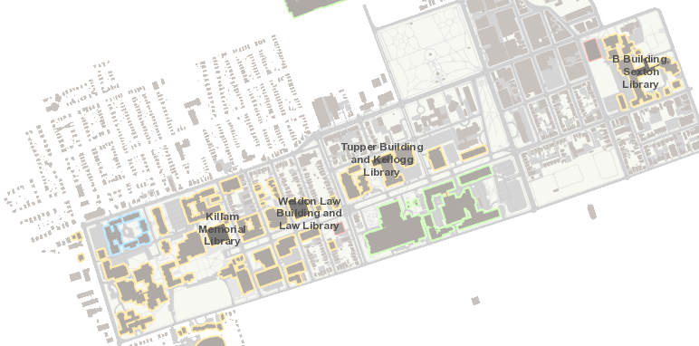
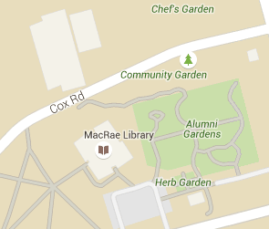
DALHOUSIE LIBRARIES

Slide 4
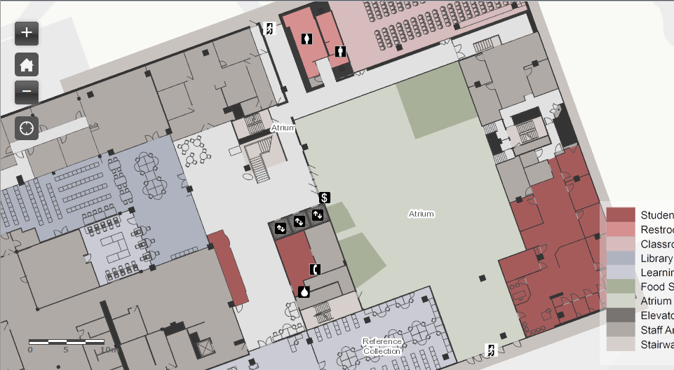
KILLAM MEMORIAL LIBRARY

Slide 5
YOUR FALL TERM “TO DO” LIST
Register your DalCard with the Libraries
Come study in the Archives and Special Collections Reading Room in the Killam Memorial Library
Use the Archives Catalogue to find a primary source
Check out the online Subject Guides

Slide 6
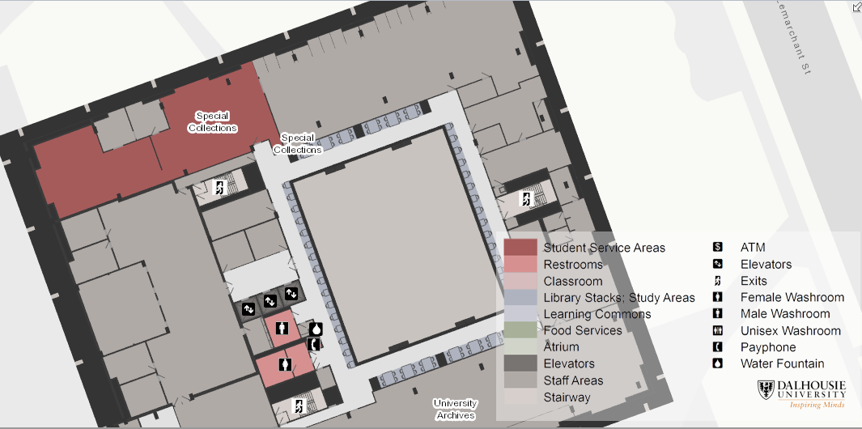
UNIVERSITY ARCHIVES

Slide 7
UNIVERSITY ARCHIVES
Reference desk and reading room on 5th floor of Killam Memorial Library
Stacks are “closed” and staff must retrieve material for you
Archival material does not circulate
Open Monday-Friday 11:00 a.m. – 5:00 p.m.

Slide 8
ARCHIVAL MATERIAL
Types of records
  Text (papyrus, parchment, pulp, etc.)
  Sound recordings (vinyl, cassette, etc.)
  Moving images (film, video, etc.)
  Still images (tintype, print, negative, etc.)
  Maps
  Technical drawings
  Research data
Advanced notice may be required
Surrogates or alternative sources may be provided

Slide 9
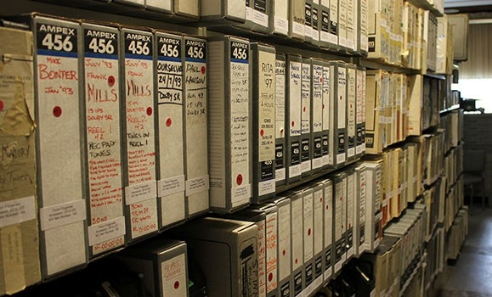
SOUND RECORDINGS

Slide 10
ONLINE RESEARCH TOOLS AT THE UNIVERSITY ARCHIVES
Guide to Major Research Collections
Guide to Archival Research
History of Dalhousie University
“Raiders of the Lost Archives” Guide

Slide 11
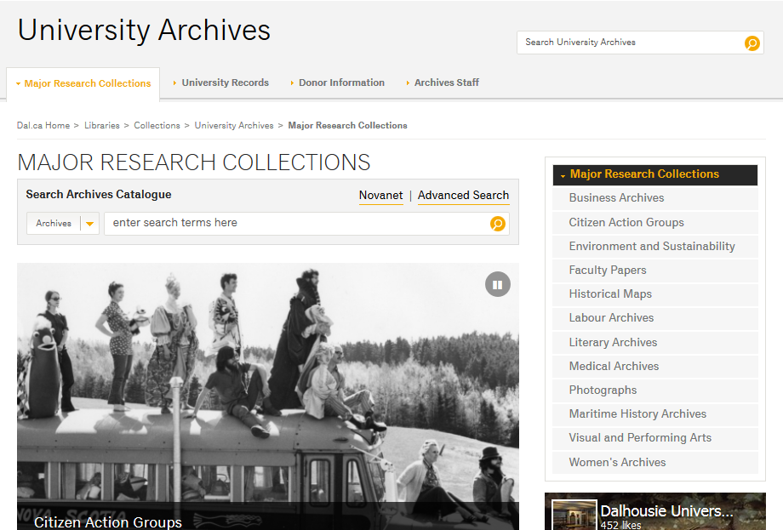

Slide 12
DEFINITIONS
Fonds: The entire body of records of an organization, family, or individual that have been created and accumulated in the course of that creator’s functions or activities.
Collection: A grouping of documents of any provenance intentionally assembled on the basis of some common characteristic.

Slide 13
DEFINITIONS
Provenance: The person(s), family (families) or corporate body (bodies) that created and/or accumulated and used records in the conduct of personal or business life.
Reference code: the unique identifier used to request archival material. Reference codes are assigned based on provenance.

Slide 14
FINDING AIDS
Archives create “finding aids” for each fonds or collection
Dalhousie finding aids are fully searchable online
The level of detail varies widely
Some finding aids contain “embedded” digitized material

Slide 15
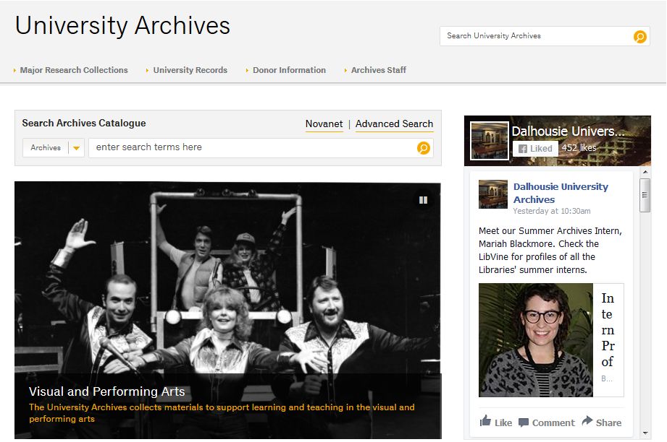

Slide 16
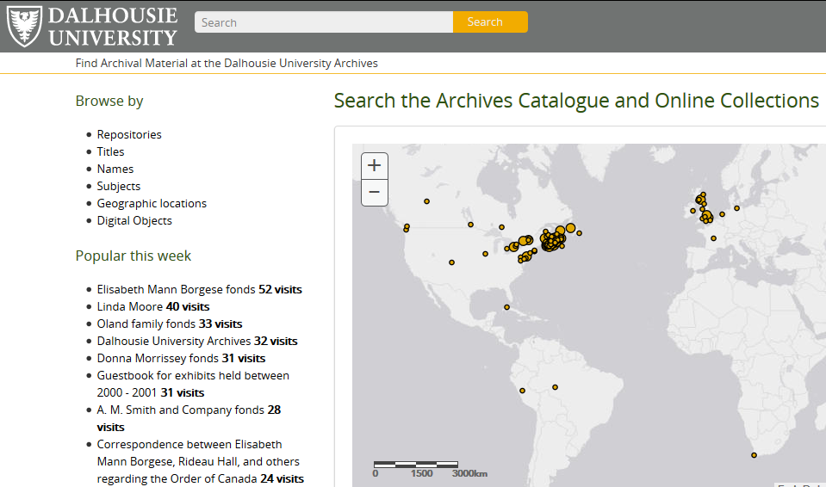

Slide 17
BROAD
CONCEPTS IN YOUR
RESEARCH QUESTION
Example: Did landlocked states influence the Exclusive Economic Zones established by the UN “Law of the Sea”?
 | CONCEPT 1 | CONCEPT 2 | CONCEPT 3
Keyword
Keyword
Keyword
Keyword
Keyword
Keyword

Slide 18
NARROW
CONCEPTS IN YOUR
RESEARCH QUESTION
Example: Does the Dalhousie University Archives have any records on Burlington, Ontario?
 | CONCEPT 1 | CONCEPT 2 | CONCEPT 3
Keyword
Keyword
Keyword
Keyword
Keyword
Keyword

Slide 19
CONTACT US!
Dalhousie University Archives
5th Floor, Killam Memorial Library
6225 University Avenue
PO Box 15000
Dalhousie University
Halifax, Nova Scotia
Canada B3H 4R2
Monday - Friday: 11:00 a.m. to 5:00 p.m.
Email: archives@dal.ca
Reference Desk: (902) 494-3615

