Slide 1
July 14, 2015 - IOI Training Programme Presented by Creighton Barrett
ELISABETH MANN BORGESE ARCHIVES

Slide 2
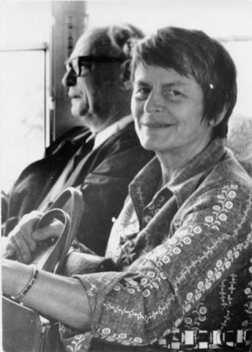
AGENDA
Overview of EMB archives
Digitization project
Demonstration of Archives catalogue
Catalogue search exercise
Brief discussion of EMB digital archives
Photograph of Elisabeth Mann Borgese and Arvid Pardo, MS-2-744, Box 237, Folder 29, Item 10

Slide 3
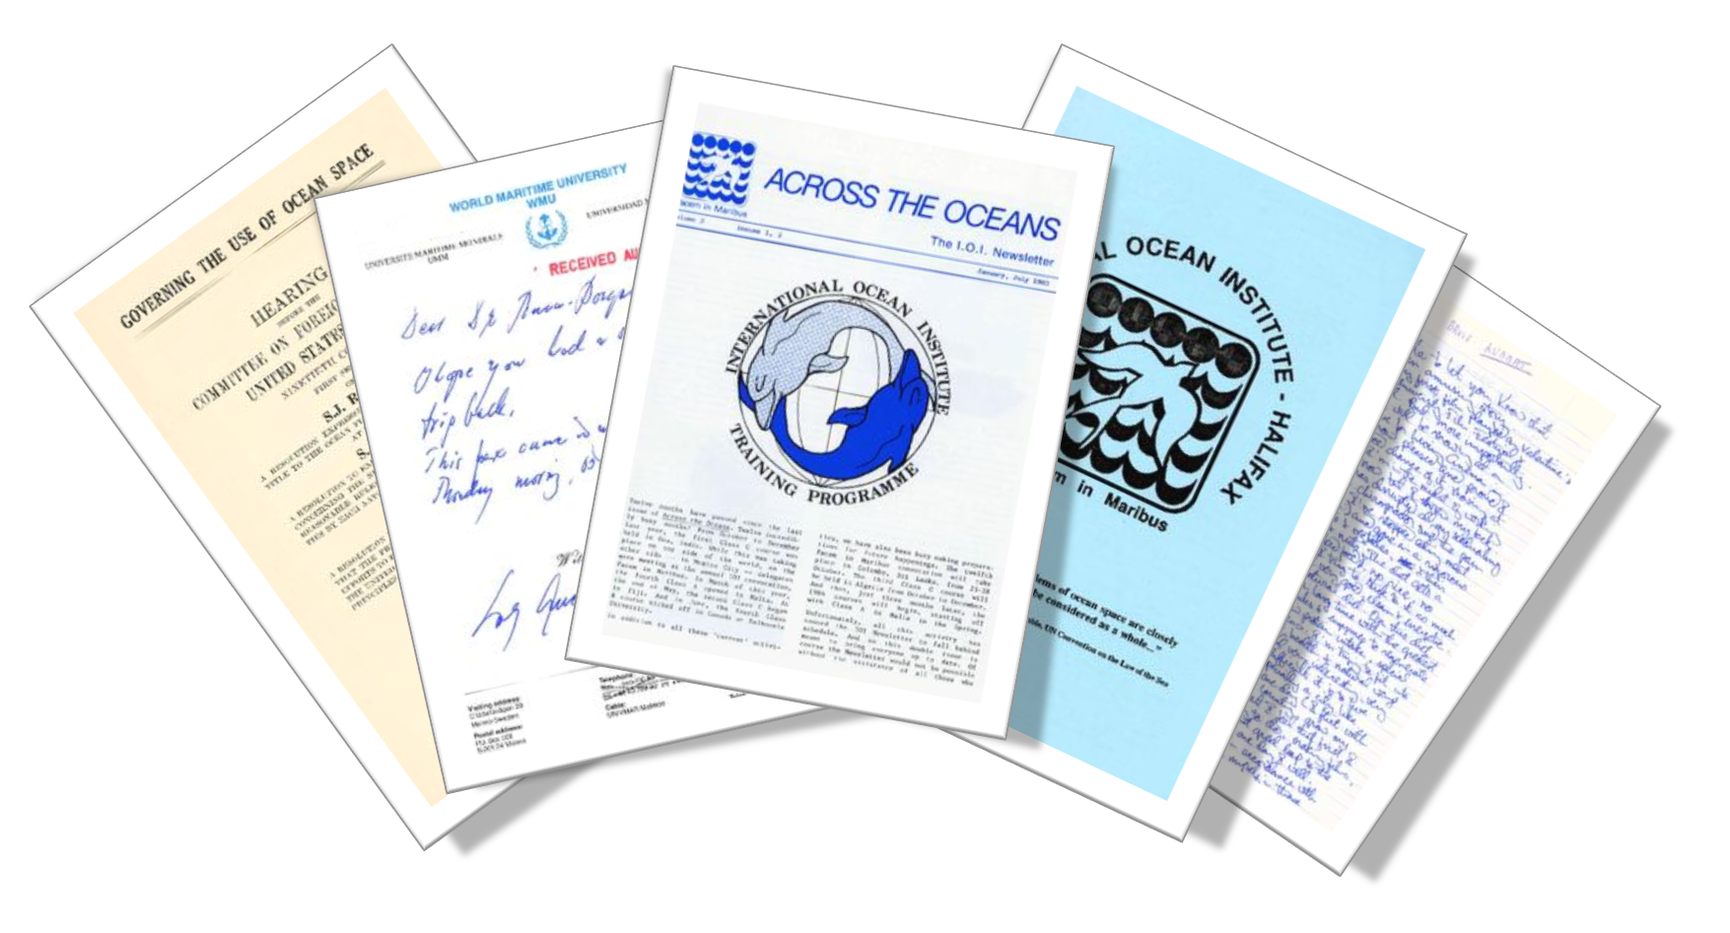
OVERVIEW OF EMB ARCHIVES

Slide 4
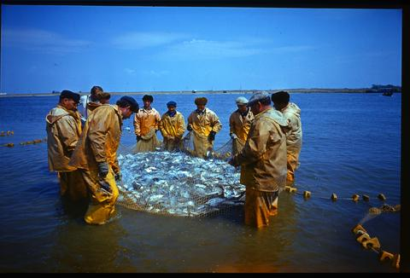
EMB ARCHIVES
370 boxes (55.5 metres)
Textual records, sound recordings, moving images, photographs, maps, etc.
Created between 1938-2002 (predominantly 1969-2001)
Photo negative of fisherman in Volga River , MS-2-744, Box 178, Folder 20, Item 6

Slide 5
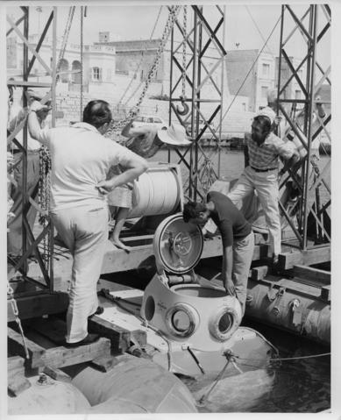
EMB ARCHIVES
UNCLoS III
International Centre for Ocean Development
International Ocean Institute
University of Chicago
Dalhousie University
Personal archives
Club of Rome
Pacem in Maribus
Photograph from Pacem in Maribus II, MS-2-744, Box 169, Folder 28, Item 13

Slide 6
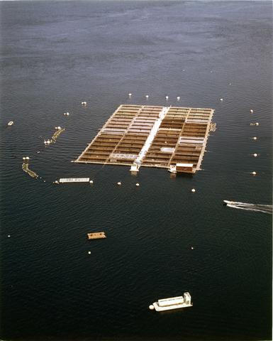
DIGITIZATION
Selected materials from various “series” of records in collection
20.75 metres digitized
126,443 pages of textual records and 700 photographs
All sound recordings and moving images
Photograph of a fish farm , MS-2-744, Box 178, Folder 5, Item 3

Slide 7
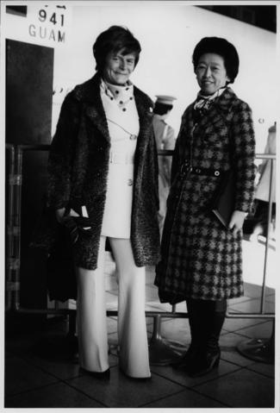
DIGITIZATION
Digitization standards
Digitization “workflow”
Extensive documentation
Rights management activities
Improvements to archival descriptions
Development of “custom” PDF script
Photograph of Elisabeth Mann Borgese and a woman in Japan , MS-2-744, Box 169, Folder 30, Item 2

Slide 8
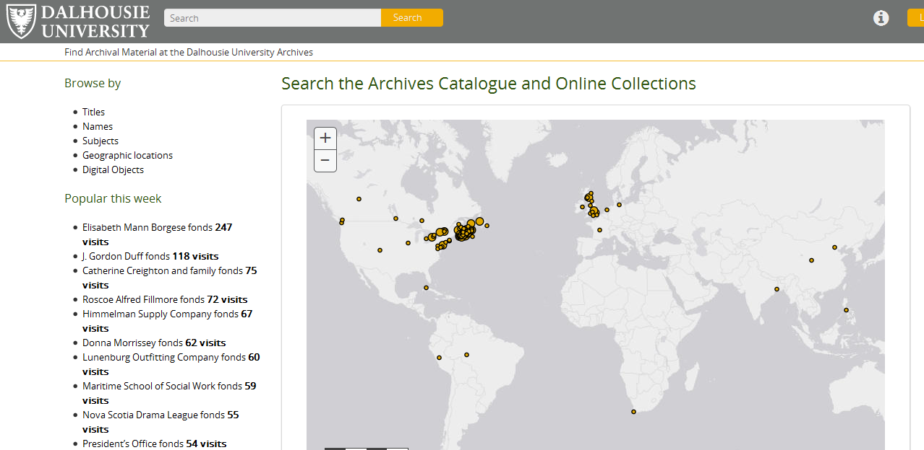
DEMONSTRATION OF
ARCHIVES CATALOGUE

Slide 9
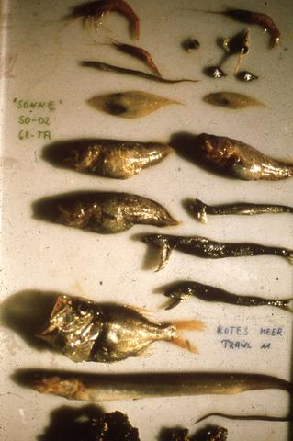
ARCHIVES CATALOGUE LINKS
EMB archives finding aid
Browse EMB digital archives
Search help
Browse help
Guide to archival research
Slide depicting sea life, deceased , MS-2-744, Box 371, Folder 5, Item 143

Slide 10
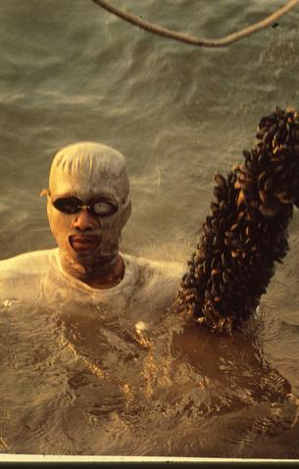
EMB CATALOGUE EXERCISE
Write down research question
Identify concepts in research question
Identify keywords associated with each concept
Search catalogue
Slide depicting mussel farming, MS-2-744, Box 371, Folder 5, Item 126

Slide 11
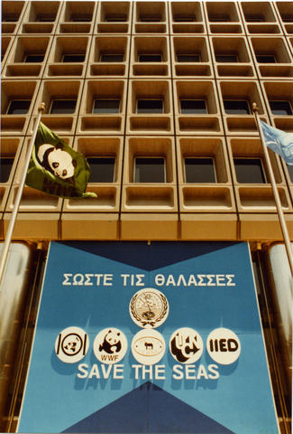
DISCUSSION
How would you use the EMB Archives?
Are there other digital archives of interest to you?
How can we improve the EMB Archives?
What can you do to ensure your work is archived?
Photograph from a Hellenic Marine Environment Protection Association (HELMEPA) event , MS-2-744, Box 237, Folder 53, Item 27

