Slide 1


Vegu Shree Rama Kamal Kumar
Visual Analysis of Oceanic Multivariate Species
Time-Series Data
Program: MSc in Computer Science (Thesis)
Supervisor: Dr. Stephen Brooks

Slide 2
Contents
Goal and Research Questions
Data Mining (Predictive and Descriptive)
Sequential Pattern Mining (Closed and Maximal)
Sequential Rule Mining
SPMF’s VMSP and TRule Growth Algorithms
Support and Minimum Gap in Sequential Mining
Related Work
High Level Architecture
Visualization of Sharks and Fishes based on Detections
Visualization of Sharks and Fishes based on Mining Algorithms through Patterns and Rules
Feedback and Reviews
Conclusion

Slide 3
Goal
Provide a data visualization dashboard which allows users to interactively analyze sequential movement patterns and rules of sharks and fishes.
Major Research Questions
How can we make time-series data representations simpler while preserving and retrieving the authenticity?
Does the visualization of pattern mining results on fish movements provide more insights to users than their current means of analysis?

Slide 4
Data Mining (Predictive and Descriptive)
Data mining is the process of discovering patterns, trends, and insights from large data sets.
Predictive Data Mining
Predictive data mining involves using algorithms and statistical models to make predictions about future events based on historical data.
These models can be used for tasks such as predicting customer churn, identifying fraudulent transactions, and forecasting demand for products or services.
Common algorithms used in predictive data mining include logistic regression, decision trees, random forests, and neural networks.
Descriptive Data Mining
Descriptive data mining is used to identify patterns and relationships in data sets that can provide insights into past events or behaviors.
These insights can be used to inform decision-making, identify trends, or detect anomalies.
Common descriptive data mining techniques include clustering, association rule mining, and sequence pattern mining and its analysis.

Slide 5
Support and Minimum Gap in Sequential Mining
Support
Frequency of occurrence of a particular sequence or pattern in a dataset.
High support values indicate that the pattern is a common occurrence in the dataset and may be considered significant.
Example: In a dataset of customer purchases, a pattern of customers buying milk and bread together has a high support value because it occurs frequently.
Minimum Gap
The concept of a minimum gap was incorporated as a parameter into the pattern analysis algorithm.
The minimum gap was set to zero, which means only direct patterns were included.
Direct patterns are those where the marine animal is detected at two consecutive locations.
Filtering through Support and Minimum Gap
Support and minimum gap are used to filter out patterns and rules that are not significant or relevant to the analysis.
By setting appropriate values for these parameters, the expert can focus on identifying the most important and informative patterns and rules in the data.

Slide 6
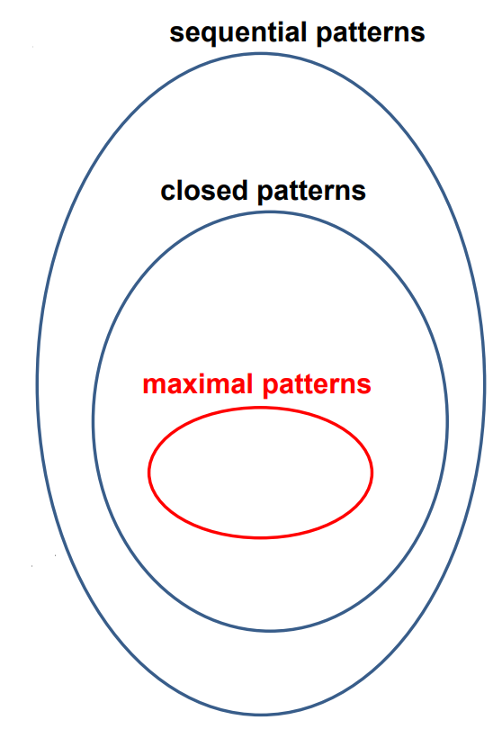
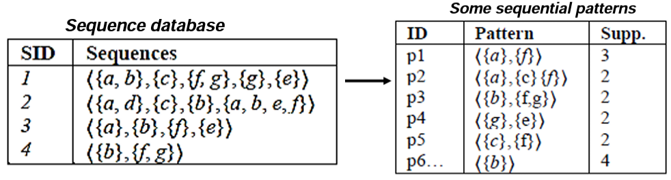
Sequential Pattern Mining (Closed and Maximal)
Sequential pattern mining is a data mining technique used to discover frequently occurring sequences of events or items in a dataset. This technique can be applied in a variety of domains, such as web usage mining, retail analysis, biological sequence, and time-series analysis.
Closed Sequential Patterns
Patterns that are not included in another pattern having the same support.
Identifies all closed sequential patterns in a dataset and their support.
Broad View of Sequential Patterns
Maximal Sequential Patterns
Patterns that are not included in another pattern.
They are lossless with an extra database scan and generally much smaller than closed patterns.
Used SPMF’s (Vertical Mining Sequential Patterns) VMSP Algorithm for generating patterns
Sequential Pattern Mining

Slide 7
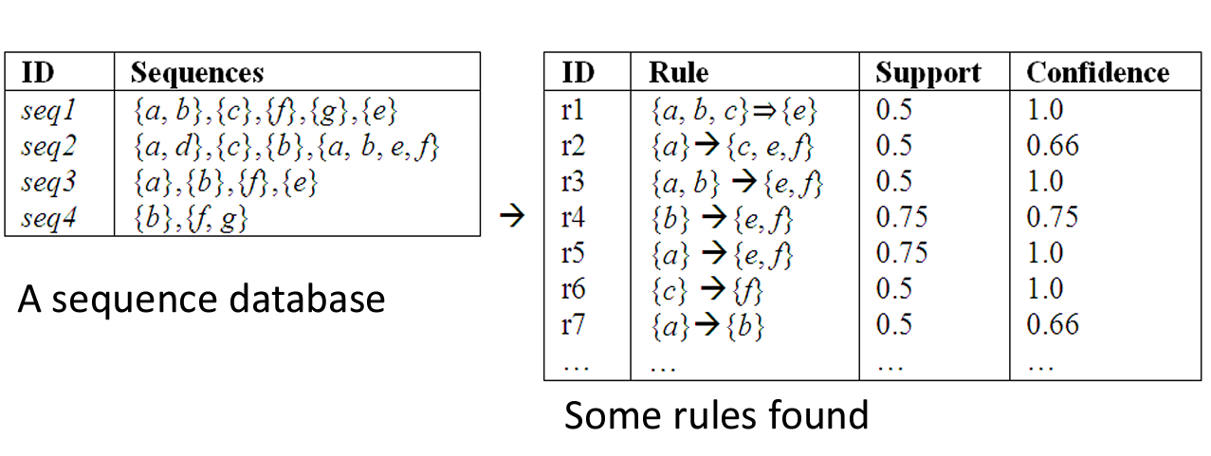
Sequential Rule Mining
Sequential rule mining is a data mining technique that identifies rules and relationships among sequential data.
It involves discovering frequent set of events or items that occur together in a specific order.
Here a sequential rule X⇒Y is a relationship between two stations or regions, such that if a shark is found at location X, the probability of it finding at location Y.
Used SPMF’s T-Rule Growth Algorithm for generating rules

Slide 8
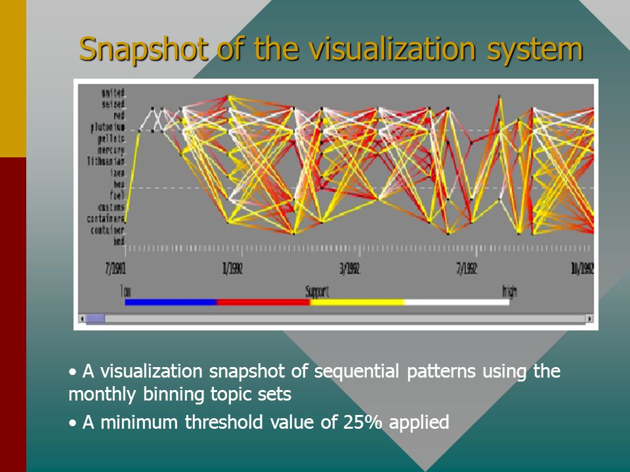
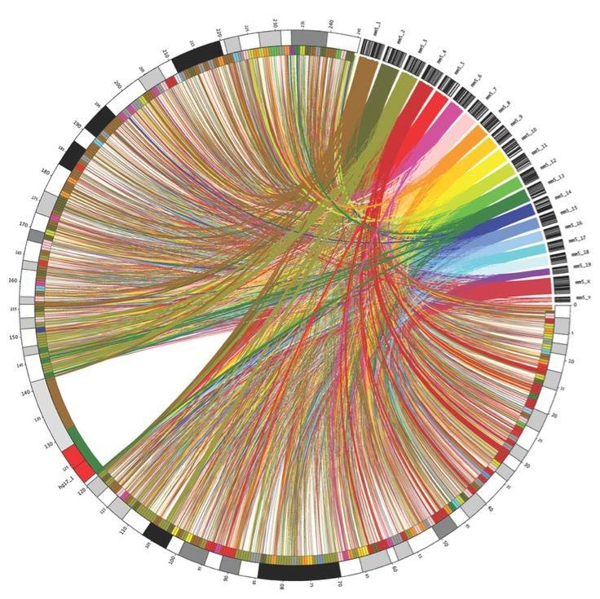
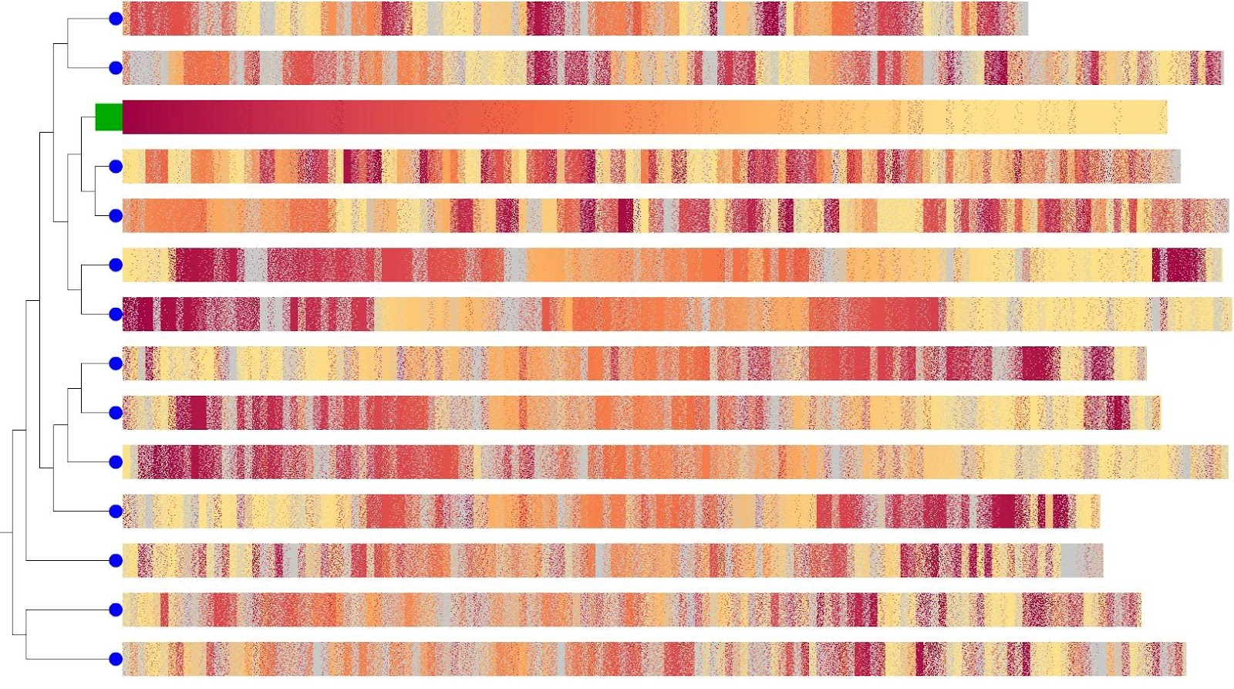
Related Work – Sequential Pattern Visualizations
Snapshot of Sequential Patterns using monthly binning topic sets
[1]
A visualization of chromosomal relationships within one genome. [2]
Genome sequence alignment visualization [2]

Slide 9
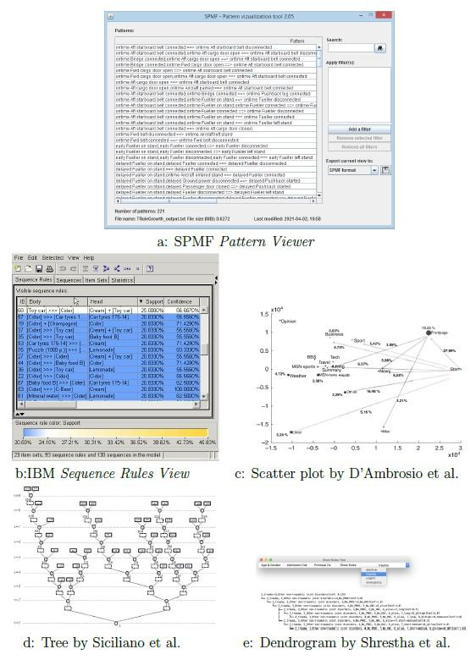
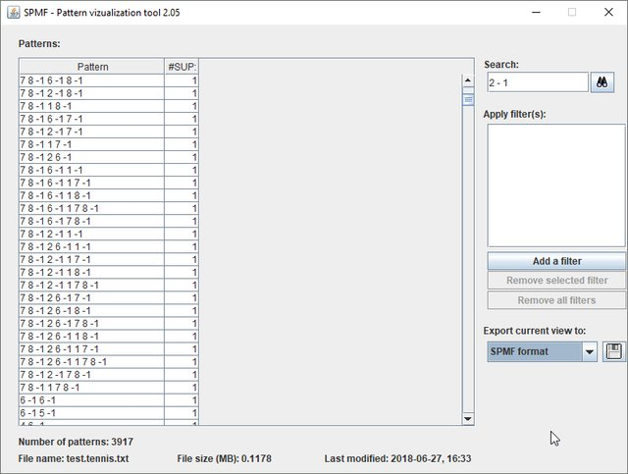
Related Work – Sequential Rule Visualizations
IBM Sequence Rules View [3]
SPMF Rule Viewer [6]
Scatter Plot by D'Ambrosio et al.
[4]

Slide 10
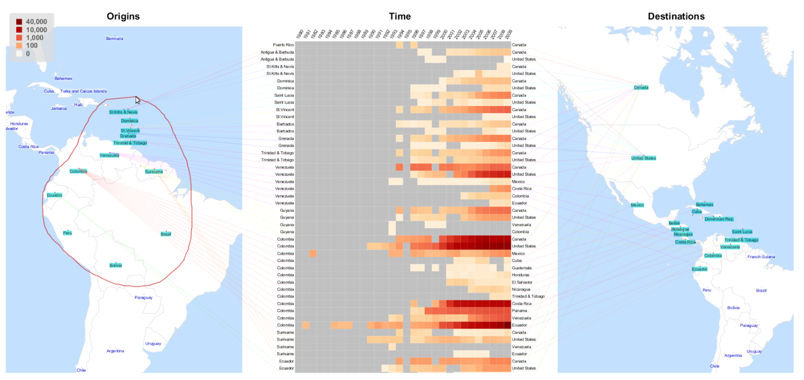
Related Work – Visualizations through Time Filter and Zone Reduction – Origin Destination Scenario
Selecting origins using lasso: When a selection is made, the heatmap is updated, so that only the flows between the selected origins and destinations are displayed.
[5]

Slide 11
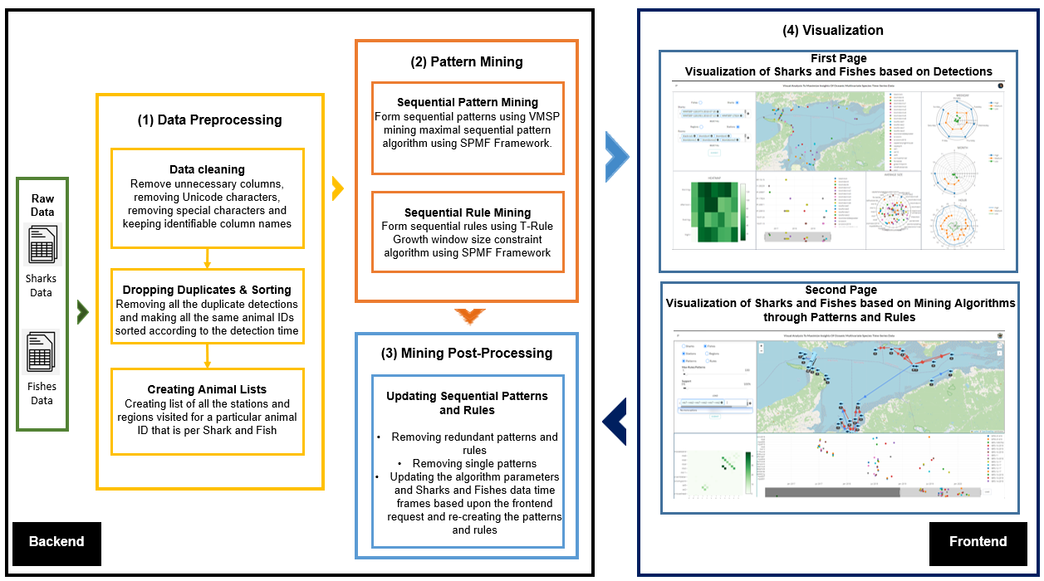
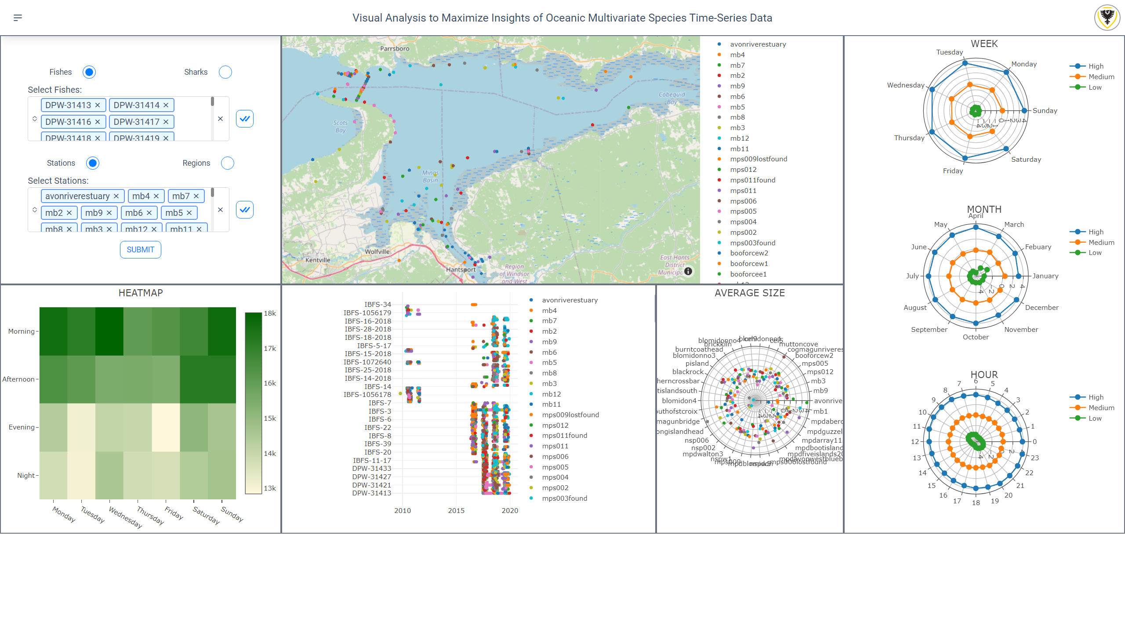
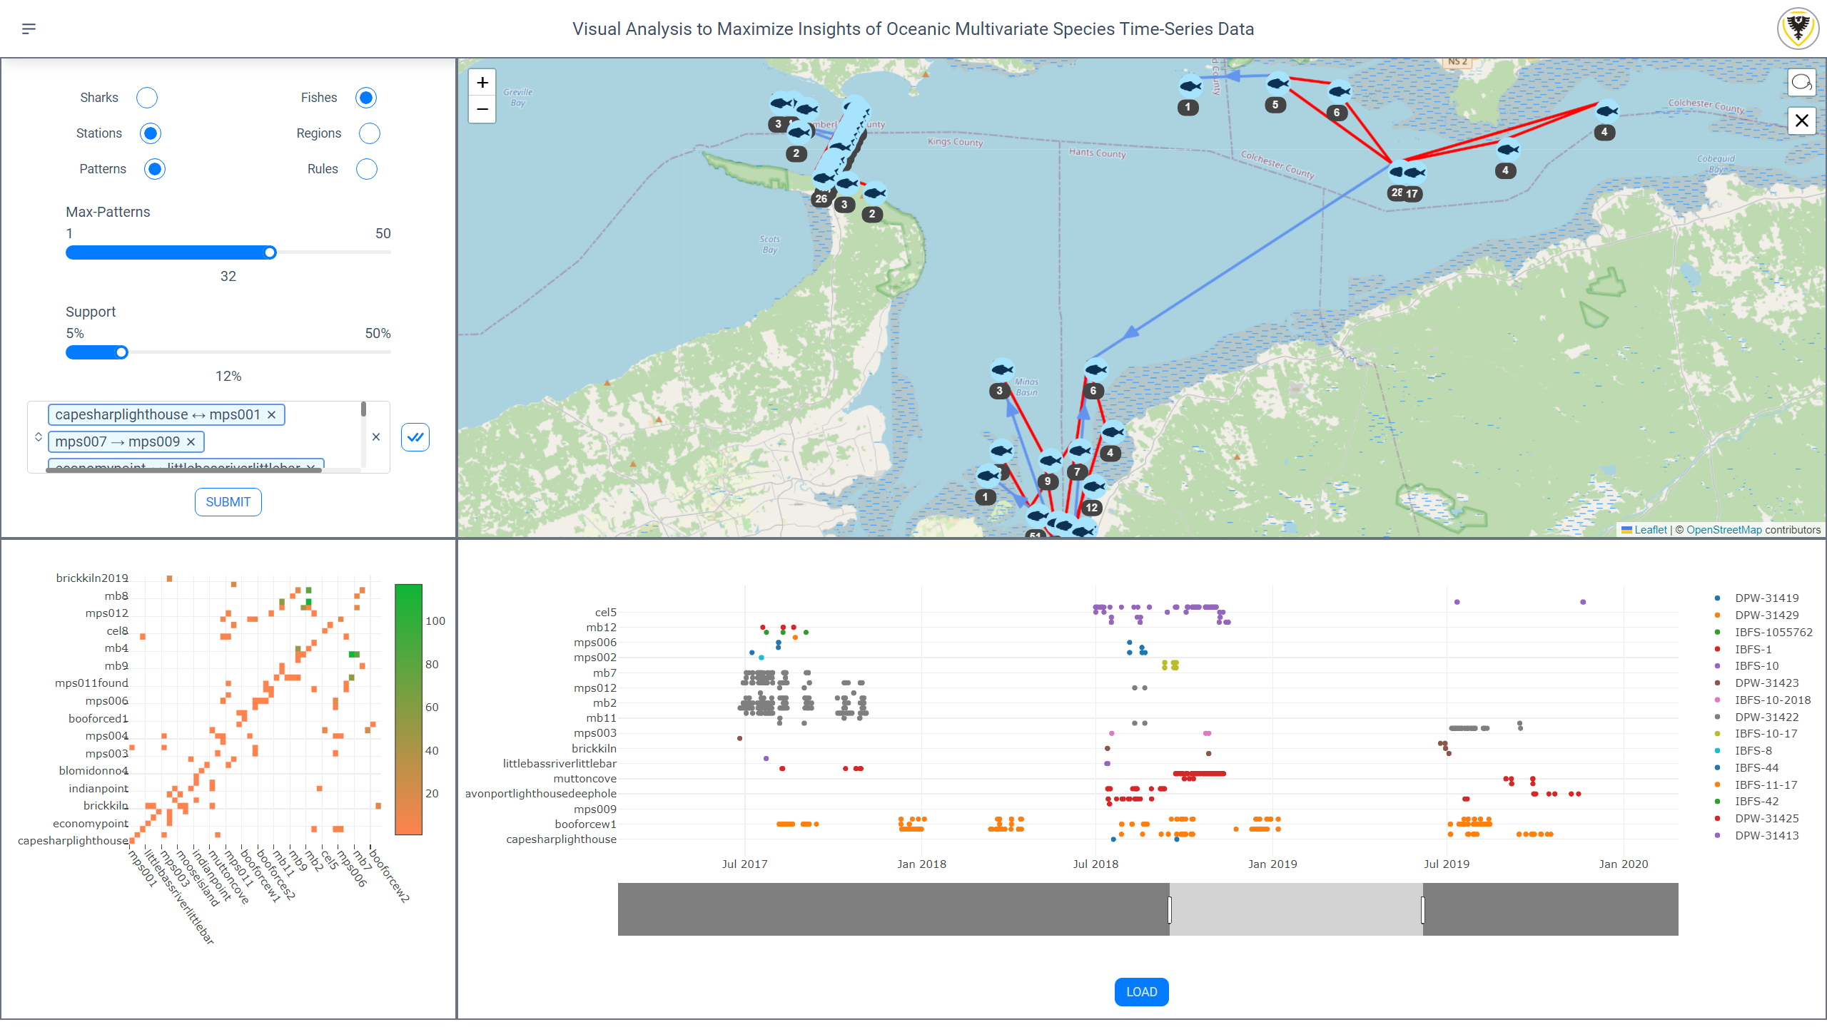
High Level Architecture

Slide 12
Visualization of Sharks and Fishes based on Detections
https://drive.google.com/file/d/1AAR6jPMHmB5lRkVXqfFFMi7Wfni2RWlP/view?usp=sharing

Slide 13
Visualization of Sharks and Fishes based on Mining Algorithms through Patterns and Rules
https://drive.google.com/file/d/1Ow9A8u52Kucwke6JpsYw_lTwE85TBZgE/view?usp=sharing

Slide 14
Feedback and Reviews
Screening Questionnaire
https://surveys.dal.ca/opinio/s?s=72328
Dashboard Interface Rating Questionnaire Detections - Page One
https://surveys.dal.ca/opinio/s?s=72366
Dashboard Interface Rating Questionnaire Patterns and Rules - Page Two
https://surveys.dal.ca/opinio/s?s=72410
Software Usability Questionnaire
https://surveys.dal.ca/opinio/s?s=72368

Slide 15
Important References
Pak Chung Wong, W. Cowley, H. Foote, E. Jurrus, and J. Thomas. Visualizing sequential patterns for text mining. In IEEE Symposium on Information Visualization. INFOVIS 2000. Proceedings. IEEE Comput. Soc, 105-114, Utah, 2000.
Danielle Albers, Colin Dewey, and Michael Gleicher. Sequence surveyor: Leveraging overview for scalable genomic alignment visualization. IEEE Transactions on Visualization and Computer Graphics, 17(12):2392 – 2401, Dec 2011.
International business machines corporation. the java-based mining visualizer. https://www.ibm.com/docs/en/db2/10.5?topic=types-java-based-miningvisualizer. 2021.
Bernard Fichet, Domenico Piccolo, Rosanna Verde, and Maurizio Vichi, editors. Classification and Multivariate Analysis for Complex Data Structures. Springer Berlin Heidelberg, 2011.
Lya Boyandin, Enrico Bertini, Peter Bak, and Denis Lalanne. Flowstrates: An approach for visual exploration of temporal origin-destination data. Computer Graphics Forum, 30(3):971–980, June 2011.
https://data-mining.philippe-fournier-viger.com/spmf-data-mining-library-0-98-new-pattern-visualization-window/

Slide 16
Thank You !!!
Notes:
Sharks - Carcharodon carcharias - white shark
Fishes - Morone saxatilis - striped bass

