Slide 1
Web Committee

Slide 2
Members
Margaret Vail (Chair & LITS Systems Developer)
Sarah Stevenson (Web Publisher)
Marc Comeau (LITS Director)
Creighton Barrett (DUASC)
Shelley McKibbon (Kellogg)
Erin MacPherson (MacRae & Information Literacy)
Mark Lewis (Law)
Amanda Sparks (Sexton & Access Services)
Allison Fulford (AUL Discovery)

Slide 3
Libraries.dal.ca usage Statistics
 | July 1, 2012 – June 30, 2013 | July 1, 2013 – June 30, 2014 | Difference
Visits | 1,947,245 | 1,618,084 | -329,161
Unique Visitors | 699,716 | 630,148 | -69,568
Page Views | 4,315,979 | 3,658,473 | -657,506
Average Visit Duration | 3:32 min. | 2:39 min. | -53 sec.

Slide 4
Mobile usage Statistics
 | July 1, 2012 – June 30, 2013 | July 1, 2013 – June 30, 2014 | Difference
Visits | 7,343 | 21,238 | +13,895
Unique Visitors | 1,756 | 5,148 | +3,392
Page Views | 8,485 | 24,885 | +16,400
Average Visit Duration | 33 sec. | 29 sec. | -4 sec.
Note: The mobile site was implemented on November 4, 2012.

Slide 5
Campus Web Team Updates
Summer 2014
Campus Web Team was given a mandate to have all CQ5 webpages mobile friendly by the end of 2014.
Libraries.dal.ca now uses Responsive Design
  Same page works on Smart Phones, Tablets and Computers

Slide 6
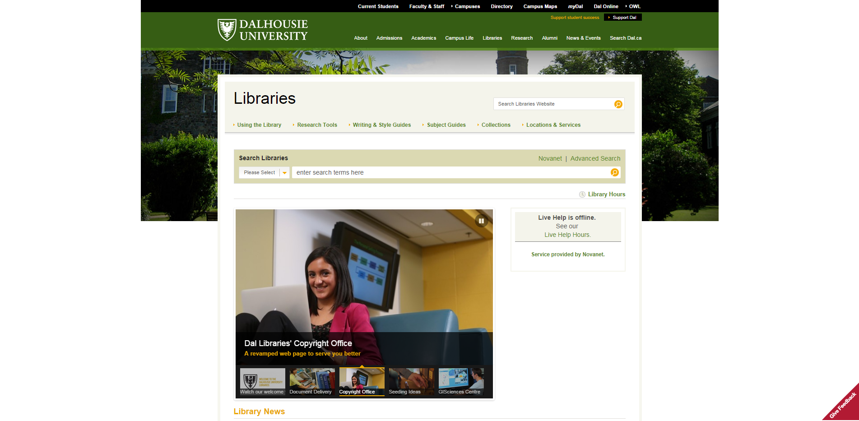

Slide 7
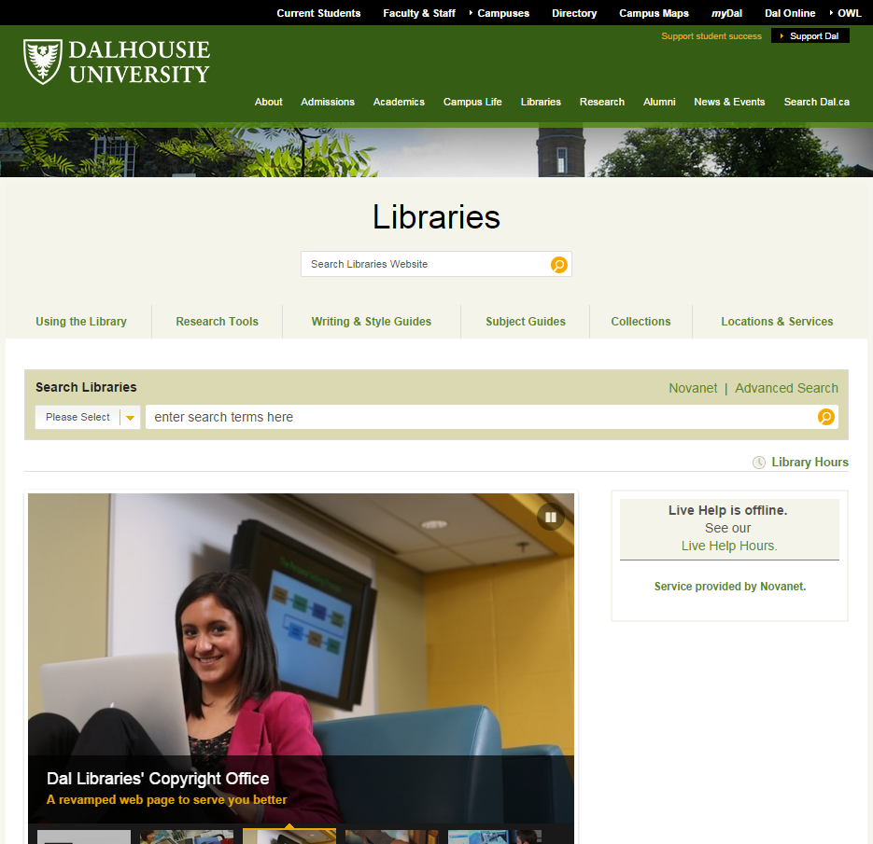

Slide 8
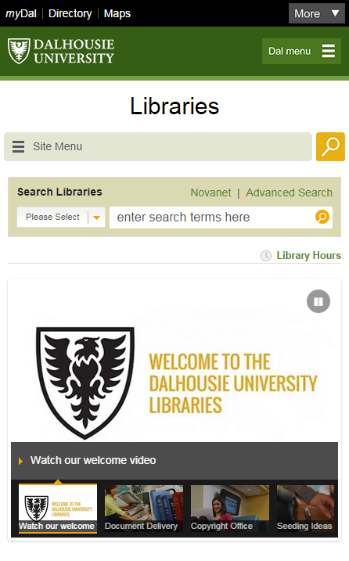

Slide 9
A few pages are not responsive Yet
Advanced Search
URLS that do not begin with libraries.dal.ca
  (ie. http://library.dal.ca or http://util.library.dal.ca)

