Slide 1
Copyright and author rights
This work is licensed under a Creative Commons Attribution-NonCommercial-ShareAlike 4.0 International License.

Slide 2
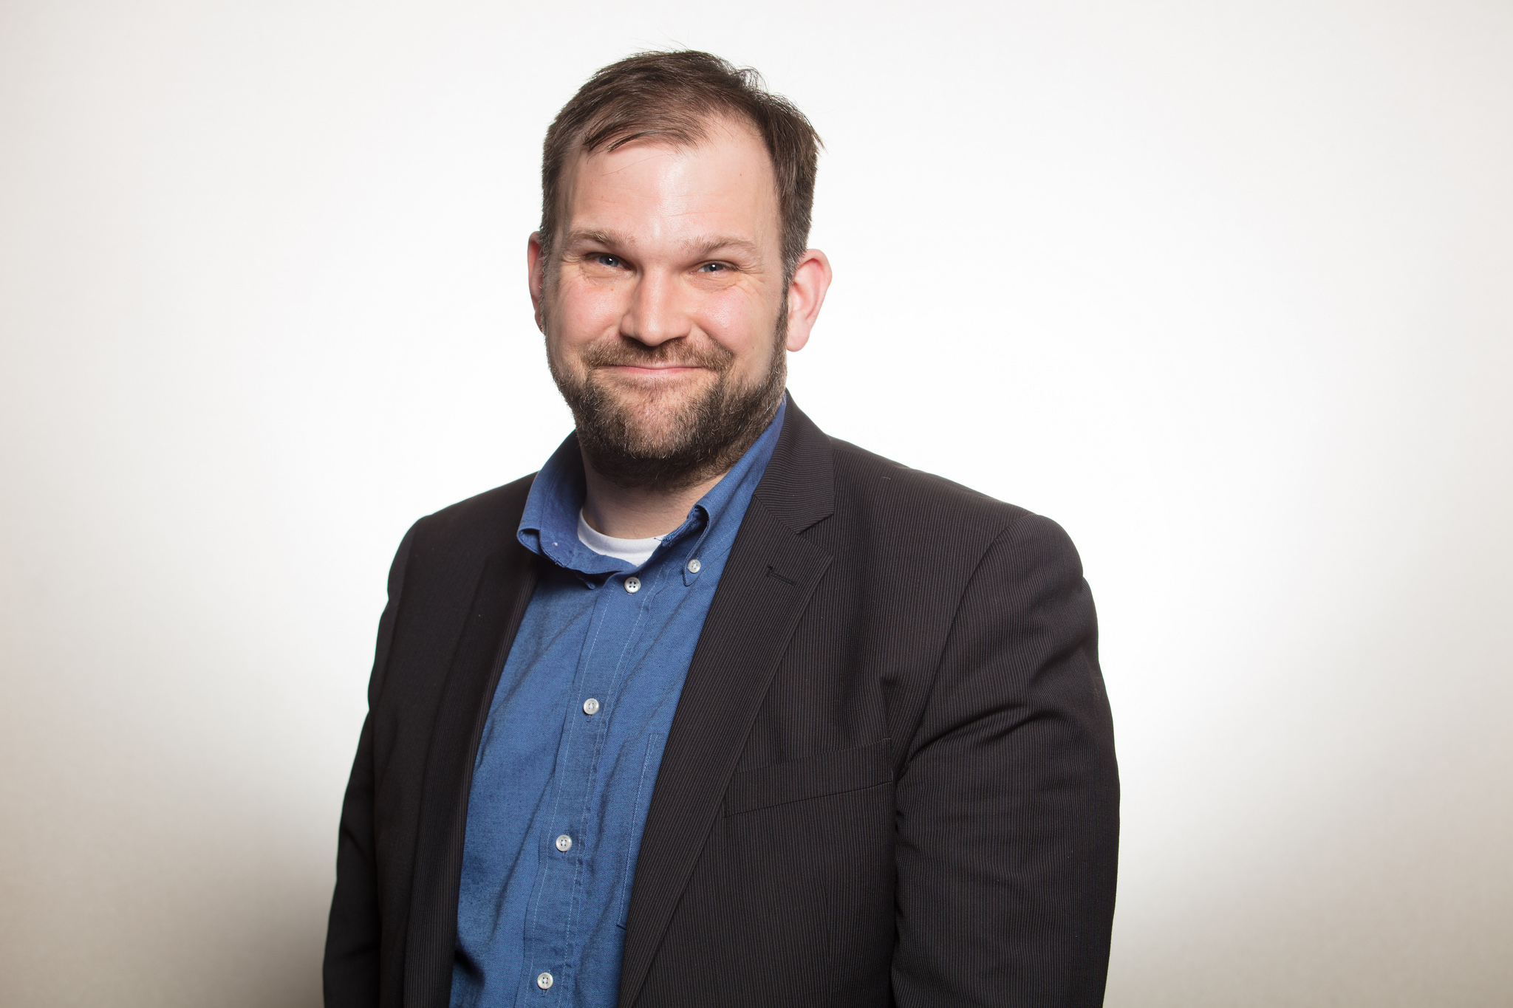
Introduction
Roger Gillis
  Copyright and Digital Humanities Librarian
  Dalhousie Libraries Copyright Office
Photo by Sebaastian Ter Burg. Licensed under CC-BY
https://libraries.dal.ca/copyright

Slide 3
Common Questions …
“My publisher has given me this agreement to sign, I don’t understand it - what do I do!? “
“I’m trying to determine if I own the copyright to my work ….”
“I have to make my publication open access according to my granting agency … how do I do this – am I breaking any copyright rules?”

Slide 4
Learning Objectives
Have a framework or understanding the nature of copyright ownership and transfer.
Understand how publishing contracts can act to inhibit authors rights to their works.
Learn strategies for negotiating with publishers in order to retain rights to publications in order to facilitate dissemination and future use by others.

Slide 5

Caveat: This presentation is not legal advice
Not legal advice.
Photo by rawpixel on Unsplash

Slide 6
Outline
What is copyright?
How does copyright ownership work?
Retaining author rights
Common scenarios in academic publishing
Negotiating rights (Select, Identify, Read, and Negotiate, Post-publication)
Resources: Author Addendum, SHERPA-RoMEO, Creative Commons Licenses
Conclusion and Recap

Slide 7

Today’s focus: Journal publishing
Photo by Jonny McLaren on Unsplash

Slide 8
What is Copyright?
Area of law that limits how original works of creators/authors can be used
One aspect of Intellectual Property law (others include: trademark, patents, industrial design…)
Grants an exclusive set of rights to users (e.g. the right to: copy, distribute, perform, adapt or otherwise use the work
Does not protect facts or ideas (only the expression of those facts or ideas)
Some text altered from Creative Commons Certification course: https://certificates.creativecommons.org/cccertedu/chapter/2-1-copyright-basics/

Slide 9

Criteria for Copyright Protection
Originality (application of skill and judgement)
Be in some fixed form (analog or digital)
Connection with Canada (or other Berne treaty country)
Copyright protection is automatic (from the moment it‘s fixed)
Photo source: Copyright CC BY-SA 3.0 Nick Youngson / Alpha Stock Images

Slide 10
Different types of Rights
Economic rights
  Reproduction/Distribution
  Performance in public
  (first) publication, translation rights
Moral rights
  Protects the reputation of the author & integrity of the work
  Cannot be assigned (but can be waived)
  Rights of Attribution & Association

Slide 11
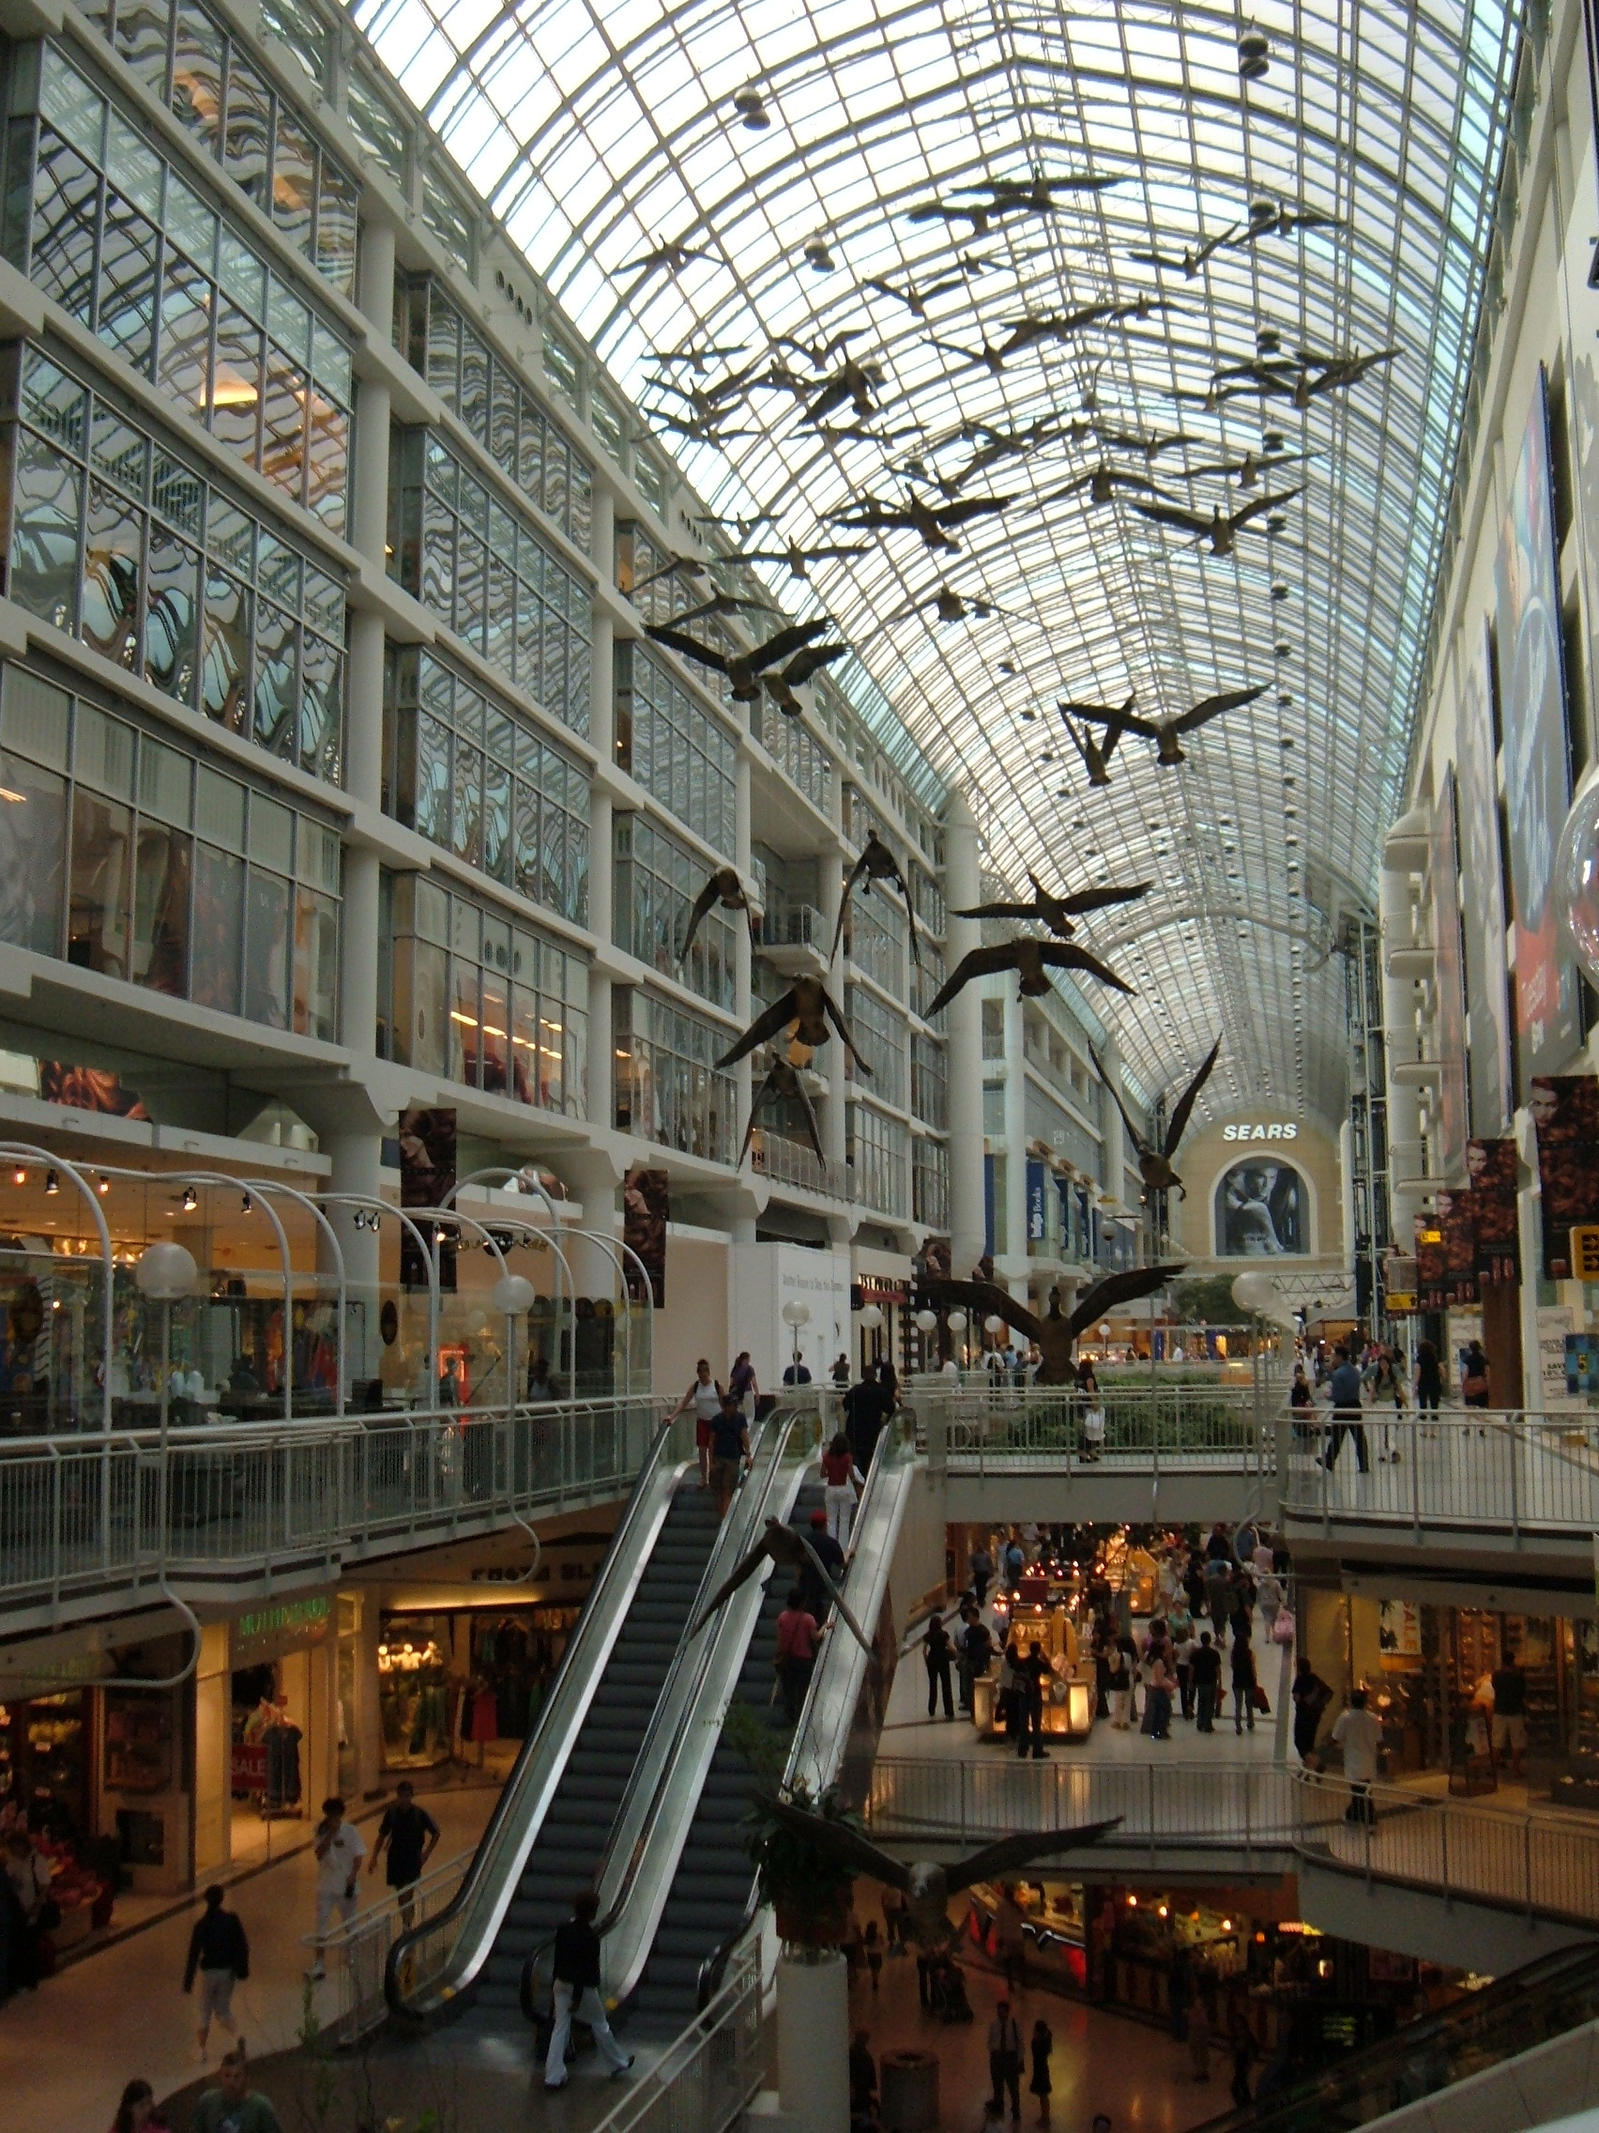
Moral Rights
Snow v. Eaton Center
Toronto Eaton Centre, facing north. Photo taken by IYY. Licensed under CC-BY-SA

Slide 12
Copyright ownership
General rule: author/creator of the work is the first owner of copyright
Organizations: Employers own copyright in cases where employees create works in the course of their duties ( exceptions: most university faculty, or where a contract exists stating otherwise)
Governments (Crown publications): Federal, Provincial, and territorial (not municipal governments)
Copyright expires (Public Domain)
  Copyright lasts for a long time (Creator’s life+50 years - but possibly more (Gee Thanks, Trudeau!).

Slide 13
Employment & copyright arrangements
”Work-for-hire” doctrine (most employers)
Independent contractors / freelancers / volunteers
University faculty
Co-authors (joint copyright holders)

Slide 14
Collective agreements: Dalhousie Faculty Association
“Except as dealt with in Clauses 23.05 and 23.06, the Board makes no claim to the copyrights in books, articles and similar material in the print or digital media written or prepared by any Member. The Board makes no claim to the copyright of any work of art, such as painting, sculpture, music or the like, created by any Member. The Board, therefore, undertakes to transfer to those Members who are the authors, and hereby transfers to those Members who are the authors, the copyrights of all material they have created in the print or digital media and in works of art.”
-- Article 23 DFA collective agreement.

Slide 15
Collective Agreements: CUPE 3912
“Part-Time Academics shall retain ownership of their lectures and any lecture materials exclusively created by them for use in teaching assigned courses unless they have agreed otherwise. Lectures and lecture materials shall not include, among other things, items such as syllabi, course outlines, examinations, tests and assignments.”
Article 23.2 – CUPE 3912 Collective agreement

Slide 16
Copyright creators and owners
The Creator of a Copyright-protected work is not the same as the owner of a copyright-protected work.
Copyright can be assigned (economic rights)
Transfer of ownership must be in writing (print or electronic)

Slide 17

Copyright as Pie
Translation rights
Print distribution rights
Electronic distribution rights
Public Performance rights
And more …
Photo by Alex Loup on Unsplash

Slide 18
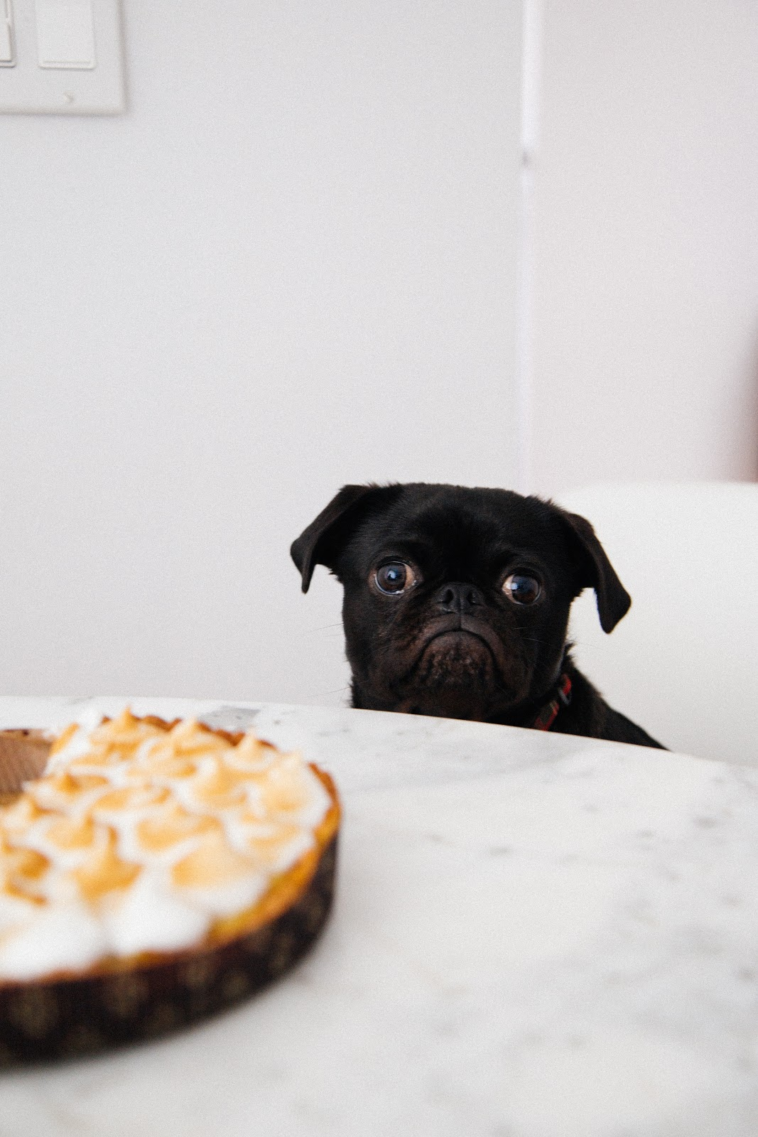
Hey! I wanted some of that pie!
Restrictive copyright agreements may prevent authors from doing particular things with their works!
Photo by Charles Deluvio 🇵🇭🇨🇦 on Unsplash

Slide 19
Authors may want to …
Deposit in a repository (Dalspace)
Share on your personal website
With colleagues at other organizations
Share on an Academic Social Networking Site (e.g. Humanities Commons)
But assigning copyright through restrictive publisher agreements may prevent authors from doing these things…

Slide 20
Copyright and Academic Publishers
Different scenarios:
  Author retains copyright (common in Open Access)
  Non-exclusive
  Author transfers copyright to the journal (Exclusive license)

Slide 21
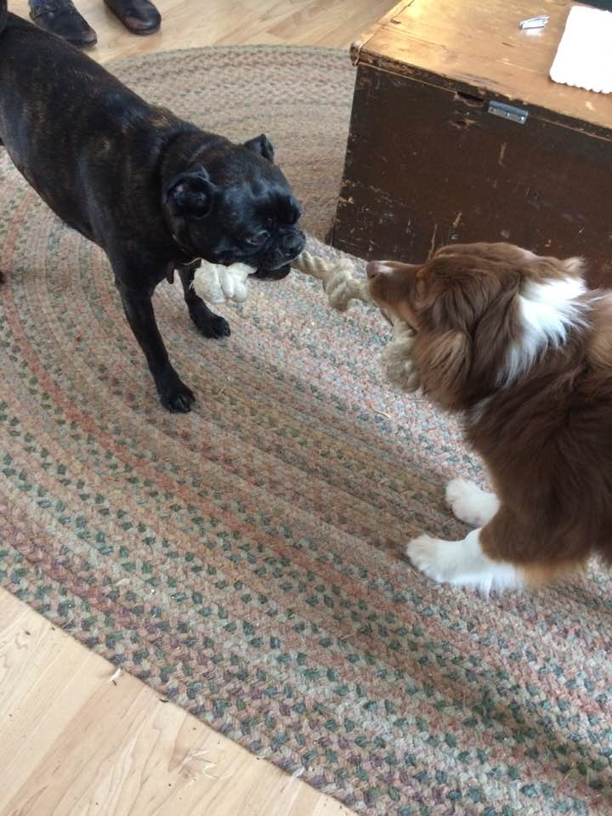
Negotiating publishing contracts – a “Tug-of-war”?
Hannah and Emma. Photo by Roger Gillis

Slide 22

Steps to take
Photo by Jake Hills on Unsplash

Slide 23
1. Select your publication venue
Look at journal/publishers’ copyright policy
Do they require transfer of copyright? Or certain, rights to be transferred
If not clear check with publisher/journal

Slide 24
Restrictive Example: American Journal of Occupational Therapy
“Copyright of the journal is held by the American Occupational Therapy Association, Inc. Permission in writing must be obtained from the Copyright Clearance Center to reproduce, photocopy, or post material appearing in the journal. Direct all requests and inquiries regarding reprinting, photocopying, or posting journal material to Copyright Clearance Center.”
Source: American Journal of Occupational Thereapy. https://ajot.aota.org/ss/about_ajot.aspx

Slide 25
Open Example: Canadian Journal for the Study of Higher Education
Copyright in the article is vested with the Author under the terms of the Creative Commons Attribution-NonCommercial-No Derivative Works 2.5 Canada license http://creativecommons.org/licenses/by-nc-nd/2.5/ca/. Authors who publish with this journal agree to the following terms:
Authors retain copyright and grant the journal right of first publication with the work simultaneously licensed under a Creative Commons Attribution License that allows others to share the work with an acknowledgement of the work's authorship and initial publication in this journal.
Authors are able to enter into separate, additional contractual arrangements for the non-exclusive distribution of the journal's published version of the work (e.g., post it to an institutional repository or publish it in a book), with an acknowledgement of its initial publication in this journal.
Authors are permitted and encouraged to post their work online (e.g., in institutional repositories or on their website) prior to and during the submission process, as it can lead to productive exchanges, as well as earlier and greater citation of published work (See The Effect of Open Access).
Source: Canadian Journal for the Study of Higher Education – About.

Slide 26
2. Identify what rights you want
You may wish to re-use and build on your works. For example, you may want to:
  distribute the work to students or colleagues,
  deposit the work in a subject repository (e.g. arXiv) or an institutional repository (e.g. Dalspace)
  re-use portions in derivative works
  share a copy of the work on a research group, departmental or personal website.
These activities are all governed by copyright, and can therefore be restricted by the terms of your publishing agreement.

Slide 27
Keep in mind …
Are you required to make your research openly accessible? Be aware of any policies or requirements that may impact the rights you need to retain in your publishing agreement, and make sure that the publisher is aware of these requirements.

Slide 28

3. Read, understand, question
Do your best to read and understand what agreement you’ll be entering into and how it may or may not work to your advantage.
Photo by rawpixel on Unsplash

Slide 29

4. Negotiate
Negotiate to retain your rights if necessary
Publishers do not require all rights to publish your work – publishing – it doesn’t have to be “all or nothing.”
Consult with co-authors (if applicable)
Photo by Cytonn Photography on Unsplash

Slide 30
When Negotiating …
Negotiate to retain certain rights by:
  communicating your rationale clearly
  specifically mentioning any policies or mandates that require certain rights,
  being positive, clear and persuasive,
  Remember: Get it in writing!
  (Revised contract (signed), Addendum to contract, emails where publisher agrees to certain exceptions)

Slide 31
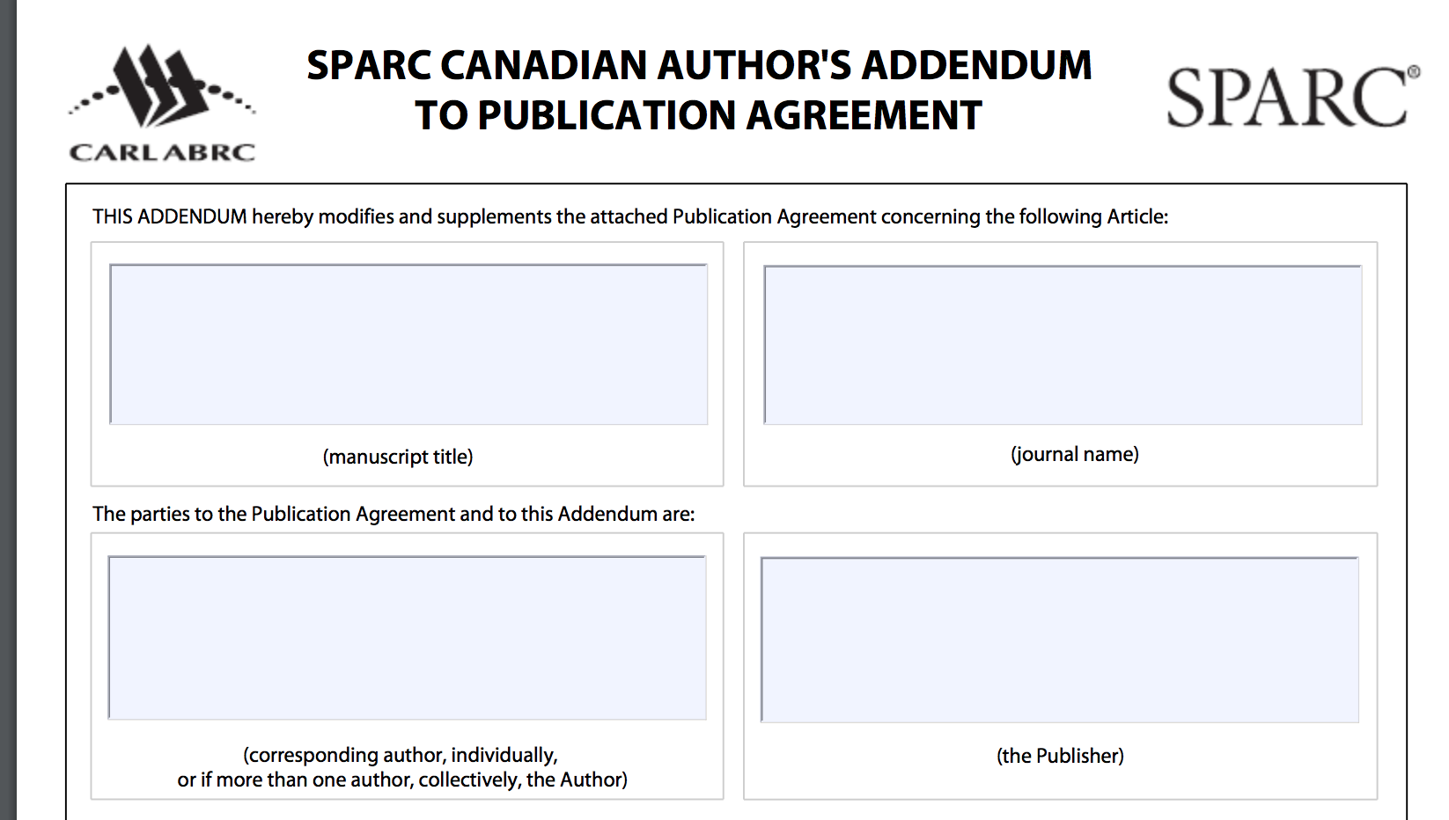
SPARC Author addendum
Info for Authors (CARL) :
https://bit.ly/2Q0PUB5
Screenshot of SPARC Canadian Author Addendum. Source: Canadian Association of Research Libraries

Slide 32
What if you’re not successful?
Seek out other publication venues
Try next time!
Advocate (within your own associations, editorial boards, etc.)

Slide 33
4. After you publish
Keep a record of any publication agreements
Consider reclaiming your rights (if applicable)
Share your work! (As widely as permitted)
  See SHERPA-RoMeO

Slide 34
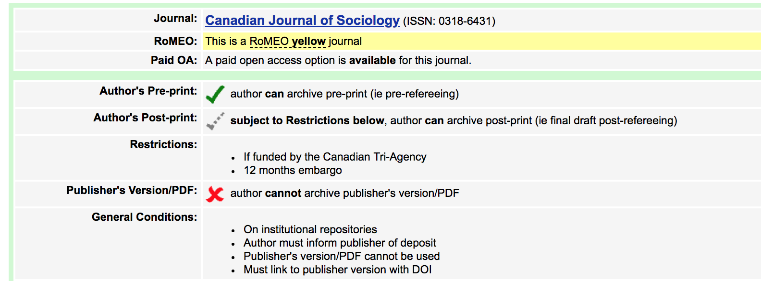
SHERPA RoMEO
Source: SHERPA RoMEO. Licensed under CC BY-NC-ND.

Slide 35
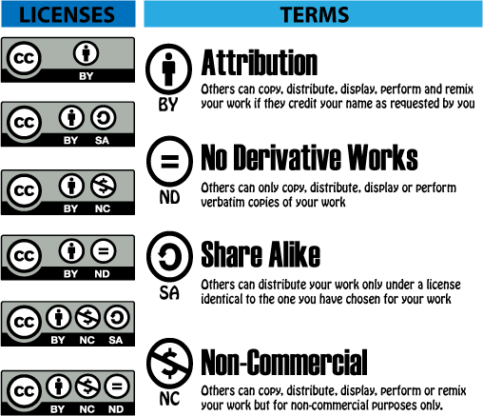
Want to Share? Use Creative Commons Licenses
Source: SUNY https://subjectguides.esc.edu/c.php?g=754755&p=5408909
https://creativecommons.org/choose/

Slide 36
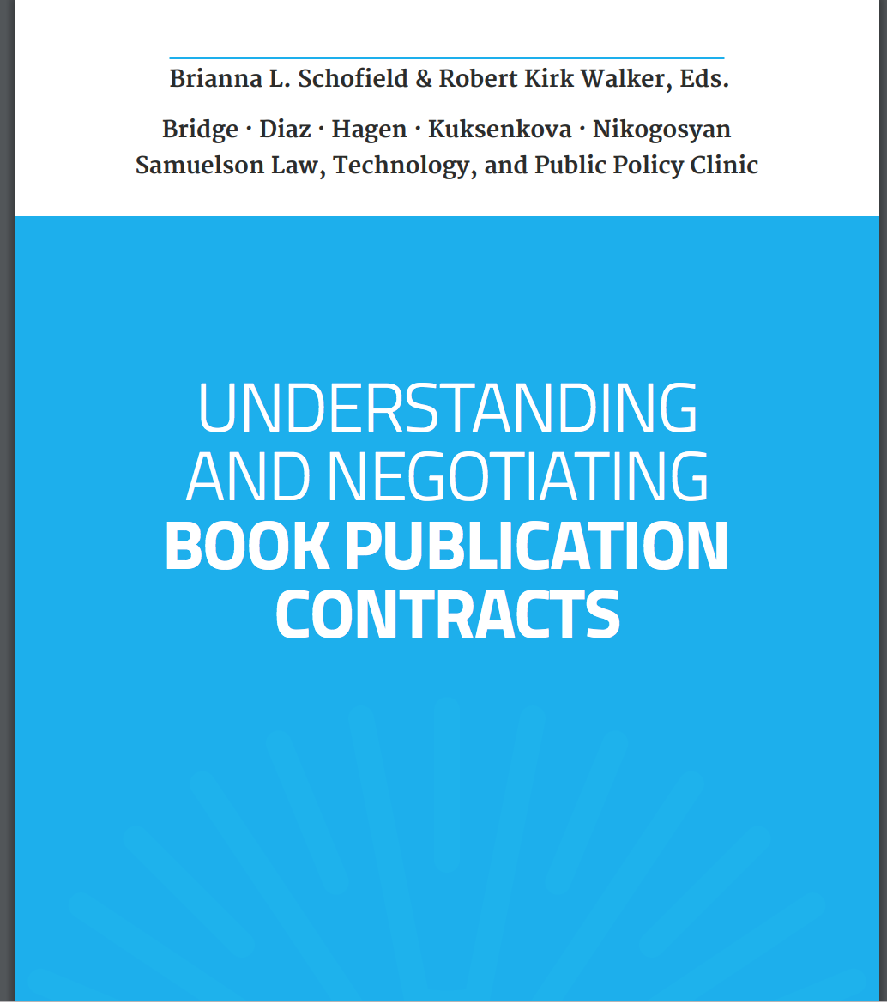
Book contracts
https://bit.ly/2DDKnuk
https://www.authorsalliance.org
Source: Author’s alliance. Understanding and negotiating book publication contracts.

Slide 37
Recap
Dogs shouldn’t eat pie (despite what I may have led you to believe …)
Understand rules around copyright ownership and how they apply to you as an owner/creator
Select your publication venue (and according copyright policy)
Identify rights you wish to retain
Read, understand, and question copyright agreements
Negotiate copyright arrangement that works for you
Use an author addendum (where possible) to retain rights

Slide 38
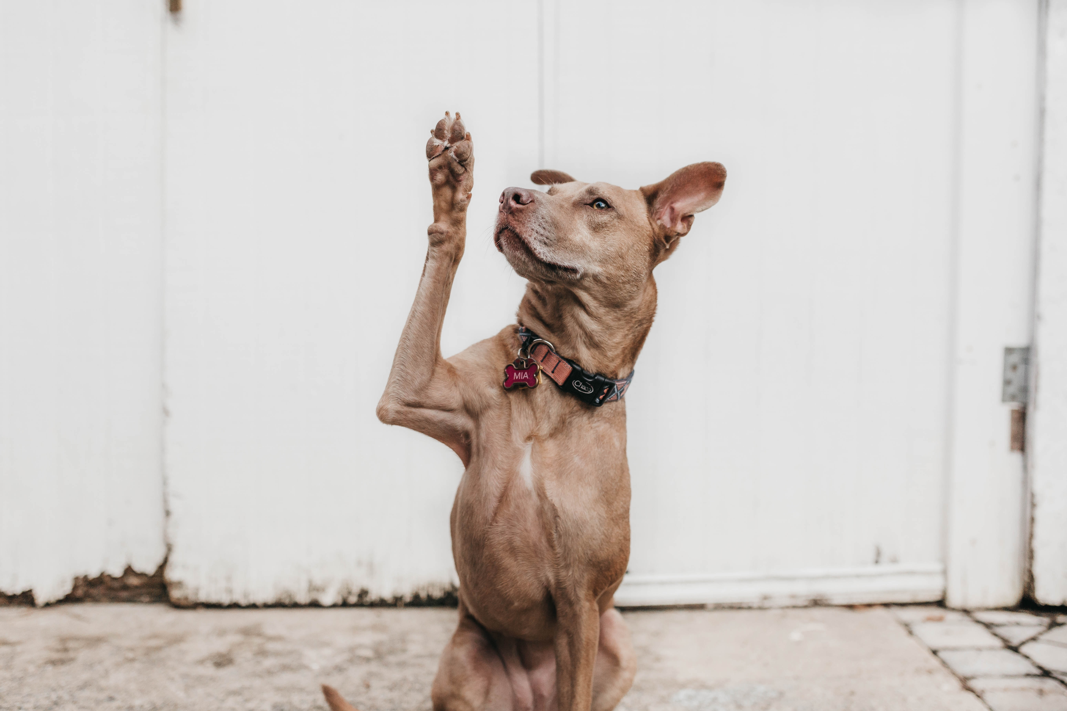
Questions?
copyright.office@dal.ca
Photo by Camylla Battani on Unsplash

