Slide 1

Using archival material to study performing arts and audience reception
Presentation for CANA / ENGL / THEA 4501
January 23, 2017
Creighton Barrett
Dalhousie University Archives

Slide 2
Today’s agenda
Issues in performing arts archives
Overview of Dalhousie theatre archives
Accessing archival material for your assignment
Citing archival material

Slide 3
Performing arts archives

Slide 4
Braden Cannon. "Evidence of Artistic Process in Performing Arts Records." Canadian Theatre Review 156, no. 156 (2013): 35-39. http://muse.jhu.edu/article/524247 (accessed January 20, 2017).
Issues in performing arts archives
Temporality and ephemerality
Performing arts as process
Representation of performance

Slide 5
Dr. Roberta Barker’s assignment handout for archival research paper assignment in CANA / ENGL / THEA 4501.03: Canadian theatre since 1968
Temporality and ephemerality
“Theatre is an ephemeral art; once ended, a production leaves only a few traces by which we can measure its characteristics, its quality, and its contributions to the cultural life of the community in which it took place.”
“This assignment invites you to complete original primary research, using archival sources to encounter the traces left behind by productions from Nova Scotia’s theatre companies.”

Slide 6
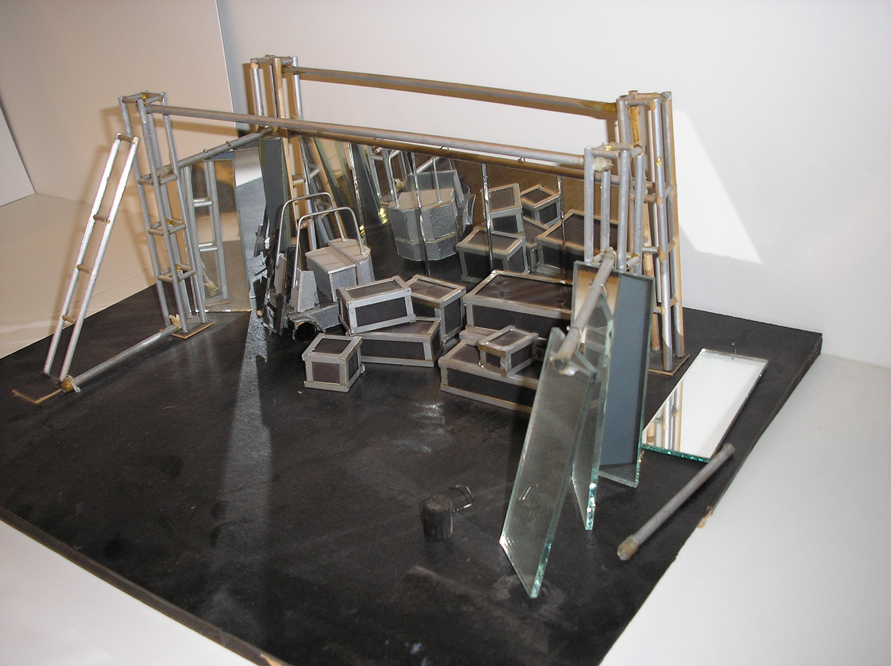
Photograph of maquette for 1979 production of 18 Wheels by John Gray.
This maquette was held on deposit for a number of years and then returned to Neptune Theatre in 2009.
Performing arts as process
Notes:
“Given that performance is a process—and the public presentation is only the end result of several months of rehearsal, repetition, and re-interpretation of texts, movement, or vocalization—there are several points at which records are created, even records that document the temporal nature of performance.”
“However, just because there is the potential for records-creation at multiple stages in the performance process that does not mean that any of said records will be preserved. Challenges are born out of the fact that it is a process that results in records-creation and that archives often focus on the end result.”
Braden Cannon. "Evidence of Artistic Process in Performing Arts Records." Canadian Theatre Review 156, no. 156 (2013): 35-39. http://muse.jhu.edu/article/524247 (accessed January 20, 2017).

Slide 7
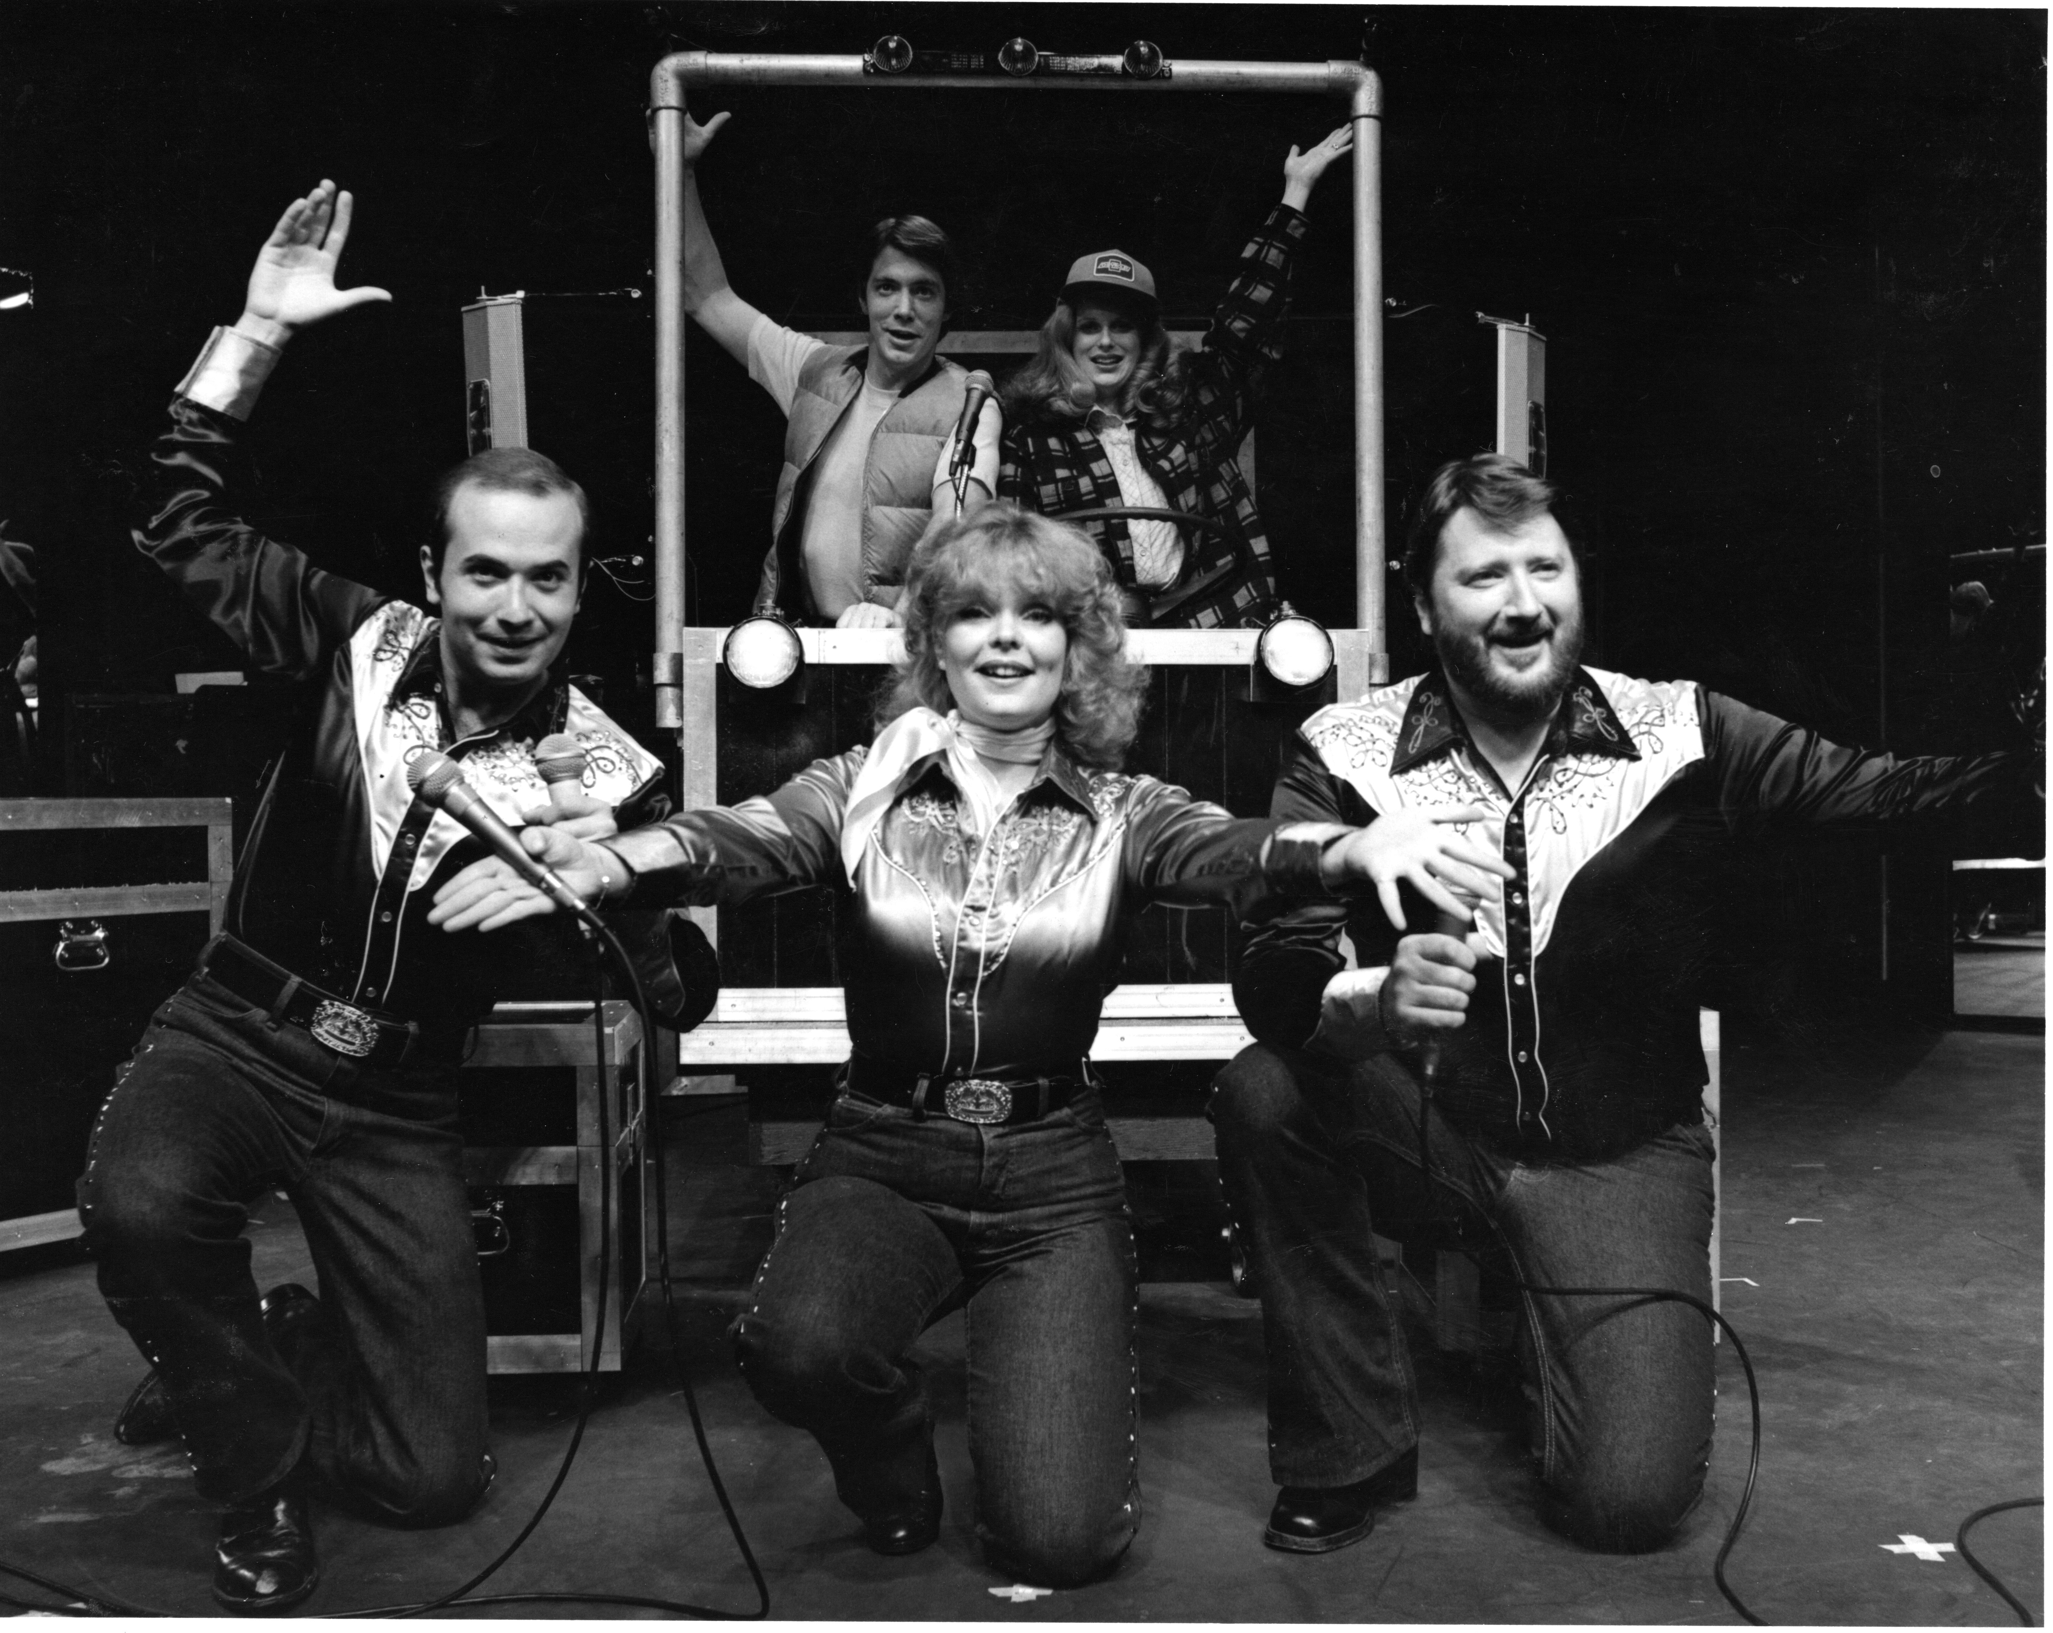
Photograph of 1979 production of 18 Wheels by John Gray.
This maquette was held on deposit for a number of years and then returned to Neptune Theatre in 2009.
Representation of performance
Notes:
“Arguably, all archiving is performance: records are surrogates that provide a window onto past moments that can never be recreated, and users interact with these records in a performance to reinterpret this past.”
“How do you capture the mood of the time or reflect what it meant to take part in or live through such experiences? Can we provide a fair and reliable version of the past through the records we create and select for posterity, when so much of human experience is inherently interactive, experiential, and performative?”
Sarah Jones, Daisy Abbott, and Seamus Ross. “Redefining the performing arts archive." Archival Science 9 (2009): 165-171. doi:10.1007/s10502-009-9086-1 (accessed January 20, 2017).

Slide 8
Dalhousie theatre archives

Slide 9
Kathryn Harvey and Michael Moosberger. “Theatre Archives’ Outreach and Core Archival Functions." Archivaria 63, (Spring 2007): 35-54. http://archivaria.ca/index.php/archivaria/article/view/13126/14365 (accessed January 20, 2017).
Theatre archives at Killam Memorial Library
Early 1970s: “The Neptune Theatre Archives has been established in the Killam Memorial Library. The Theatre Collection is now being expanded to include other theatres, drama groups, music societies, etc…of Halifax and Nova Scotia.”

Slide 10
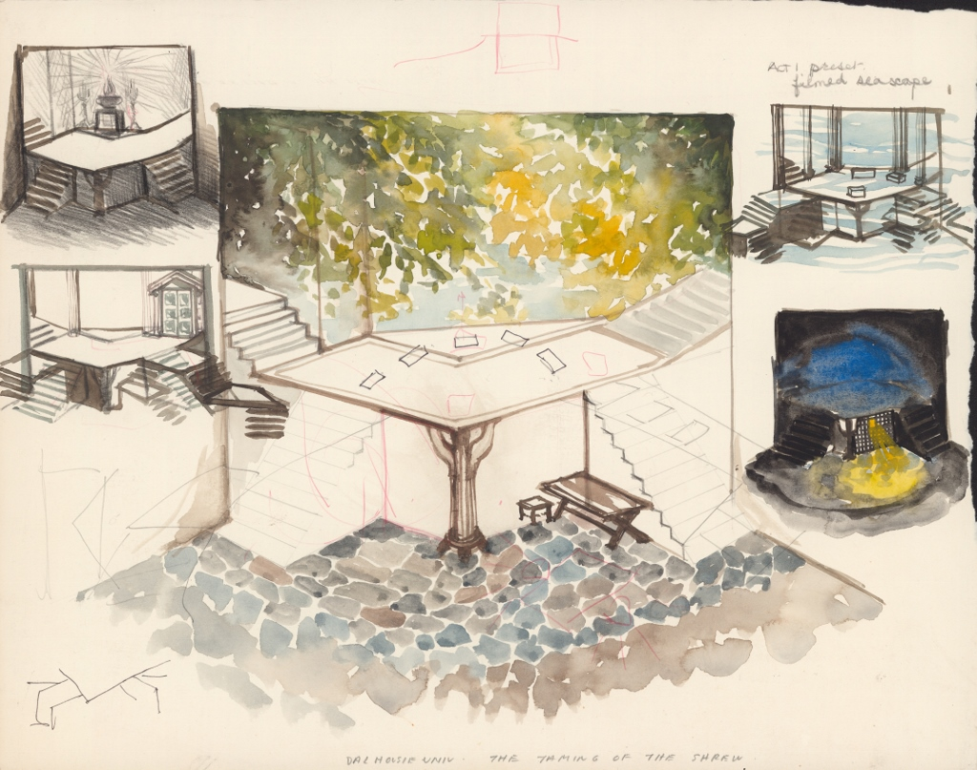
Set design for The Taming of the Shrew, Robert Doyle fonds, MS-3-18, Box 6, Folder 15, Item 1, Dalhousie University Archives, Halifax, Nova Scotia, Canada. http://findingaids.library.dal.ca/set-design-for-taming-of-shrew.
Goal of theatre archives: document artistic process, performance, and reception of Nova Scotia theatre

Slide 11
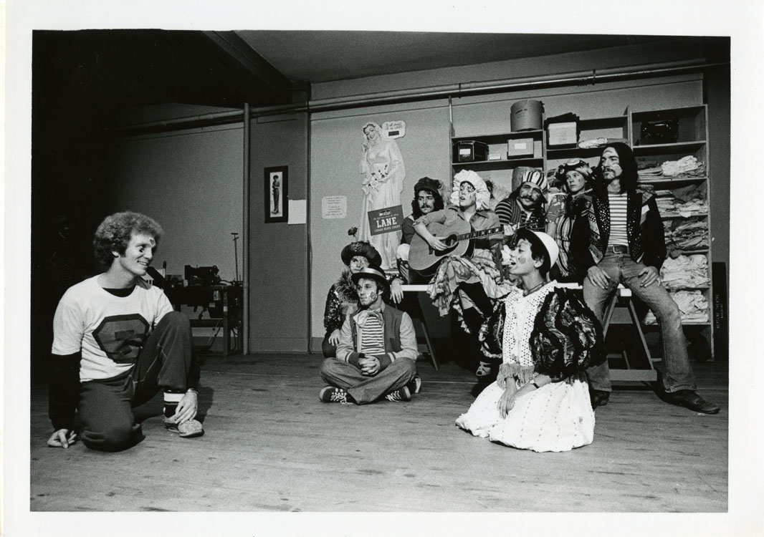
Photograph of rehearsal of Neptune Theatre’s 1974 production of Godspell, Neptune Theatre fonds, MS-3-1, PC3 Box 4, Folder 16, Dalhousie University Archives, Halifax, Nova Scotia, Canada.
Evidence of artistic process in the Neptune Theatre fonds

Slide 12
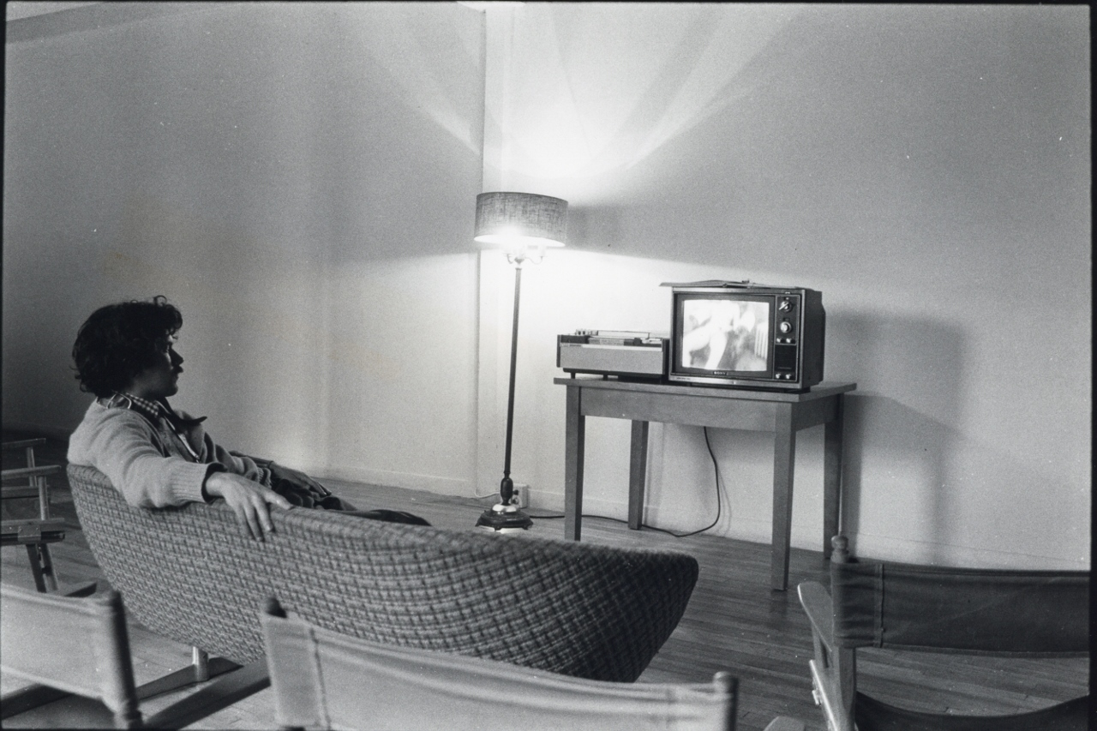
Photograph of a person watching television, Centre for Art Tapes fonds, MS-3-46, Box 54, Folder 16, Item 4, Dalhousie University Archives, Halifax, Nova Scotia, Canada.
http://findingaids.library.dal.ca/photograph-of-person-watching-television-2
Broad coverage of visual and performing arts

Slide 13
Featured fonds
Neptune Theatre fonds
Pier One Theatre fonds
David Renton fonds
Linda Moore fonds
Catherine Banks fonds

Slide 14
Accessing archival material

Slide 15
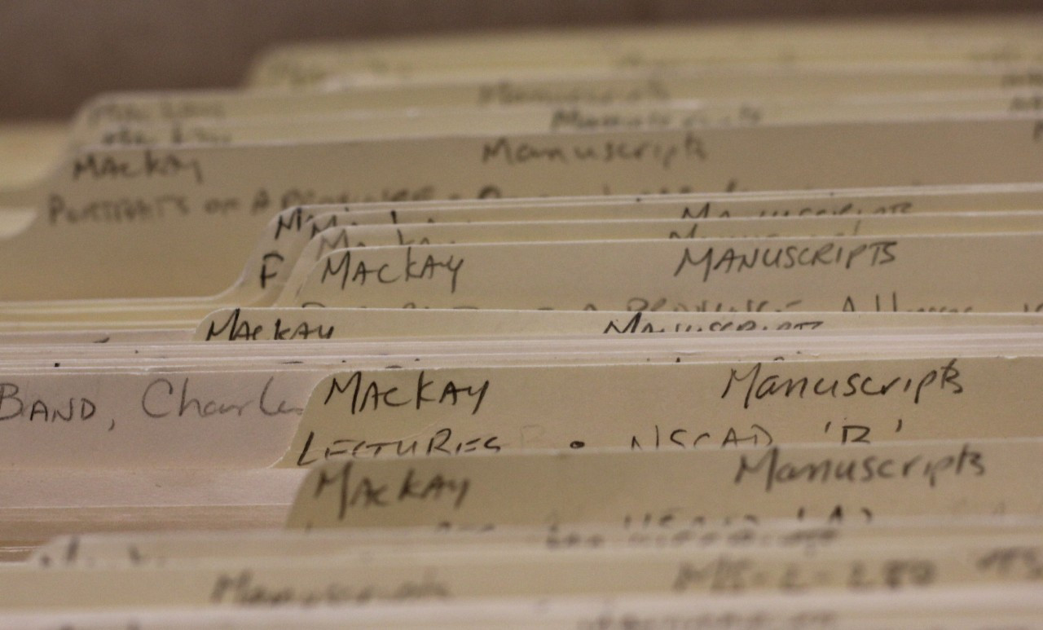
Photograph of files in the D.C. Mackay fonds (Photograph taken in 2014 by Creighton Barrett)
Normally, you have to search and browse…

Slide 16
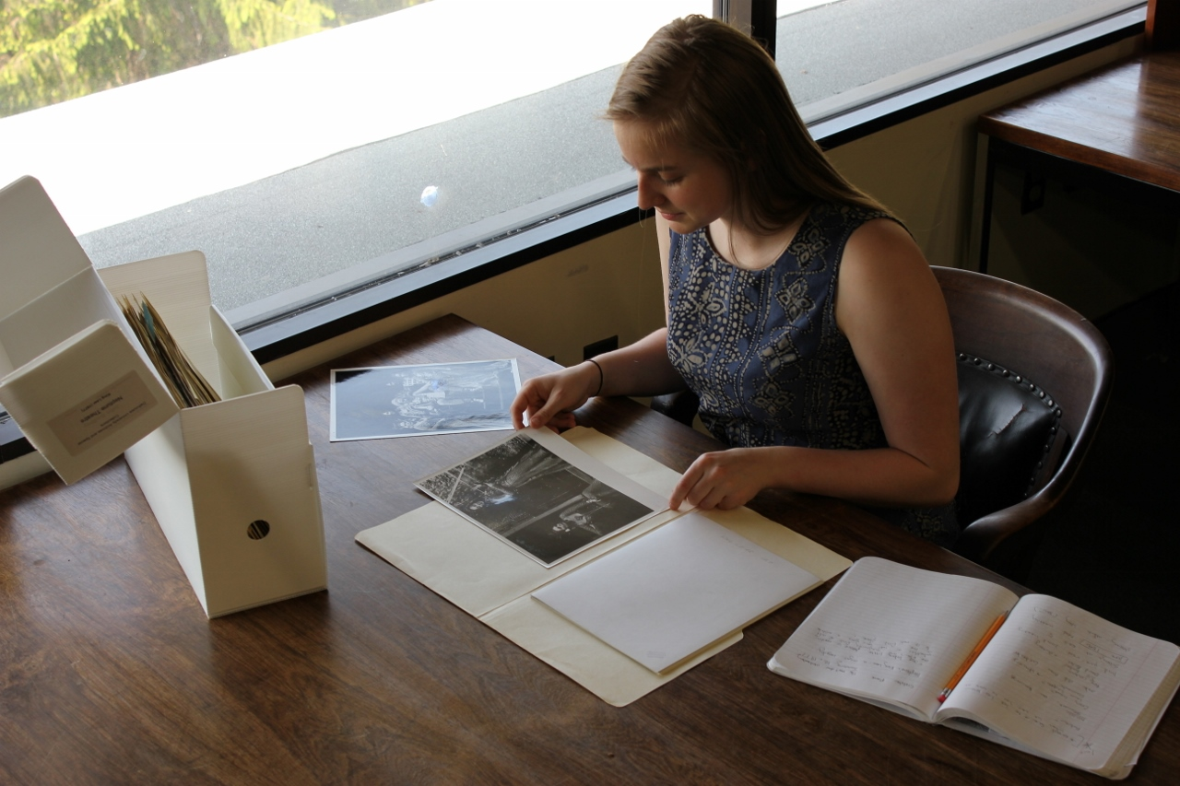
Karen Gross reviewing records from Neptune Theatre’s 1977 production of King Lear (Photograph taken in 2013 by Creighton Barrett)
We will provide an initial set of archival records for each production

Slide 17
Tip: Give yourself enough time to review all of the files in your production.
Archives staff cannot retrieve additional files after 4:00 p.m.
Access archival material
Hours: 11:00 a.m. – 5:00 p.m., Monday to Friday
Drop in and request records for the production you have selected (e.g., “Can I have the records for Neptune Theatre’s 1988 production of Blood Relations?”)
Request additional files in person or by email: archives@dal.ca
Include “reference codes” or use “clipboard” feature to save a list of search results as a PDF and attach your list

Slide 18
Tip: If you are using a digital camera or mobile phone to photograph documents, write the full “reference code” on a small strip of paper and make sure the strip of paper is included in the photograph.
It will help when you need to cite your sources!
Archives and Special Collections Reading Room
Strict no food or drink policy
Pencils only
View materials one folder at a time
No flash photography

Slide 19
Reminder: ask me questions! I am happy to help: creighton@dal.ca
Guide to archival research
Comprehensive guide for first-time and experienced researchers
Tips for first-time archives researchers: http://dal.ca.libguides.com/c.php?g=257178&p=1717152
How to search the Archives Catalogue: http://dal.ca.libguides.com/c.php?g=257178&p=1717150
How to browse the Archives Catalogue: http://dal.ca.libguides.com/c.php?g=257178&p=1717151

Slide 20
Tip: do not rely on the archives document delivery service if you are in a pinch for time. The free service can take up to two weeks depending on staff availability.
Archives document delivery service
Students, faculty, and staff can request free digital copies of files and items found in the Archives Catalogue and Online Collections
Log into Document Delivery Request Form and submit an “Archives Request”
See “Guide to Archival Research” for more information about eligible and ineligible material, turnaround times, and instructions on completing the archives request form

Slide 21
Citing archival material

Slide 22
Visit our citation guide: http://dal.ca.libguides.com/archivalresearch/citation
Tip: Always check with your professor to confirm preferred citation style.
Citing archival material
Chicago footnote or endnote for “ephemera”: Poster for Dalhousie Student Union event, "In Search of the Supernatural," 1986, MS-1-Ref, Box 16, Folder 27, Dalhousie University Reference Collection, Dalhousie University Archives, Halifax, Nova Scotia, Canada.
MLA reference page: Dalhousie Student Union. "In Search of the Supernatural" [poster]. 1986. MS-1-Ref, Box 16, Folder 27. Dalhousie University Reference Collection. Dalhousie University Archives, Halifax, Nova Scotia, Canada.

Slide 23
Questions?

Slide 24
Dr. Roberta Barker’s assignment handout for archival research paper assignment in CANA / ENGL / THEA 4501.03: Canadian theatre since 1968
Feedback, please!
“Canada hosts relatively few theatrical archives, so Canadian students rarely have the chance to experience the exciting process of primary theatre research. Please make the most of this opportunity, dig in to the archives and feel free to give us lots of feedback on how we can improve your experience!”

