Slide 1
INFO 6850 Archives II
Week Seven
http://hdl.handle.net/10222/64533
THEORY, STANDARDS, BEST PRACTICES
How do you encode the “context” of archival records?

Slide 2
AGENDA
Announcements
Review the role of provenance in archival description
Discuss readings
Introduce ISAAR(CPF) and EAC standards
Demonstration of “History Research Tool”

Slide 3
ROLE OF PROVENANCE IN ARCHIVAL DESCRIPTION
“External” and “internal” factors of arrangement
“Static” versus “dynamic” relationships between records
Practical application of theoretical concept of respect des fonds has been challenged in recent literature

Slide 4
ROLE OF PROVENANCE IN ARCHIVAL DESCRIPTION
Sandra Barr’s “accession based” processing
Australian “series system”
Fonds vs. collection vs. hybrid
Multiple contexts, multiple interpretations

Slide 5
ROLE OF PROVENANCE IN ARCHIVAL DESCRIPTION
Trend towards separate descriptions of creators
“Authority records” created with new International Standard for Archival Authority Records (ISAAR-CPF)
What does this mean for RAD’s rules for administrative histories and biographical sketches?

Slide 6
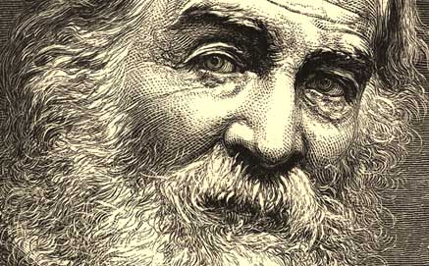
Barney et al.
ORDERING CHAOS
Walt Whitman Archive: http://www.whitmanarchive.org/

Slide 7
WALT WHITMAN ARCHIVE
How does the site integrate EAD XML finding aids and TEI transcriptions?
How did archivists overcome the challenge of untitled manuscripts?
How does the site integrate digital objects into the archival descriptions?
How would you “rebuild” or “migrate” this site?
Notes:
Check the Policies page: http://www.whitmanarchive.org/about/index.html#policies

Slide 8
SONG OF THE UNIVERSAL
WALT WHITMAN
Come, said the Muse,
Sing me a song no poet yet has chanted,
Sing me the Universal.
In this broad Earth of ours,
Amid the measurelessc` grossness & the slag,
Enclosed & safe within its central heart,
Nestles the seed Perfection.
By every life a share, or more or less,
None born but it is born—conceal'd or
unconceal'd the seed is waiting.

Slide 9
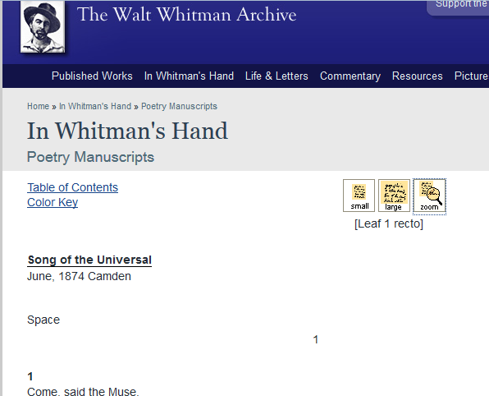
WALT WHITMAN ARCHIVE

Slide 10
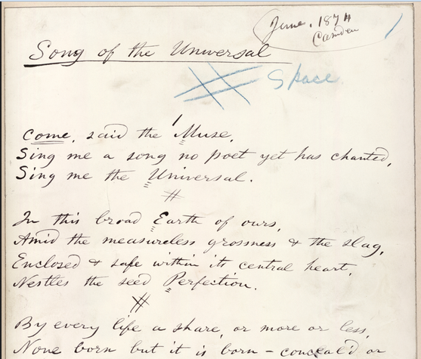
WALT WHITMAN ARCHIVE

Slide 11
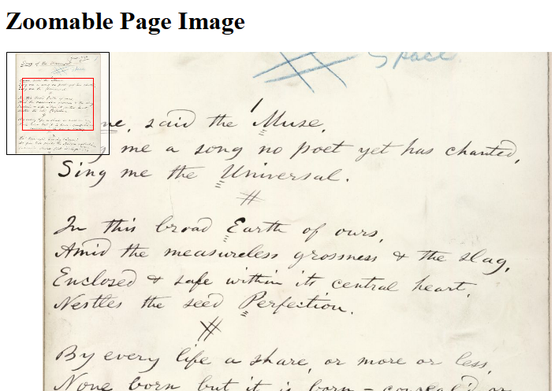
WALT WHITMAN ARCHIVE

Slide 12

Pitti et al.
SOCIAL NETWORKS AND ARCHIVAL CONTEXT (SNAC)

Slide 13
SOCIAL NETWORKS AND ARCHIVAL CONTEXT (SNAC)
Why is it a good idea to separate authority records from the archival descriptions?
How has SNAC “set the stage” for international collaboration?
What standards are used in the SNAC project?
Notes:
SNAC has developed a “prototype” international catalogue of authority records linked to archival descriptions from multiple institutions. This is a major accomplishment!
SNAC used EAD files from various institutions. The EAD incorporated
ISAAR-CPF “Scope and Purpose” 1.5:
There are many reasons why separate capture and maintenance of this type of contextual information is a vital component of archival description. The practice enables the linking of descriptions of records creators and contextual information to descriptions of records from the same creator(s) that may be held by more than one repository and to descriptions of other resources such as library and museum materials that relate to the entity in question. Such links improve records management practices and facilitate research.

Slide 14
Geoffrey Yeo
DESCRIPTION OF DIGITAL RECORDS
Digital information increases tenfold every five years
90% of the data in the world are said to have been created in the last two years
By 2020, there will be 5,2000 GB of data per person

Slide 15
DESCRIPTION OF DIGITAL RECORDS
What are some of the approaches to archival description that Geoffrey Yeo describes?
What are the advantages and disadvantages to each approach?
Can you think of other approaches to help archivists describe digital records?
Notes:
Geoffrey Yeo’s article discusses four approaches:
Minimal processing
Has “tempted many practitioners because it appears to offer a cost-effective solution to some of these challenges in the domain of paper records…” (p. 24)
“…but it leads in the wrong direction as a response to the coming digital deluge” (p. 24)
Reuse of metadata supplied by creator
User contributions
Outsource description
User engagement
Potential for low quality, inaccurate information
Automated capture of descriptive information using emerging technologies
Automated capture of descriptive information has a lot of potential but it also fundamentally alters the required skills and abilities of professional archivists.
We must wait for technology to continue emerging and find ways to “choose” the right tools and methods.
The options are rather limited. Can we organize digital “items” into archival “files?”
Digital records require strong appraisal methods and that is where the “gap” currently lies.

Slide 16
DESCRIPTION OF DIGITAL RECORDS
Minimal processing
Reuse of metadata supplied by creator
User contributions
Automated capture of descriptive information
Notes:
“When used in isolation, none of the four approaches examined in this paper seems likely to provide a comprehensive answer to the descriptive challenges archivists now face.” (p. 24)

Slide 17

ISAAR(CPF)
First edition published in 1996
Second edition published in 2004
Provides guidance for preparing authority records
How can authority records be used in archival description systems?
Notes:
Scope and Purpose 1.2
Authority records may be used to:
to describe a corporate body, person, or family as units within an archival descriptive system; and/or
to control the creation and use of access points in archival descriptions;
to document relationships between different records creators and between those entities and the records created by them and/or other resources about or by them.

Slide 18
RECORDS AND CONTEXT CONTROL
RAD ARCHIVAL DESCRIPTION
PROVENANCE
FONDS
Corporate body
Series
Person
File
Family
Item
Notes:
Last week, we discussed how Australian Peter Scott used the terms “records control” and “context control” to describe the “series-system.”
RAD “merges” records and context control into one description but the series-system separates them.
Context control is achieved through the Archival Description Area
Administrative History/Biographical Sketch
Custodial History
Records control is achieved through the rest of the archival description

Slide 19
CONTEXT CONTROL
Organization
Family
Agency
Person
RECORDS CONTROL
RAD ARCHIVAL DESCRIPTION
Series
File
Item
ISAAR-CPF AUTHORITY RECORD
Notes:
The ISAAR-CPF standard more or less codifies the “separate” context control and records control that the Australian “series-system” encourages.
Context is “encoded” in an authority record that is linked to archival descriptions.
The ISAAR(CPF) standard provides for a richer and more useful description of the creators of records than the RAD administrative history/biographical sketch note.

Slide 20
ELEMENTS OF AN AUTHORITY RECORD
Identity area
Description area
Relationships area
Control area
Notes:
ELEMENTS OF AN AUTHORITY RECORD
5.1 IDENTITY AREA
5.1.1 Type of entity
5.1.2 Authorized form(s) of name
5.1.3 Parallel forms of name
5.1.4 Standardized forms of name according to other rules
5.1.5 Other forms of name
5.1.6 Identifiers for corporate bodies
5.2 DESCRIPTION AREA
5.2.1 Dates of existence
5.2.2 History
5.2.3 Places
5.2.4 Legal status
5.2.5 Functions, occupations and activities
5.2.6 Mandates/Sources of authority
5.2.7 Internal structures/Genealogy
5.2.8 General context
5.3 RELATIONSHIPS AREA
5.3.1 Names/Identifiers of related corporate bodies, persons or families
5.3.2 Category of relationship
5.3.3 Description of relationship
5.3.4 Dates of the relationship
5.4 CONTROL AREA
5.4.1 Authority record identifier
5.4.2 Institution identifiers
5.4.3 Rules and/or conventions
5.4.4 Status
5.4.5 Level of detail
5.4.6 Dates of creation, revision or deletion
5.4.7 Languages and scripts
5.4.8 Sources
5.4.9 Maintenance notes

Slide 21
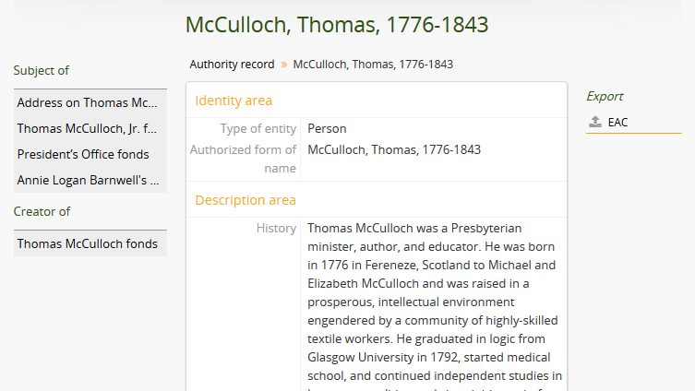
AUTHORITY RECORD
Notes:
Authority records can be linked to archival descriptions through a “Creator” access point or a “Subject” access point.
Here, you can see that Thomas McCulloch is the creator of his own fonds but he is also the subject of other fonds and collections.
Most applications now support the ability to import and export standardized data. Here, you can see that the Access to Memory application lets you export ISAAR(CPF) authority records as Encoded Archival Context (EAC) XML.

Slide 22
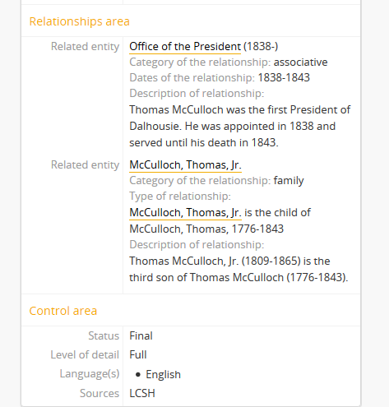
AUTHORITY RECORD
Notes:
Authority records can be linked to other authority records and the nature of the relationship can be described. Here, you can see that Thomas McCulloch is related to the “Office of the President” authority record because McCulloch was the first President of Dalhousie. He is also related to the authority record for Thomas McCulloch, Jr., who is McCulloch’s third son.
The control area is a place record information about the authority record. Here, you can see that the “authorized form of name” came from the Library of Congress Subject Headings.

Slide 23
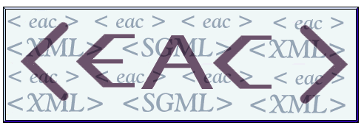
EAC
Approved in January 2011
Maintained by the Society of American Archivists in partnership with the Berlin State Library
Supports the exchange of ISAAR (CPF) compliant authority records
We will revisit the EAC standard during Week Eleven “Archives Technology”

Slide 24
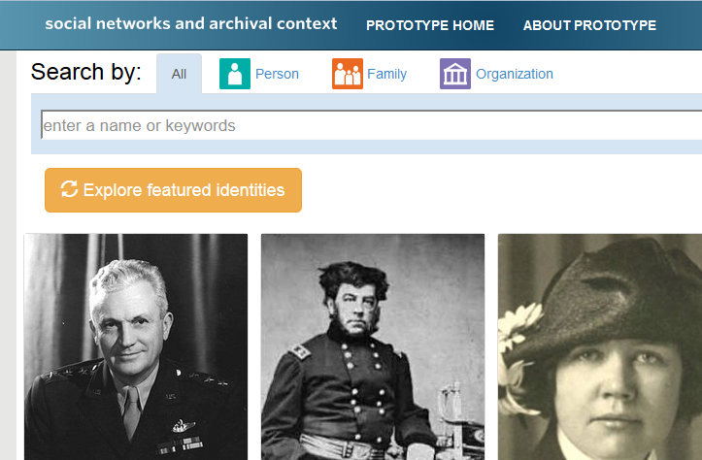
SNAC PROJECT
HISTORY RESEARCH TOOL
Notes:
R&D statement: “SNAC is demonstrating the feasibility of separating the description of persons, families, and organizations—including their socio-historical contexts—from the description of the historical resources that are the primary evidence of their lives and work. A key objective is to provide researchers with convenient, integrated access to historical collections held by multiple private and public archives and libraries around the world while also setting the stage for a cooperative program for maintaining information about the people documented in the collections.”
Cooperative Program Planning statement: “SNAC is laying the groundwork for a sustainable international cooperative program for archival description, hosted by the U.S. National Archives and Records Administration (NARA). The Cooperative will enable archivists, librarians, and scholars to jointly maintain information about the people documented in archival collections. It will also improve the economy and quality of archival processing and description, and address the challenge of discovering, locating, and using distributed historical records.”

Slide 25
HISTORY RESEARCH TOOL
What are some of the challenges associated with maintaining an international standards-based bank of names?
How can the SNAC “History Research Tool” support archival reference and research services?

Slide 26
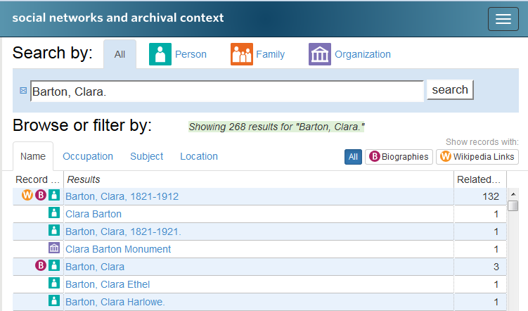
HISTORY RESEARCH TOOL DEMO
Notes:
You can search the History Research Tool for names. We’ll use Clara Barton (founder of the American Red Cross) as an example.
Notice that the search results include entries for people and

Slide 27
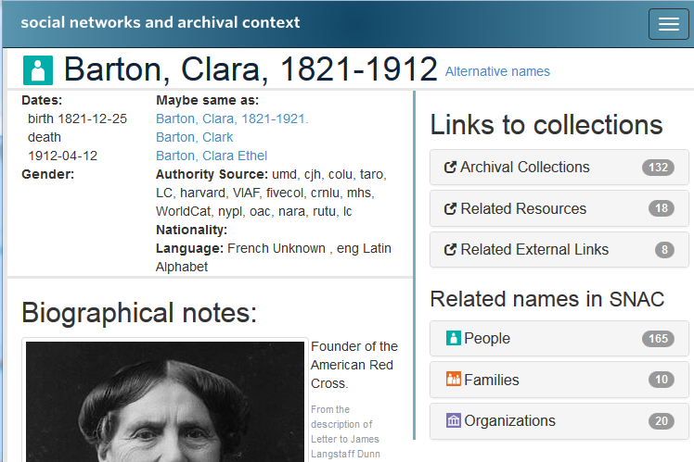
HISTORY RESEARCH TOOL DEMO
Notes:
Th

Slide 28
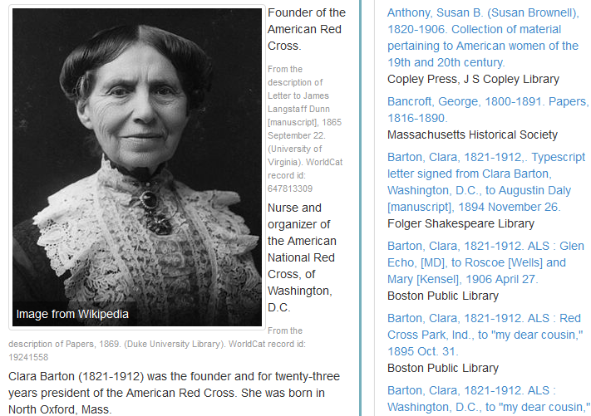
HISTORY RESEARCH TOOL DEMO

Slide 29
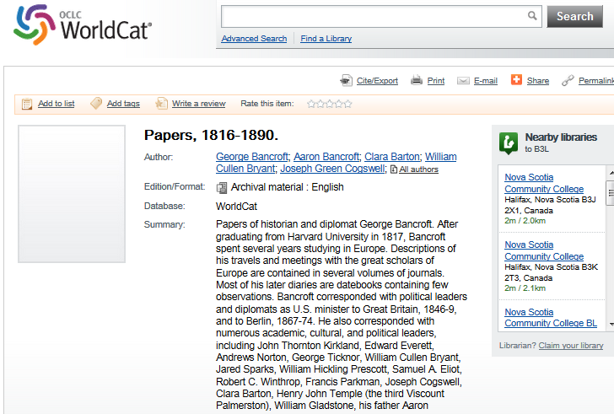
HISTORY RESEARCH TOOL DEMO
?

Slide 30
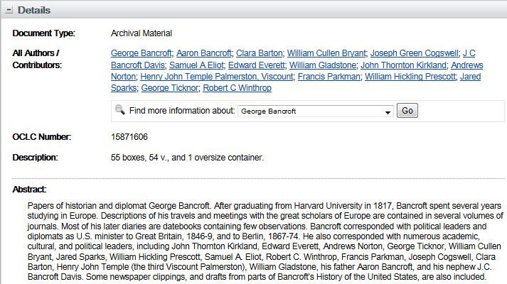
HISTORY RESEARCH TOOL DEMO

Slide 31
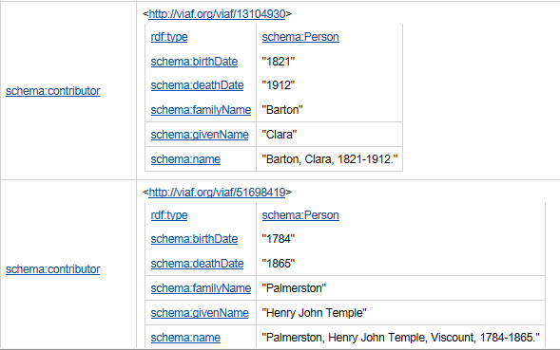
HISTORY RESEARCH TOOL DEMO

Slide 32
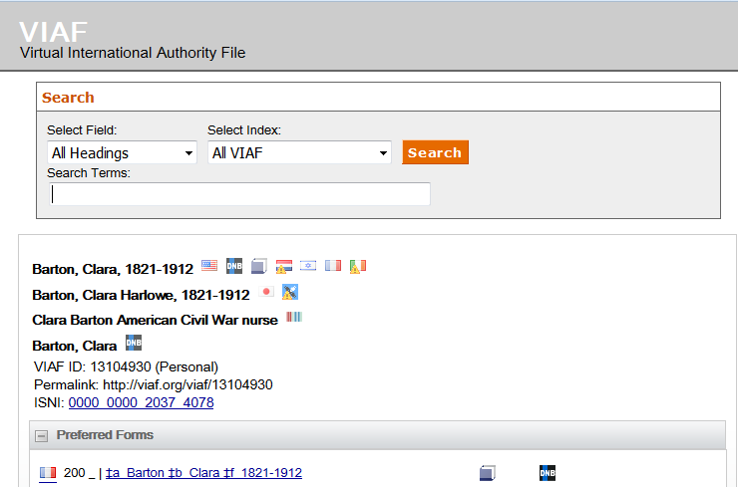
HISTORY RESEARCH TOOL DEMO

Slide 33
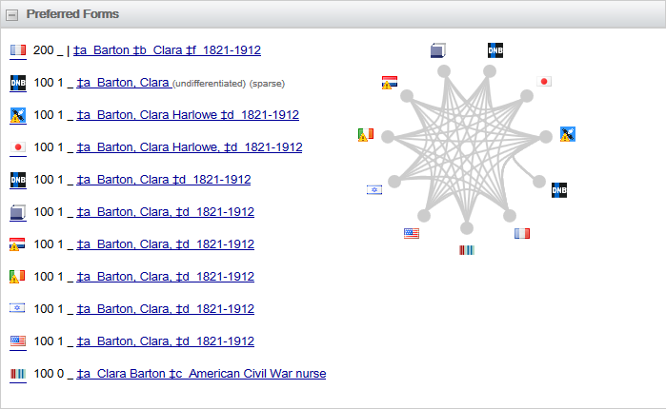
HISTORY RESEARCH TOOL DEMO

Slide 34
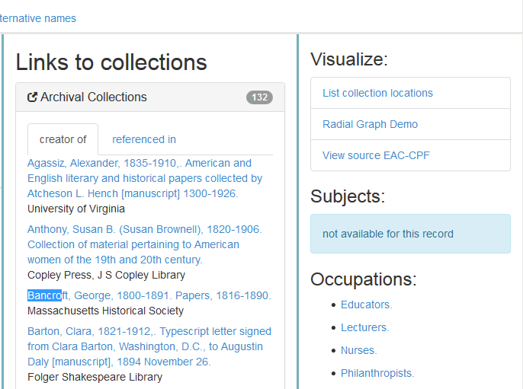
HISTORY RESEARCH TOOL DEMO
Notes:
You can view a “radial graph” of relationships between one name record and other name records in the History Research Tool.

Slide 35
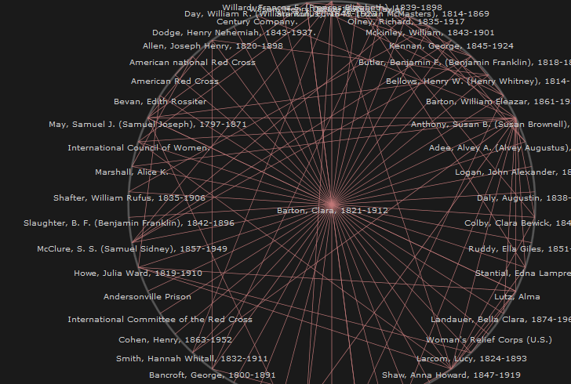
HISTORY RESEARCH TOOL DEMO
Notes:
The graph shows the relationship between Clara Barton and George Bancroft that we just looked at, but it also shows the relationships between Barton and many other individuals and organizations with whom she corresponded (such as Susan B. Anthony).
These relationships are all described in the ISAAR(CPF) “Relationships area” and encoded in the EAC XML files for each authority record.

Slide 36
HISTORY RESEARCH TOOL DEMO
Notes:
You can also view the source EAC-CPF file used to create the entry for Clara Barton.

Slide 37
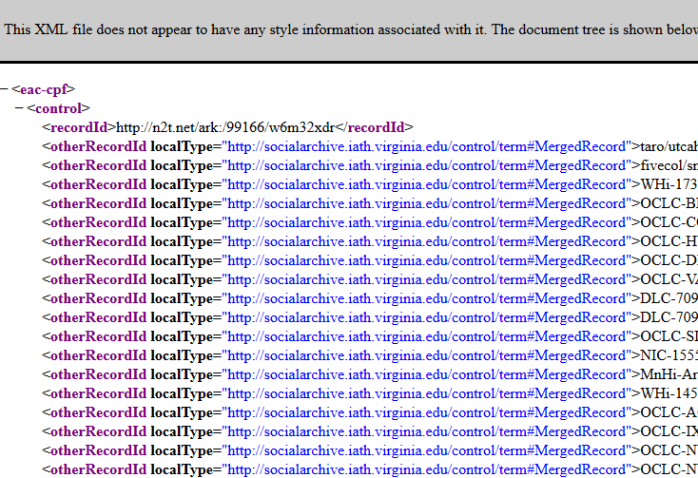
HISTORY RESEARCH TOOL DEMO
Notes:
The EAC-CPF file shows all of the source records that were merged into the SNAC authority record for Clara Barton. There are over 125 terms!

Slide 38
READINGS
Barney, Brett et al. “Ordering Chaos: An Integrated Guide and Online Archive of Walt Whitman’s Poetry Manuscripts.” Literary and Linguistic Computing 20, no. 2 (2005): 205-217. http://llc.oxfordjournals.org.ezproxy.library.dal.ca/content/20/2/205.full.pdf+html.
Pitti, Daniel et al. “Social Networks and Archival Context: From Project to Cooperative Program.” Journal of Archival Organization 12, no. 1-2 (2014): 77–97. http://www.tandfonline.com.ezproxy.library.dal.ca/doi/abs/10.1080/15332748.2015.999544#.VRl5xuEl92A.

Slide 39
READINGS
“History Research Tool.” Social Networks and Archival Context (SNAC) Project. http://socialarchive.iath.virginia.edu/snac/search.
Yeo, Geoffrey. “Archival Description in the Era of Digital Abundance.” Comma 2013, no. 2 (Spring 2015): 15-26. doi:10.3828/comma.2013.2.2. (available in course website).

Slide 40
IMAGES
Slides 9-11: Screenshots of the Walt Whitman Archive: http://www.whitmanarchive.org/
Slide 12: Screenshot of the SNAC website: http://socialarchive.iath.virginia.edu/
Slides 21-22: Screenshot of authority record from Dalhousie Archives Catalogue and Online Collections
Slide 24, Slides 26-37: Screenshot of the SNAC History Research Tool and related sites: http://socialarchive.iath.virginia.edu/snac/search

