Slide 1
INFO 6850 Archives II
Week Six
http://hdl.handle.net/10222/64532
MULTI-LEVEL DESCRIPTION
What is the “ideal” display of a multilevel finding aid?

Slide 2
AGENDA
Announcements
Review tax certification
Introduce archival description assignment
Discuss readings
Series and item-level description exercises

Slide 3
TAX CERTIFICATION
Institutions must be “designated” by Minister of Heritage
Institutions must prepare justification of outstanding significance/national importance
Working with certified monetary appraiser(s)
imX Communications case study

Slide 4
ARCHIVAL DESCRIPTION ASSIGNMENT
Byron Ulric Hatfield glass plate “magic lantern” slides
Fonds/collection level description
At least 25 item-level descriptions
ISAAR(CPF) authority record

Slide 5
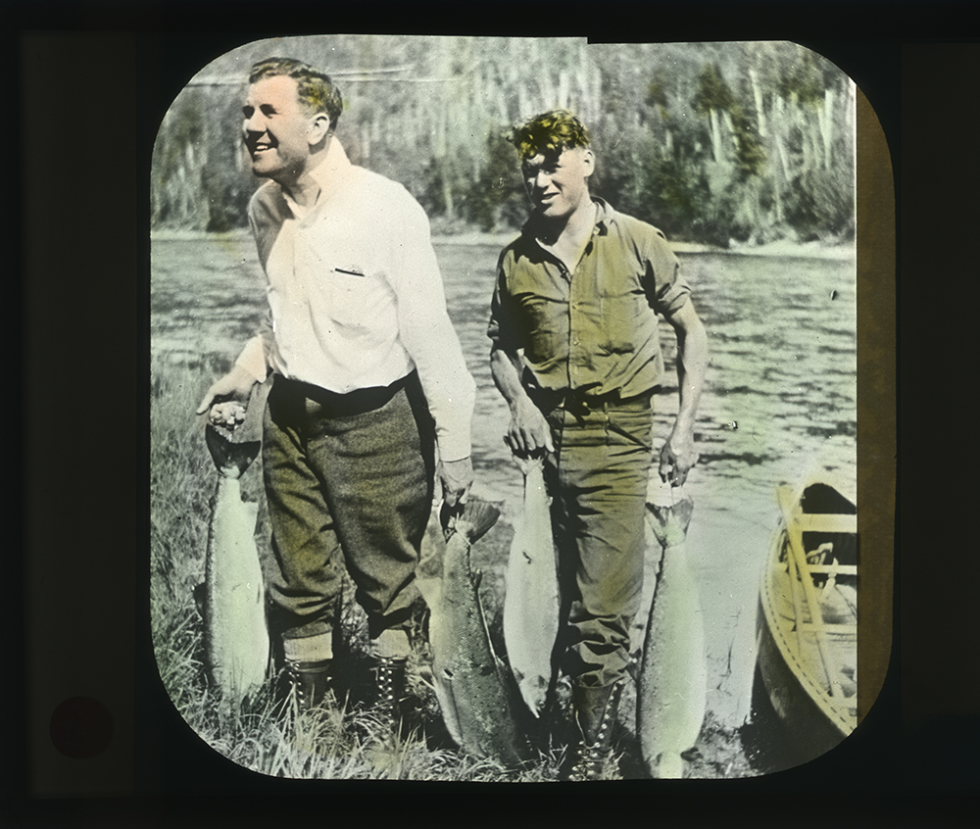
Filename
MS-2-781_PB16_020.jpeg
MS-2-781, PB Box 16, Folder 20
Reference Code

Slide 6
Bob Krawczyk
CROSS-REFERENCE HEAVEN
What is the Australian “series system” and how does it work?
What types of records are particularly suited to the series system?
Why did the Archives of Ontario abandon the fonds as the primary level of arrangement for government records?

Slide 7
CONTEXT CONTROL
Organization
Family
Agency
Person
RECORDS CONTROL
Series
(Item)
(Document)
(Information)
Notes:
This diagram

Slide 8
CROSS-REFERENCE HEAVEN
Hierarchical nature of government organizations
The “problem” of rapid administrative / organizational change
No standards for archival arrangement
No applied definition of “fonds-creating body”

Slide 9
CROSS-REFERENCE HEAVEN
Michel Duchein and Peter Scott say a creator must have:
  A legal identity
  An official mandate
  A defined hierarchical position
  A sufficient degree of autonomy
  An organizational structure
  Independent record-keeping system

Slide 10
CROSS-REFERENCE HEAVEN
The “freaks of administrative stability” (e.g., Ontario Labour Relations Board) lead archivists to apply the concept of the fonds to difficult cases.
The series system separates “context control” from “records control”
“Multi-provenance” series created by linking a series to multiple authority records

Slide 11
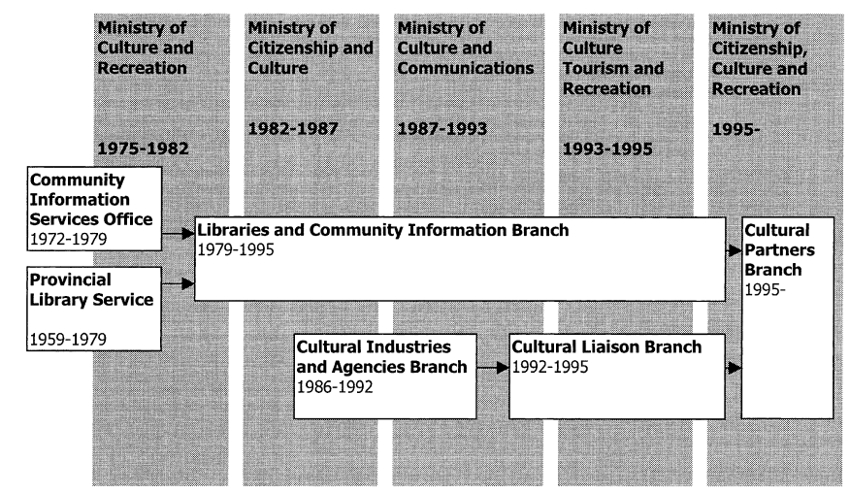
LIBRARY ADMINISTRATION IN ONTARIO
Notes:
In Week Six, we looked at this diagram of the Australian series-system.

Slide 12
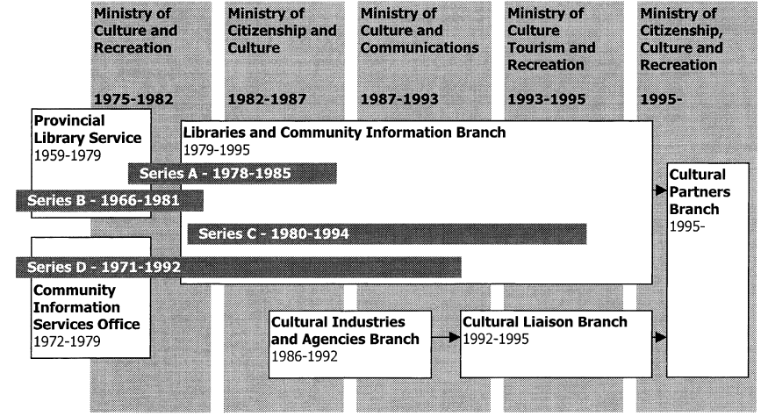
RECORDS OF LIBRARY ADMINISTRATION IN ONTARIO
Notes:
In Week Six, we looked at this diagram of the Australian series-system.

Slide 13
Jennifer Meehan
EVIDENCE AND INFERENCE
What are some approaches to intellectual arrangement?
What are some approaches to physical arrangement?
Does an active relationship with a donor/creator change how archivists “infer” and “contruct” the relationships of a body of records?

Slide 14
EVIDENCE AND INFERENCE
Intellectual arrangement is process of “identifying and/or creating the contextual relationships of a body of records”
Role and “historical standpoint” of archivist
Necessity of using evidence
Inference plays a large role in intellectual arrangement

Slide 15
EVIDENCE AND INFERENCE
Arrangement and description “produces a conceptual and physical entity – a processed collection – from different groups or accessions of records in various states of (in)completeness and (dis)array.”
“Making the leap from parts to whole is perhaps the biggest act of interpretation and representation involved in arranging and describing a body of records…”

Slide 16
Daines and Nimer
USER-FRIENDLY FINDING AIDS
What are the advantages of “single-level display” of archival descriptions? What are the advantages of full multilevel display of archival descriptions?
How does single-level display allow for greater reuse of finding aid data?

Slide 17
USER-FRIENDLY FINDING AIDS
“The ability to access information digitally is changing the way that users access information about archival and other research collections.”
Expectation of “sophisticated search tools” and clear and understandable search results
Archivists need to employ “user-centered design”

Slide 18
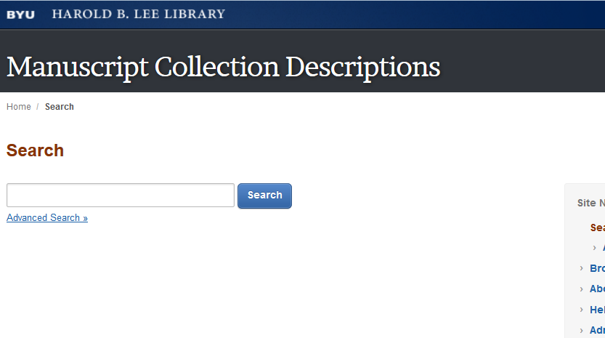
USER-FRIENDLY FINDING AIDS

Slide 19
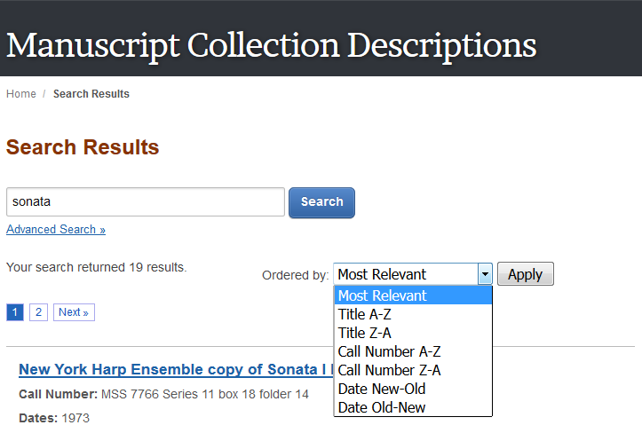
USER-FRIENDLY FINDING AIDS

Slide 20
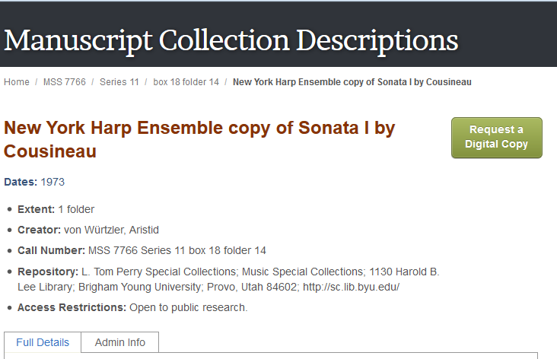
USER-FRIENDLY FINDING AIDS

Slide 21
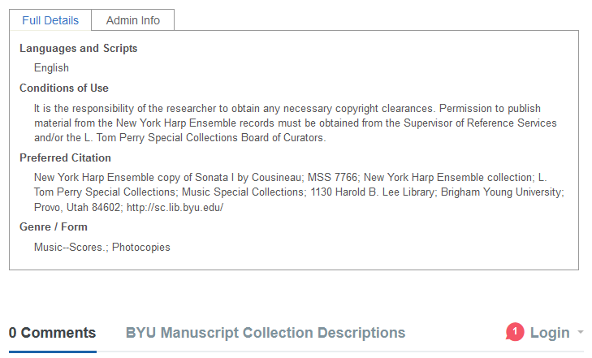
USER-FRIENDLY FINDING AIDS

Slide 22
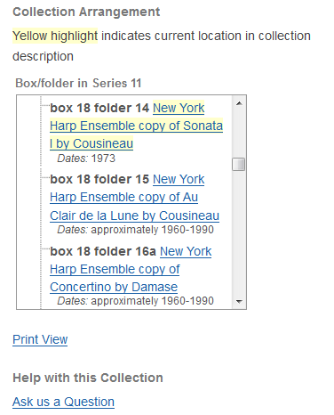
USER-FRIENDLY FINDING AIDS

Slide 23
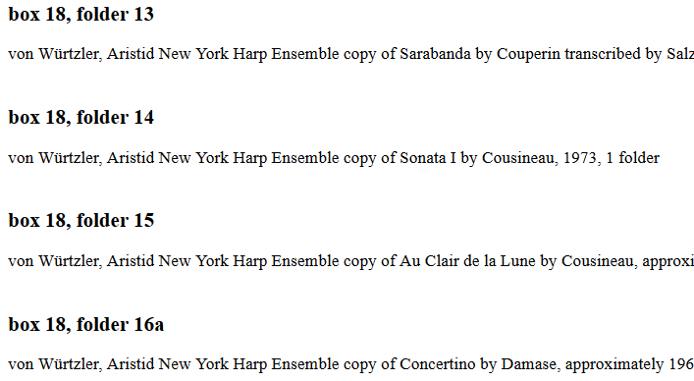
USER-FRIENDLY FINDING AIDS

Slide 24
HOW DOES “AtoM” CREATE USER-FRIENDLY FINDING AIDS?
AtoM has used “single-level” display since its inception
AtoM is the only open-source application that fully supports RAD
As of Version 2.2, the application supports PDF downloads of complete finding aids

Slide 25
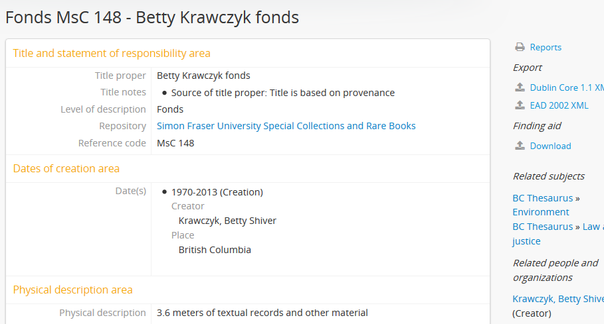
SFU ARCHIVES

Slide 26
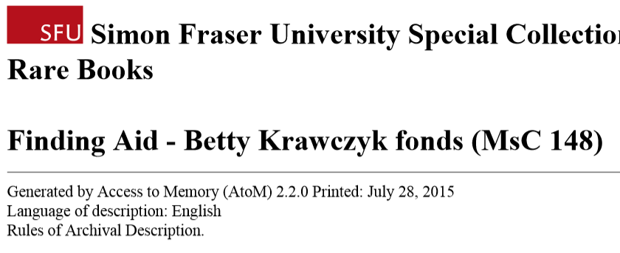
SFU ARCHIVES

Slide 27
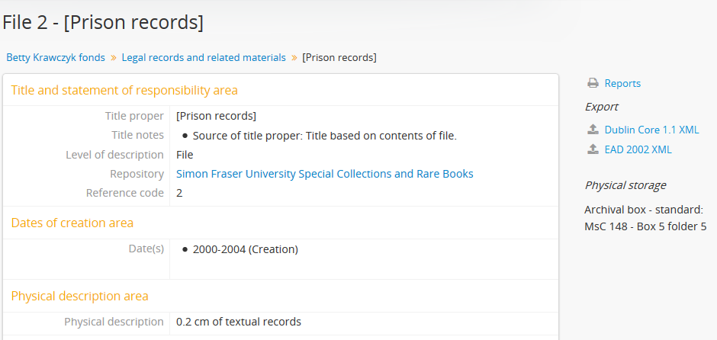
SFU ARCHIVES

Slide 28
Richard Dancy
DEVELOPING ARCHIVAL STANDARDS
What does physical description mean in a digital world?
What are the three key changes that have occurred since RAD was introduced twenty-five years ago?
Notes:
What are the three key changes?
International standards now exist
“The world has gone digital”
Growing recognition that there are many descriptive communities

Slide 29
DEVELOPING ARCHIVAL STANDARDS
Chapter Nine of Rules for Archival Description: “Records in Electronic Form”
Description of “born digital” records vs. description of records that have been digitized
Relationship to RDA’s “entity” concepts?

Slide 30
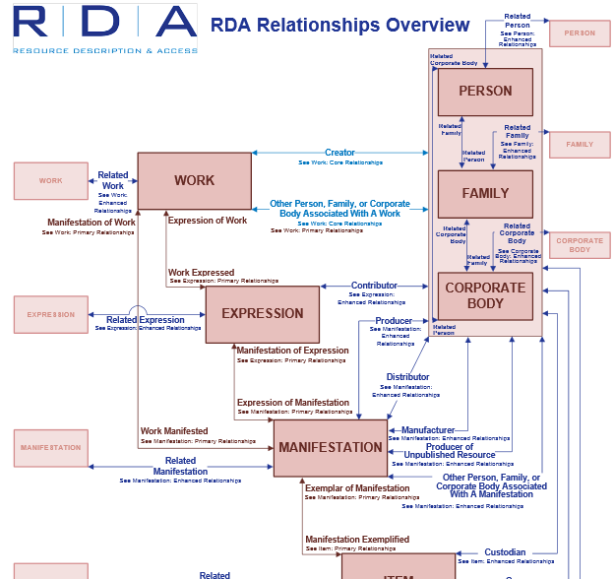

Slide 31
DEVELOPING ARCHIVAL STANDARDS
Canadian Council of Archives “Canadian Committee on Archival Description”
International Council of Archives
Society of American Archivists
What is the next step?

Slide 32
READINGS
Krawczyk, Bob. “Cross Reference Heaven: The Abandonment of the Fonds as the Primary Level of Arrangement for Ontario Government Records.” Archivaria 48 (1999): 131-153. http://journals.sfu.ca/archivar/index.php/archivaria/article/view/12720/13899.
Meehan, Jennifer. "Making the Leap from Parts to Whole: Evidence and Inference in Archival Arrangement and Description." American Archivist 72, no. 1 (Summer 2009): 72-90. http://archivists.metapress.com/content/kj672v4907m11x66/fulltext.pdf.

Slide 33
READINGS
Daines, J. Gordon and Cory L. Nimer. “Re-Imagining Archival Display: Creating User-Friendly Finding Aids. Journal of Archival Organization 9, 1 (2011): 4-31. DOI: 10.1080/15332748.2011.574019.
Dancy, Richard. “Developing Archival Standards.” Archivaria 78 (Fall 2014): 171-174. http://journals.sfu.ca.ezproxy.library.dal.ca/archivar/index.php/archivaria/article/view/13503/14832.

Slide 34
IMAGES
Slide 10: “Library Administration in Ontario,” Figure from Bob Krawczyk, “Cross-Reference Heaven: The Abandonment of the Fonds as the Primary Level of Arrangement for Ontario Government Records.” Archivaria 48 (1999): 131-53 (p. 139).
Slide 11: “Records of Library Administration in Ontario,” Figure from Bob Krawczyk, “Cross-Reference Heaven: The Abandonment of the Fonds as the Primary Level of Arrangement for Ontario Government Records.” Archivaria 48 (1999): 131-53 (p. 141).

Slide 35
IMAGES
Slides 17-22: Screenshots of Brigham Young University Library’s Manuscript Collection Descriptions: http://findingaid.lib.byu.edu/.
Slide 24-26: Screenshots of Simon Fraser University Archives’ “SFU AtoM” site: http://atom.archives.sfu.ca
Slide 29: RDA Relationship Overview: http://www.rdatoolkit.org/backgroundfiles/RelationshipsOverview_10_9_09.pdf

