Slide 1
INFO 6850 Archives II
Week Three
http://hdl.handle.net/10222/64067
THE DONATION PROCESS
What documents do you create during the negotiation and acceptance of a donation of archival material?

Slide 2
AGENDA
Announcements
Discuss readings
Review case files and associated records

Slide 3
DONOR RELATIONS
Relationships require stewardship
Issues may be sensitive and donors may be emotional
Long-term relationships
Regarded and protected as some of the “best” aspects of archival work

Slide 4
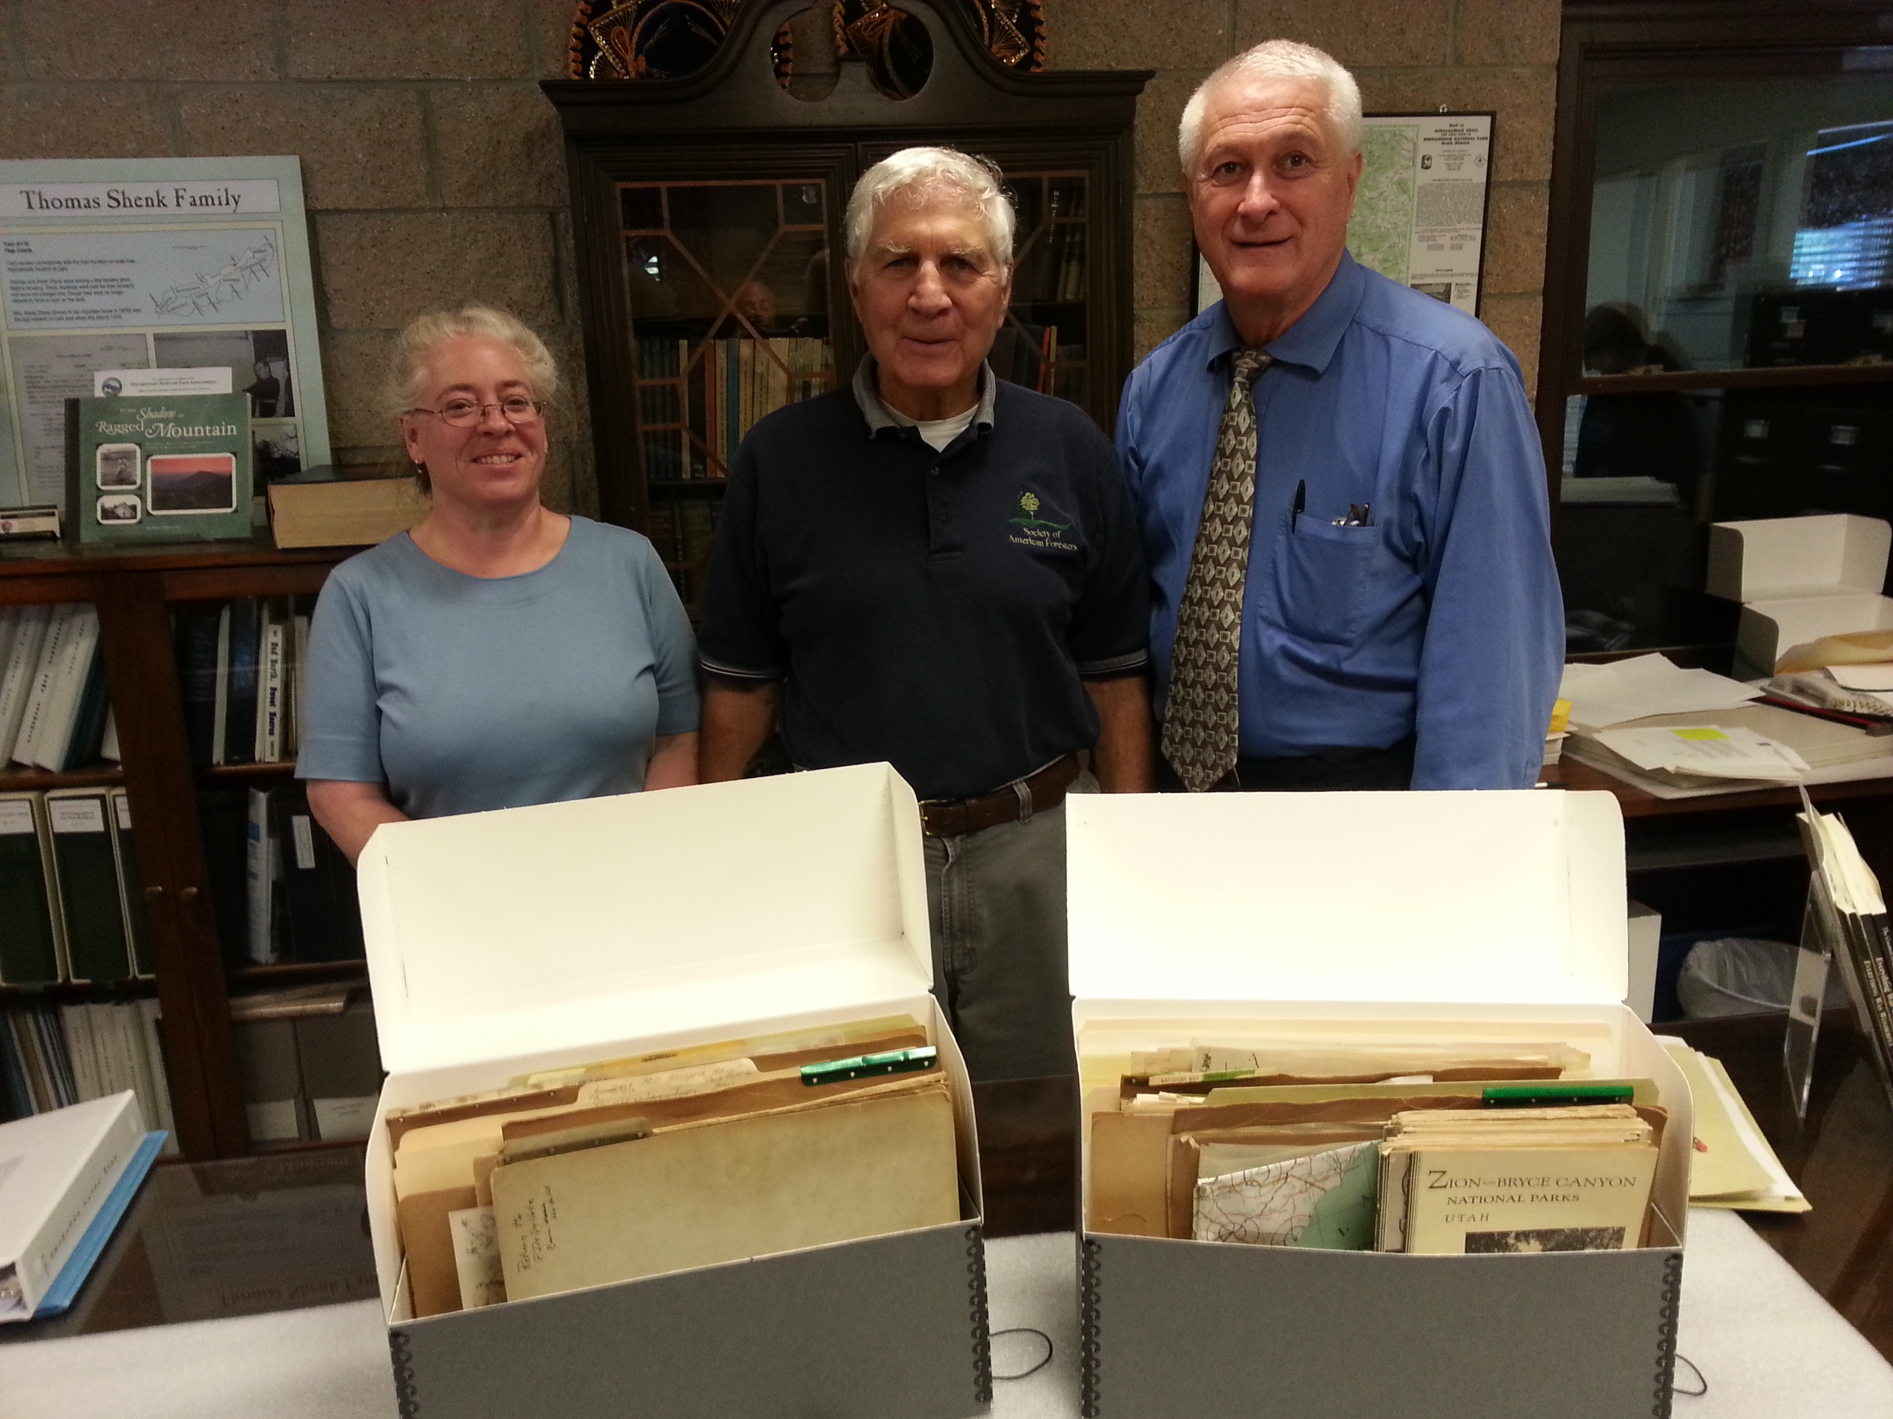
DONOR RELATIONS
Archivist and donors of the National Park Service records, from the National Archives’ “The Text Message” blog.

Slide 5
Bellmore,
Bénaud, and
Bordeianu
J.B. JACKSON
Considered originator of cultural landscape studies in America
Donated majority of his estate to University of New Mexico (UNM)
Center for Southwestern Research (CSWR) at UNM works to document Jackson’s legacy

Slide 6
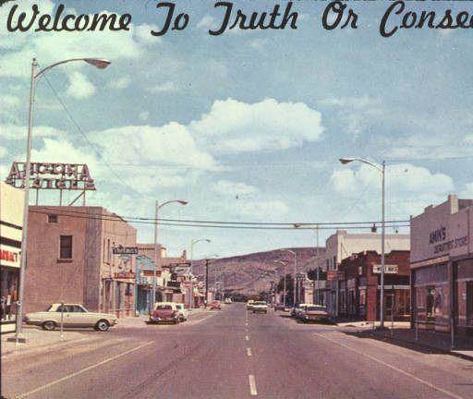
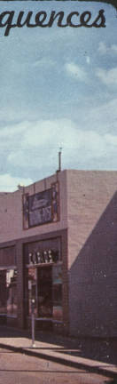
J.B. JACKSON
“Welcome to Truth or Consequences,” J.B. Jackson Pictorial Materials Collection, 000-866-8-V-11

Slide 7
J.B. JACKSON
Jackson’s archives were “collected from a dispersed set of donors, primarily Jackson’s friends, colleagues, and former teaching assistants.”
Jackson’s archives presented complex challenges to CSWR at UNM (image quality, original order, context, copyright, accessibility, display issues…)

Slide 8
J.B. JACKSON DISCUSSION QUESTIONS
What challenges might arise from acquiring materials of a single provenance from multiple donors?
How did UNM balance its responsibility to donors with its responsibility to organize archival material according to respect des fonds?
Notes:
Challenges:
Donors might want different restrictions.
Respect des fonds can be distorted (e.g., other papers can become intermingled with materials).
Custodial history can be complex.
Balance:
Each collection is named (e.g., Paul Groth J.B. Jackson Collection) and described.
Maintain provenance of donations and respect donor wishes but draw relationships between collections.

Slide 9
J.B. JACKSON DISCUSSION QUESTIONS
What is the difference between the Paul Groth J.B. Jackson Collection and the Paul Groth Image Collection?
Notes:
Paul Groth J.B. Jackson Collection appears to be a selection of Groth’s personal archives that relates to J.B. Jackson. Or is it? The article notes that “After Jackson's death, Groth donated a collection of course materials, manuscripts, correspondence and personal photographs to UNM.”
Paul Groth Image Collection appears to be a collection of 3,300 slides used by Jackson in his teaching and scholarship activities.
“Rather than create a separate finding guide, the Groth images are described in an added series statement in the main Paul Groth J.B. Jackson Collection.”

Slide 10
Donating personal or family records
SAA GUIDE ON DONATING RECORDS
Colour brochure produced by SAA’s Manuscript Repositories Section
Brochure is also published as a website
Resource to share with prospective donors, but also useful “checklist” for archivists

Slide 11
SAA GUIDE DISCUSSION QUESTIONS
What would cause an institution to make monetary donations a prerequisite for accepting a donation of archival material?
How would the institution determine the size of the monetary donation?

Slide 12
SAA GUIDE DISCUSSION QUESTIONS
Do we have to ask the donor before we recover deleted files?
If your institution required donors to pay for monetary appraisals, what would you do if you encountered a potential donor with valuable records who refused to pay for the appraisal?

Slide 13
Deeds of gift
SAA GUIDE TO DEEDS OF GIFT
“The deed of gift is a formal and legal agreement between the donor and the repository that transfers ownership of and legal rights to the donated materials. A legal agreement is in the best interest of both donor and repository.”

Slide 14
SAA GUIDE TO DEEDS OF GIFT DISCUSSION QUESTIONS
What are the elements of a deed of gift?
If your institution required donors to pay for monetary appraisals, what would you do if you encountered a potential donor with valuable records who refused to pay for the appraisal?
Notes:
Elements of a deed of gift:
Name of donor and the recipient
Title and description of the materials donated
Transfer of ownership
Access to the collection
Transfer of intellectual property rights
Separations (i.e., discards, deaccessioning, etc.)
Other elements (e.g., discuss relevant issues, specific institutional policies, etc.)

Slide 15
SAA GUIDE TO DEEDS OF GIFT DISCUSSION QUESTIONS
You are working with a donor on the terms and conditions to be outlined in a deed of gift for an important collection of artistic and literary material. The donor does not want to transfer copyright but you recognize that obtaining copyright will greatly simplify your institution’s work on the collection. What are your “options”?
Notes:
For example:
Persuasion
Refusal of donation
Referall (e.g., to other donors, sources of information)
Negotiate separate license agreement

Slide 16
Donor relations and development
CARLA SUMMERS
Archivists are adept at building relationships
Archivists often shy away from asking for money
“Archivists have little choice but to embrace the art of development.”

Slide 17
CARLA SUMMERS
How to understand the work of development in order to influence its outcome (become “donor literate”)
How to find revenue sources
How to stop entrepreneurial collecting by university administrators and faculty that benefits other areas of the university at the expense of the archives

Slide 18
CARLA SUMMERS DISCUSSION QUESTIONS
What are some techniques archivists might use for asking for monetary donations to support their work?
What should archivists do to gain experience with development?

Slide 19
CARLA SUMMERS DISCUSSION QUESTIONS
Do you see financial development activities as a responsibility of a professional archivist?
How should archivists at universities and other institutions with development offices work collaboratively to raise funds for processing and long-term preservation?

Slide 20
READINGS
Bellmore, Audra, Claire-Lise Bénaud, and Sever Bordeianu. "J.B. Jackson, Cultural Geographer: Evolution of an Archive." Collection Building 31, no. 3 (2012): 115-119. doi: http://dx.doi.org/10.1108/01604951211243515. http://ezproxy.library.dal.ca/login?url=http://search.proquest.com/docview/1022686521?accountid=10406.
Society of American Archivists. Donating Your Personal or Family Records to a Repository (2013). http://www2.archivists.org/publications/brochures/donating-familyrecs.

Slide 21
READINGS
Society of American Archivists. A Guide to Deeds of Gift (2013). http://www2.archivists.org/publications/brochures/deeds-of-gift.
Summers, Carla. “Archival Donor Relations and Development: Keeping a Balance.” Provenance: The Journal of the Society of Georgia Archivists 20, no. 1 (2002): 73-81. http://digitalcommons.kennesaw.edu/cgi/viewcontent.cgi?article=1102&context=provenance.

Slide 22
IMAGES
“Archivist and donors of the National Park Service records,” from “Joe and Dave’s Excellent Adventure” post on the National Archives’ “The Text Message” blog, October 2, 2014. http://blogs.archives.gov/TextMessage/2014/10/02/joe-and-daves-excellent-adventure/.
“Welcome to Truth or Consequences,” J.B. Jackson Pictorial Materials Collection, 000-866-8-V-11. http://econtent.unm.edu/cdm/ref/collection/Groth/id/733.

