Slide 1


Social media and collaborative technologies: Information management dream or nightmare?
Louise Spiteri
School of Information Management
Dalhousie University

Slide 2
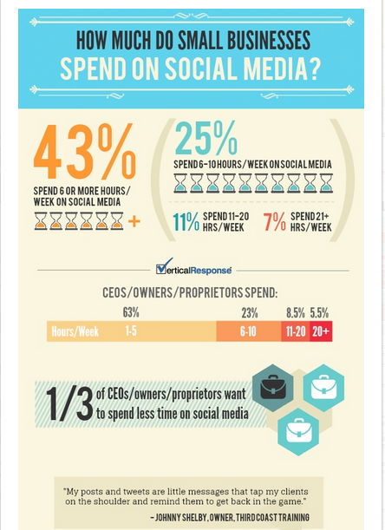

Slide 3
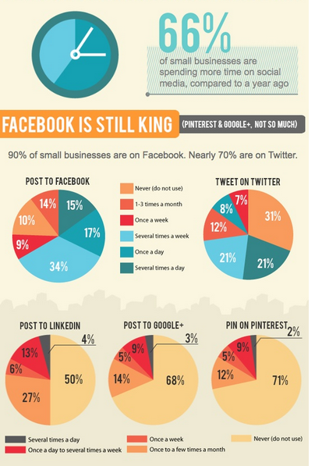

Slide 4
Why do enterprises use social media?
Too much effort has been exerted on platform knowledge rather than developing a business strategy. Significant time and money has already been spent collecting Facebook fans, followers on twitter and engagement using a healthy dose of trivia and emotive images—but for what purpose? ~http://www.information-management.com/news/enterprise-social-media-is-more-than-fun-and-games-10023862-1.html
Notes:
For organizations social media application provide the opportunity to integrate information and opinions from citizens or clients into the policy making process in innovative ways
The traditional information creation, vetting and approval process includes multiple steps and does not provide the opportunity for real-time feedback cycles as social media applications demand.
Social media tools have the potential to increase the degree of transparency, accountability and collaborative content creation.
Representation of the organization on all available channels. The representation objective is to be as inclusive as possible and reach audiences in their social spaces they frequent on a daily basis.

Slide 5
Use of social media, 1
For organizations social media application provide the opportunity to integrate information and opinions from citizens or clients into the policy making process in innovative ways
The traditional information creation, vetting and approval process includes multiple steps and does not provide the opportunity for real-time feedback cycles as social media applications demand.
Social media tools have the potential to increase the degree of transparency, accountability and collaborative content creation.

Slide 6
Use of social media, 2
Representation of the organization on all available channels. The representation objective is to be as inclusive as possible and reach audiences in their social spaces they frequent on a daily basis.

Slide 7

What is the role of the Records and Information Management (RIM)professional in enterprise use of social media?

Slide 8
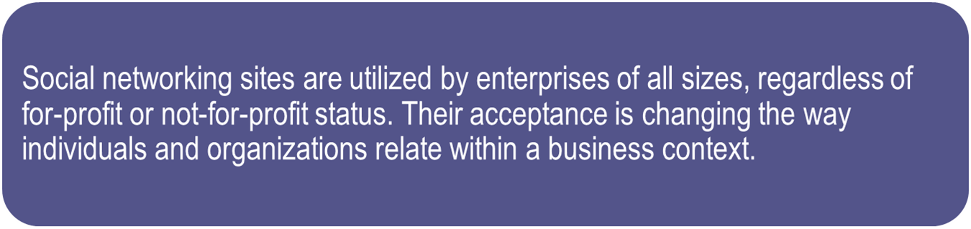
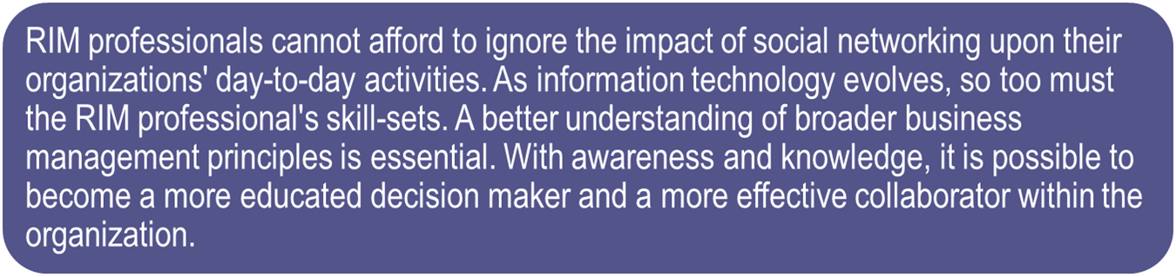
Social media and RIM, 1

Slide 9
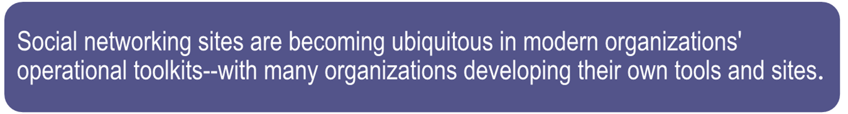
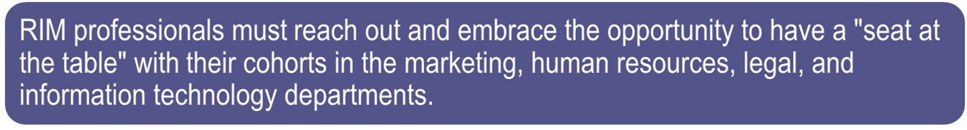
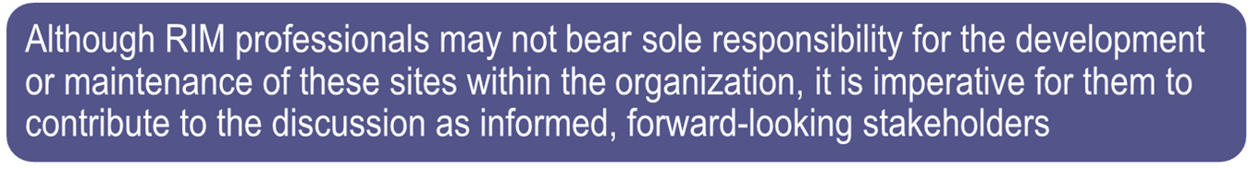
Social media and RIM, 2

Slide 10
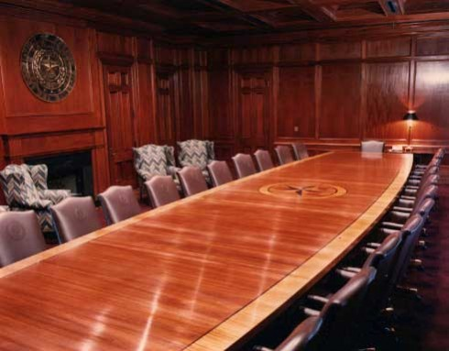
A place at the social media table: Why do we need to be there?

Slide 11
Increasing need for RIM, 1
Since social media are based on the collaboration of their users, social media management is a collaborative venture as well.
Realizing shared organizational goals by sharing knowledge, learning, and building consensus across departments is yet another social media management competency.
Interdepartmental coordination allows the leveraging of tools and techniques into the organization’s social media culture and into its products and services. It ensures that a consistent message is delivered through its social media channels

Slide 12
Increasing need for RIM, 2
It is essential that policies and practices in organizations be updated in order to ensure that essential records generated through social media technologies are retained and protected accordingly.
As social computing tools become increasingly integrated into company infrastructure, stakeholders must consider how existing records management policies can be expanded and extended in order to address social computing content, examine how companies review current practices in light of evolving social computing technologies, and provide guidance in policies to support the use of these technologies within the company.

Slide 13

Main challenges of social media

Slide 14
Social media strategies
What kind of social media?
Letting go
Participation
Maintenance
Notes:
Do you need to utilize social networking sites, blogs, real-time updates (e.g., Twitter), social news sites, media-sharing sites, review/directory sites, virtual worlds, or display ads on social media sites
Examine the characteristics of the type of social media you want to have a presence on and how those characteristics fit what you're trying to accomplish to help choose the ones that will work best for you.
Participation. How do you plan to drive people to your social media presence?
Maintenance. Who will maintain your social media presence?
You must have something to say and someone to say it on a regular basis.
Measurement. How do you measure success or failure?
What happens if you don't get there?
Once you engage in a conversation with customers, you have to give up control. Is your company willing to do that?

Slide 15
Social media strategies, 1
What kind of social media? Do you need to utilize social networking sites, blogs, real-time updates (e.g., Twitter), social news sites, media-sharing sites, review/directory sites, virtual worlds, or display ads on social media sites
  Examine the characteristics of the type of social media you want to have a presence on and how those characteristics fit what you're trying to accomplish to help choose the ones that will work best for you.
Letting go
  Once you engage in a conversation with customers, you have to give up control. Is your company willing to do that?

Slide 16
Social media strategies, 2
Participation. How do you plan to drive people to your social media presence?
Maintenance. Who will maintain your social media presence?
  You must have something to say and someone to say it on a regular basis.
Measurement. How do you measure success or failure?
  What happens if you don't get there?

Slide 17
Are we ready?
There is a low level of preparedness within the ranks of RIM professionals regarding social networks. The results of a recent survey of more than 400 enterprises, conducted by AIIM, show that:
only 13% of respondents utilize a records management plan for social networking sites.
53% responded that a plan was not yet in place, while at least one-third of the survey participants were unsure about their organization's use of a plan.

Slide 18
RIM challenges ,1
What is a social media record? Social media content is difficult to define as a record. Agencies are still grappling with records management for email, much less wikis and blogs.
The social media content that is record material must be identified as such by system users if there is no automation support for records identification (largely absent from current social media applications).
Social media systems do not generally lend themselves to handling system content as business records that may require separate handling and application of business rules.

Slide 19
RIM challenges ,2
Much of the social media content is in the public domain and, therefore, not under control of the agency, which may cause difficulty in capturing content.
Social Media Metadata: Applying metadata to tag social media content for retrieval is difficult. Most agencies use manual methods of adding metadata for social media content.
Governance: Organizations need to listen to what is said about them, both by employees and clients or the general public. Policies need to be in place to deal with multiple types of scenarios, e.g., responding to a compliment or dealing with an employee who just posted something inappropriate or sensitive.

Slide 20
RIM challenges, 3
Social Media Scheduling/ Disposition: The lack of control of the content makes scheduling and disposition of records difficult.
Privacy & Security: How do you maintain and protect the privacy and security of information pertaining to your employees and your organization?
Staffing and Education: Education is needed to implement a successful social media records policy.

Slide 21
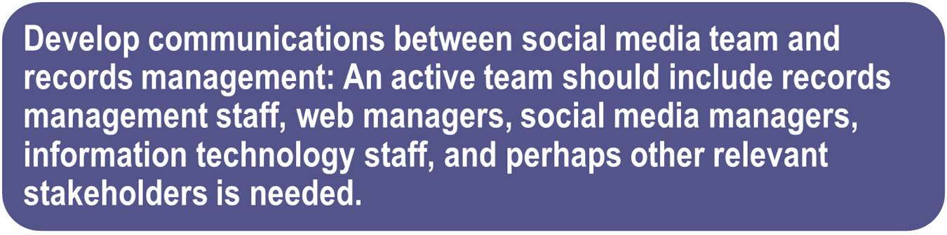
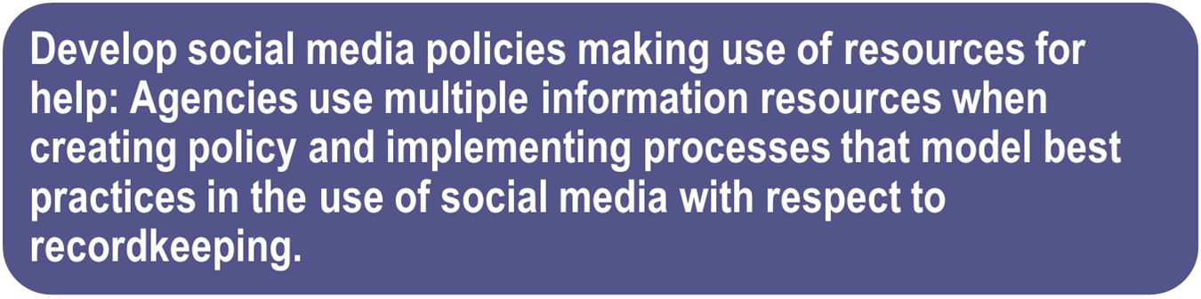
Best practices, 1

Slide 22
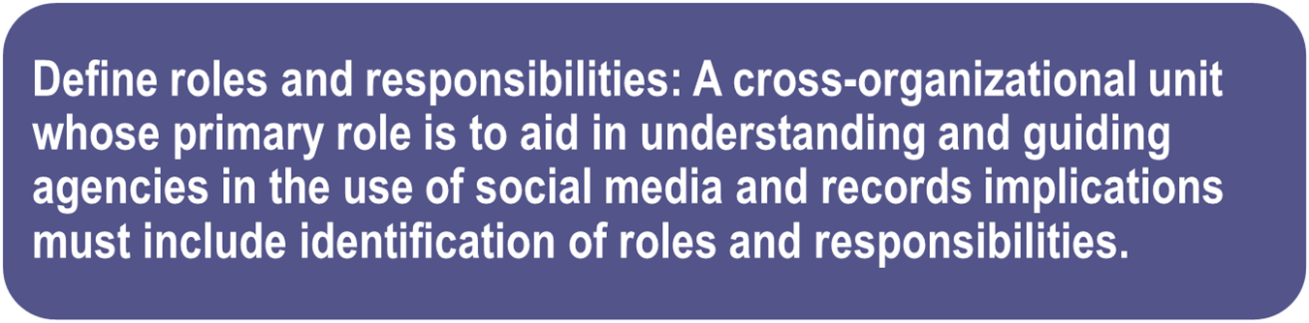
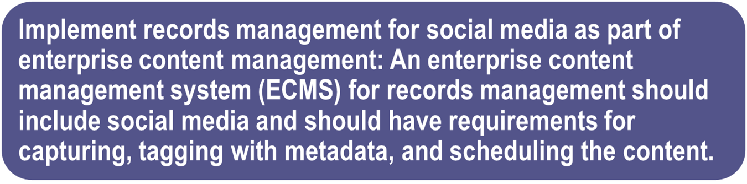
Best practices, 2

Slide 23
Guidelines for social media policies, 1
Remind employees to familiarize themselves with the employment agreement and policies included in the employee handbook.
State that the policy applies to multi-media, social networking websites, blogs and wikis for both professional and personal use.
Internet postings should not disclose any information that is confidential or proprietary to the company or to any third party that has disclosed information to the company.
If an employee comments on any aspect of the company's business they must clearly identify themselves as an employee and include a disclaimer.

Slide 24
Guidelines for social media policies, 2
The disclaimer should be something like "the views expressed are mine alone and do not necessarily reflect the views of (your company’s name)."
Internet postings should not include company logos or trademarks unless permission is asked for and granted.
Internet postings must respect copyright, privacy, fair use, financial disclosure, and other applicable laws.

Slide 25
Guidelines for social media policies, 3
Employees should neither claim nor imply that they are speaking on the company's behalf.
Corporate blogs, Facebook pages, Twitter accounts, etc., could require approval when the employee is posting about the company and the industry.
That the company reserves the right to request the certain subjects are avoided, withdraw certain posts, and remove inappropriate comments.

Slide 26
Examples of social media policies
Canada Post
Dell
Government of New Zealand
Transport Canada
Government of Canada
Government of Alberta

Slide 27
Examples of corporate social media sites
Halifax Regional Police:
http://www.facebook.com/HalifaxRegionalPolice
https://twitter.com/HfxRegPolice
Environment Canada:
http://www.facebook.com/environmentcan
https://twitter.com/environmentca
The Shopping Channel:
http://www.facebook.com/TheShoppingChannel
https://twitter.com/theShoppingChan
http://www.youtube.com/user/TheShoppingChannel?feature=watch
http://pinterest.com/shoppingchannel/
http://www.theshoppingchannelblog.com/

Slide 28



Slide 29
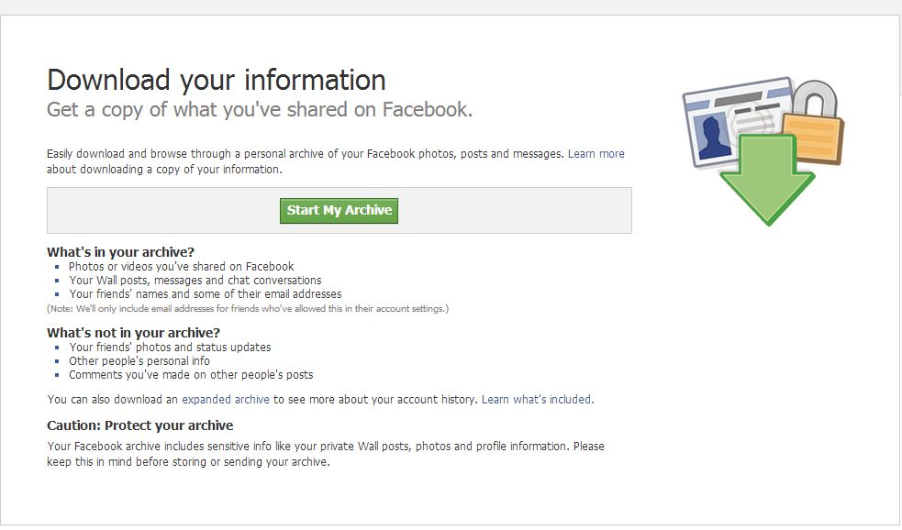
Archiving Facebook
Notes:
I have not had much luck with this feature, as it keeps getting stuck on “pending.” S

Slide 30
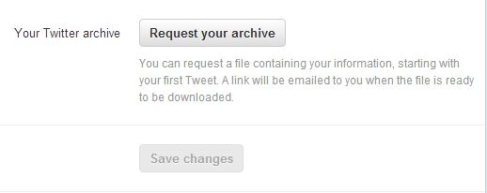
Archiving Twitter

Slide 31
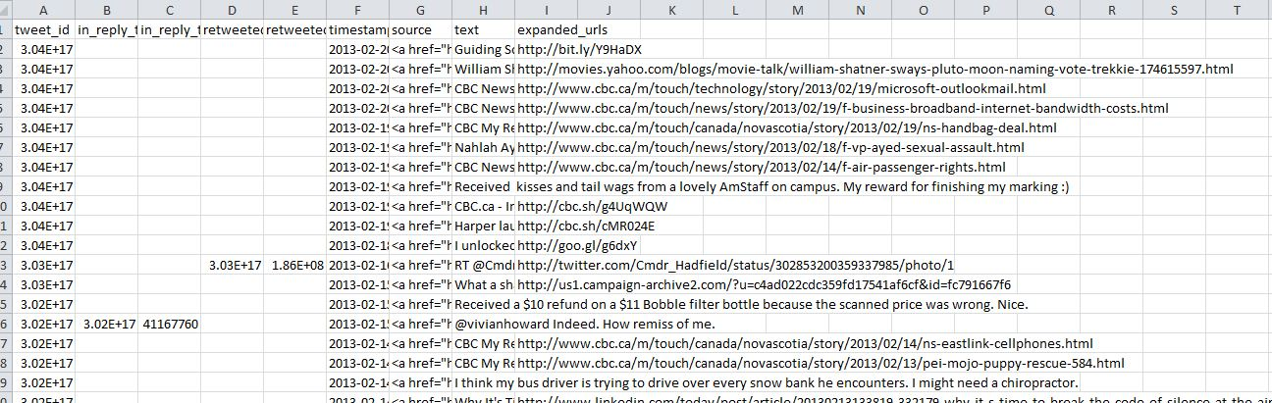
Twitter archive

Slide 32
Source for infographics
http://pinterest.com/pin/112097478196551490/

Slide 33
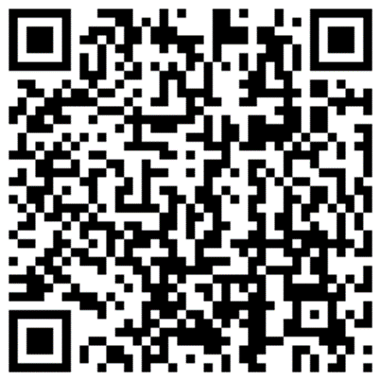



Questions?
Louise Spiteri, PhD
Louise.Spiteri@dal.ca
@dalsimnews
My About Me Profile

